Slide 1
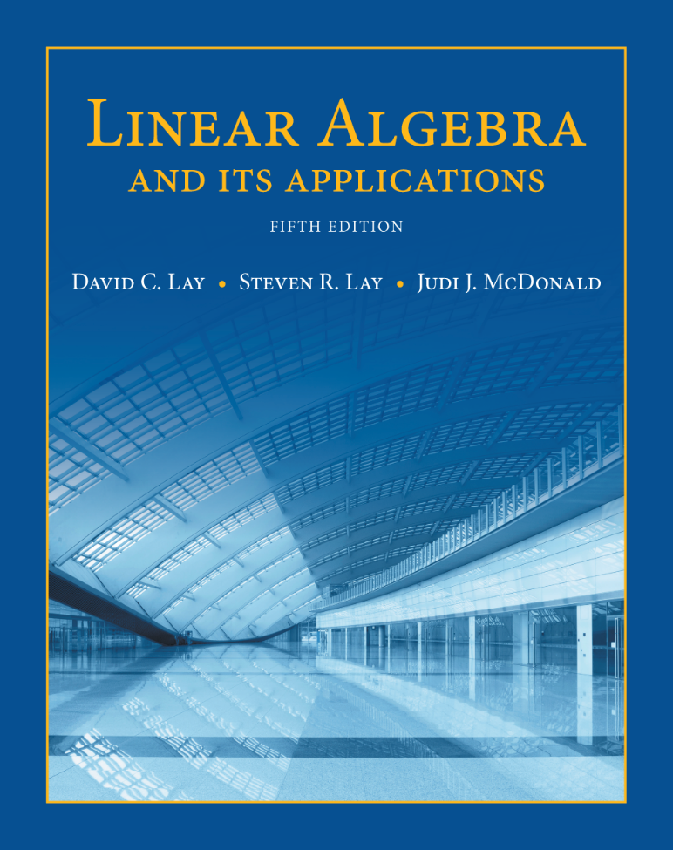
Linear Equations in Linear Algebra
THE MATRIX OF A LINEAR TRANSFORMATION

Slide 2
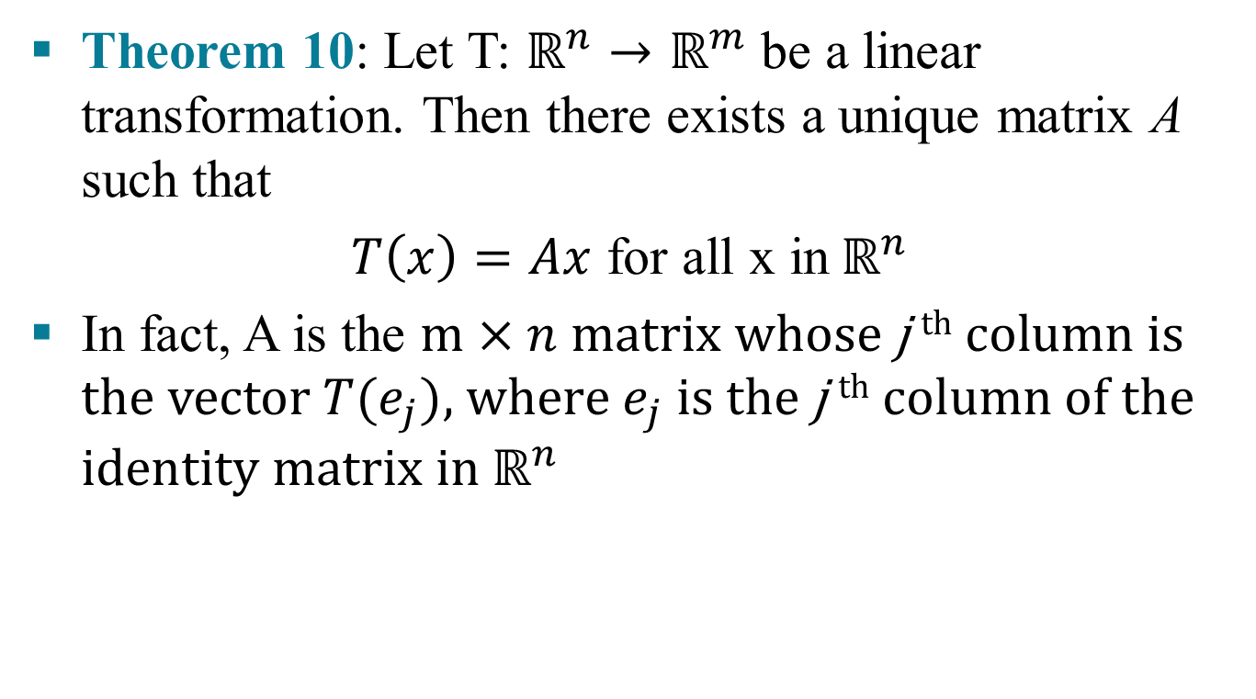

THE MATRIX OF A LINEAR TRANSFORMATION
Theorem 10: Let T: $ℝ^{n}→ℝ^{m}$ be a linear transformation. Then there exists a unique matrix A such that
$T\left(x\right)=Ax$ for all x in${ ℝ}^{n}$
In fact, A is the $m×n \text{matrix} \text{whose} \text{j} \text{th} \text{column} \text{is} \text{the} \text{vector} T(e_{j})\text{, }\text{where} e_{j} \text{is} \text{the} \text{j} \text{th} \text{column} \text{of} \text{the} \text{identity} \text{matrix} \text{in} ℝ^{n}$
$A=[T(e_{1})\text{...}T(e_{n})\text{]}$
(3)

Slide 3


THE MATRIX OF A LINEAR TRANSFORMATION
Proof: Write x= $I_{n}x=\left[e_{1} …e_{2}\right]x=x_{1}e_{1}+ …+x_{n}e_{n}$ , and use the linearity of T to compute
$T\left(x\right)=T(x_{1}e_{1}+…+x_{n}e_{n}$)= $x_{1}T{(e}_{1})+…+x_{n}T{(e}_{n})$
$=[T\left(e_{1}\right) \text{. . .} T\left(e_{n}\right)\text{]}\left[\begin{aligned}x_{1} \\ . \\ . \\ . \\ x_{n}\end{aligned}\right]=Ax$

Slide 4
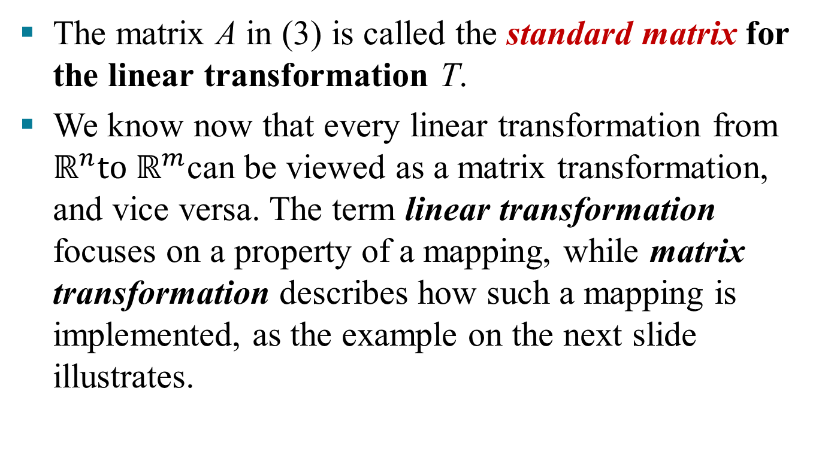
THE MATRIX OF A LINEAR TRANSFORMATION
The matrix A in (3) is called the standard matrix for the linear transformation T.
We know now that every linear transformation from $ℝ^{n}to ℝ^{m}$can be viewed as a matrix transformation, and vice versa. The term linear transformation focuses on a property of a mapping, while matrix transformation describes how such a mapping is implemented, as the example on the next slide illustrates.

Slide 5

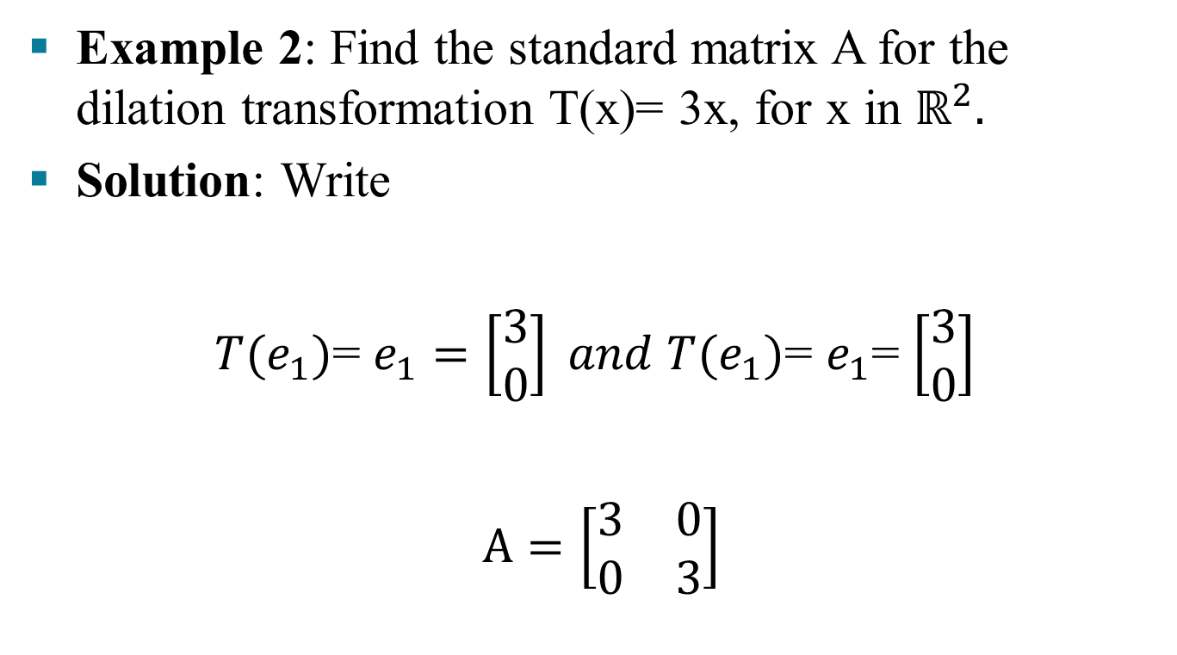
THE MATRIX OF A LINEAR TRANSFORMATION
Example 2: Find the standard matrix A for the dilation transformation T(x)= 3x, for x in $ℝ^{2}.$
Solution: Write
$T{(e}_{1})$= $e_{1}=\left[\begin{aligned}3 \\ 0\end{aligned}\right] and T{(e}_{1})$= $e_{1}$= $\left[\begin{aligned}3 \\ 0\end{aligned}\right]$
$A=\left[\begin{matrix}3 & 0 \\ 0 & 3\end{matrix}\right]$

Slide 6
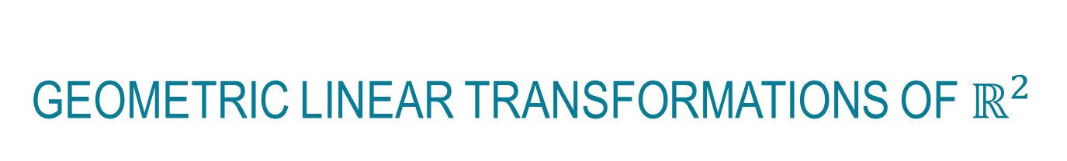
GEOMETRIC LINEAR TRANSFORMATIONS OF $ℝ^{2}$
Tables 1-4 illustrate other common geometric linear transformations of the plane.

Slide 7
EXISTENCE AND UNIQUENESS QUESTIONS
Table 1 continued:

Slide 8
EXISTENCE AND UNIQUENESS QUESTIONS
Table 1 continued:

Slide 9
EXISTENCE AND UNIQUENESS QUESTIONS

Slide 10
EXISTENCE AND UNIQUENESS QUESTIONS

Slide 11
EXISTENCE AND UNIQUENESS QUESTIONS

Slide 12
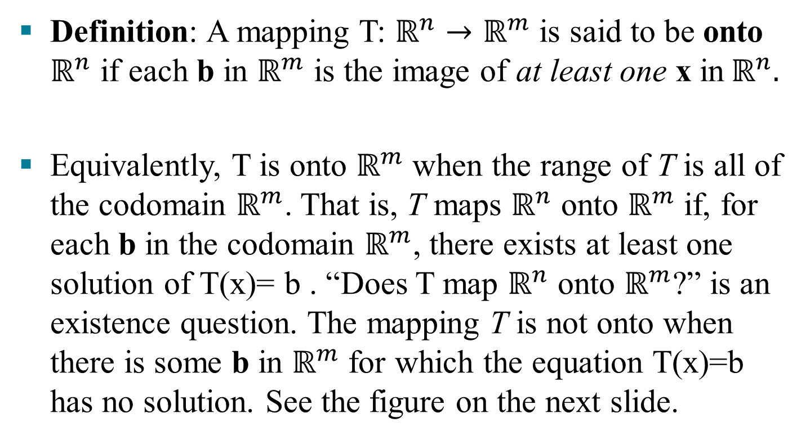
EXISTENCE AND UNIQUENESS QUESTIONS
Definition: A mapping T: $ℝ^{n}→ℝ^{m}$ is said to be onto $ℝ^{n}$ if each b in $ℝ^{m}$ is the image of at least one x in${ ℝ}^{n}.$
Equivalently, T is onto $ℝ^{m}$ when the range of T is all of the codomain $ℝ^{m}$. That is, T maps $ℝ^{n}$ onto $ℝ^{m}$ if, for each b in the codomain $ℝ^{m}$, there exists at least one solution of T(x)= b . “Does T map $ℝ^{n}$ onto $ℝ^{m}$?” is an existence question. The mapping T is not onto when there is some b in $ℝ^{m}$ for which the equation T(x)=b has no solution. See the figure on the next slide.

Slide 13

EXISTENCE AND UNIQUENESS QUESTIONS
Definition: A mapping T: $ℝ^{n}→ℝ^{m}$ is said to be one-to-one if each b in $ℝ^{m}$ is the image of at most one x in${ ℝ}^{n}.$

Slide 14
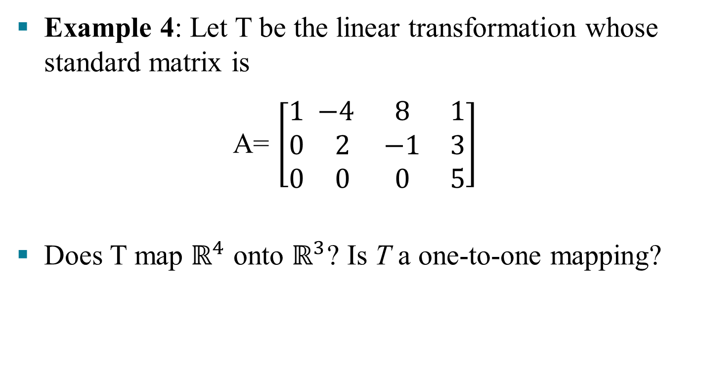
EXISTENCE AND UNIQUENESS QUESTIONS
Example 4: Let T be the linear transformation whose standard matrix is
A= $\left[\begin{aligned}1 \\ 0 \\ 0\end{aligned}\begin{matrix} −4 & 8 & 1 \\ 2 & −1 & 3 \\ 0 & 0 & 5\end{matrix}\right]$
Does T map $ℝ^{4}$ onto $ℝ^{3}$? Is T a one-to-one mapping?

Slide 15
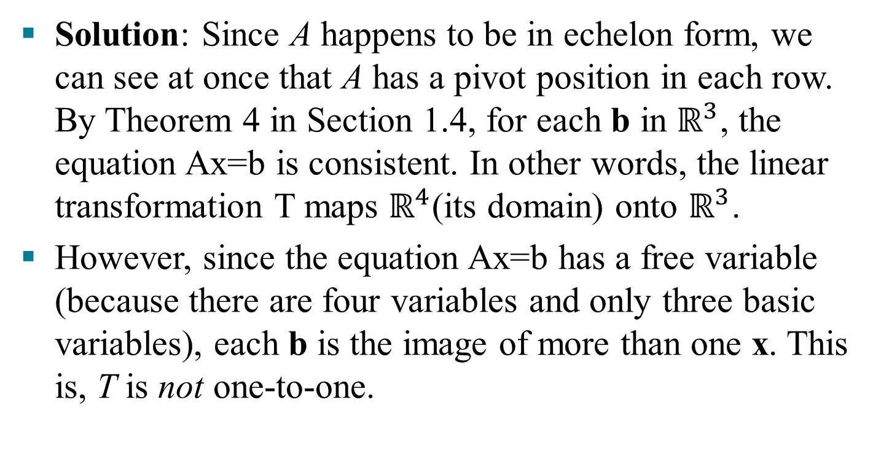
EXISTENCE AND UNIQUENESS QUESTIONS
Solution: Since A happens to be in echelon form, we can see at once that A has a pivot position in each row. By Theorem 4 in Section 1.4, for each b in $ℝ^{3}$, the equation Ax=b is consistent. In other words, the linear transformation T maps $ℝ^{4}$(its domain) onto $ℝ^{3}$.
However, since the equation Ax=b has a free variable (because there are four variables and only three basic variables), each b is the image of more than one x. This is, T is not one-to-one.

Slide 16
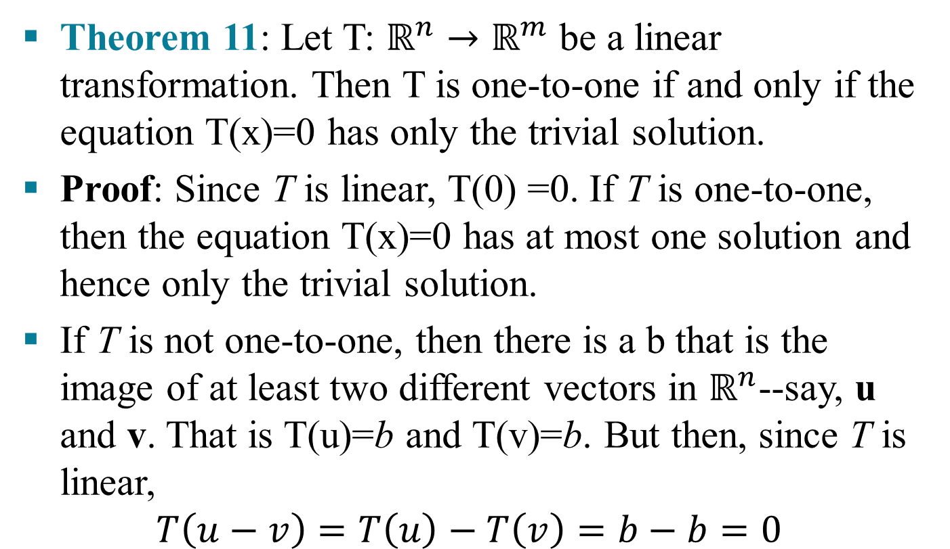
EXISTENCE AND UNIQUENESS QUESTIONS
Theorem 11: Let T: $ℝ^{n}→ℝ^{m}$ be a linear transformation. Then T is one-to-one if and only if the equation T(x)=0 has only the trivial solution.
Proof: Since T is linear, T(0) =0. If T is one-to-one, then the equation T(x)=0 has at most one solution and hence only the trivial solution.
If T is not one-to-one, then there is a b that is the image of at least two different vectors in $ℝ^{n}$--say, u and v. That is T(u)=b and T(v)=b. But then, since T is linear,
$$T\left(u−v\right)=T\left(u\right)−T\left(v\right)=b−b=0$$

Slide 17
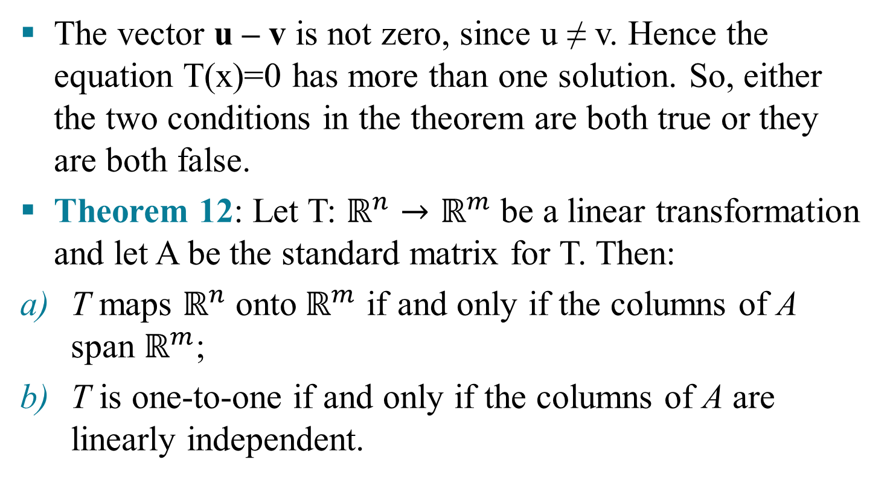
EXISTENCE AND UNIQUENESS QUESTIONS
The vector u – v is not zero, since u ≠ v. Hence the equation T(x)=0 has more than one solution. So, either the two conditions in the theorem are both true or they are both false.
Theorem 12: Let T: $ℝ^{n}→ℝ^{m}$ be a linear transformation and let A be the standard matrix for T. Then:
T maps $ℝ^{n}$ onto${ ℝ}^{m}$ if and only if the columns of A span $ℝ^{m}$;
T is one-to-one if and only if the columns of A are linearly independent.

Slide 18
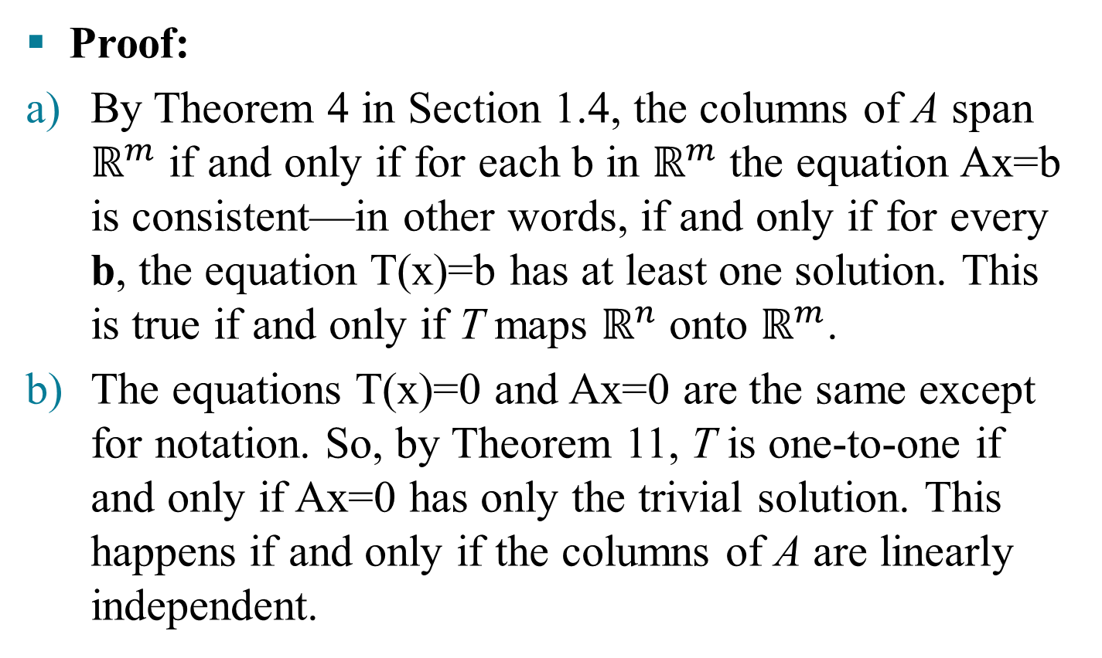
EXISTENCE AND UNIQUENESS QUESTIONS
Proof:
By Theorem 4 in Section 1.4, the columns of A span $ℝ^{m}$ if and only if for each b in $ℝ^{m}$ the equation Ax=b is consistent—in other words, if and only if for every b, the equation T(x)=b has at least one solution. This is true if and only if T maps $ℝ^{n}$ onto $ℝ^{m}$.
The equations T(x)=0 and Ax=0 are the same except for notation. So, by Theorem 11, T is one-to-one if and only if Ax=0 has only the trivial solution. This happens if and only if the columns of A are linearly independent.

