Slide 1
Linear Equations in Linear Algebra
INTRODUCTION TO LINEAR TRANSFORMATIONS

Slide 2
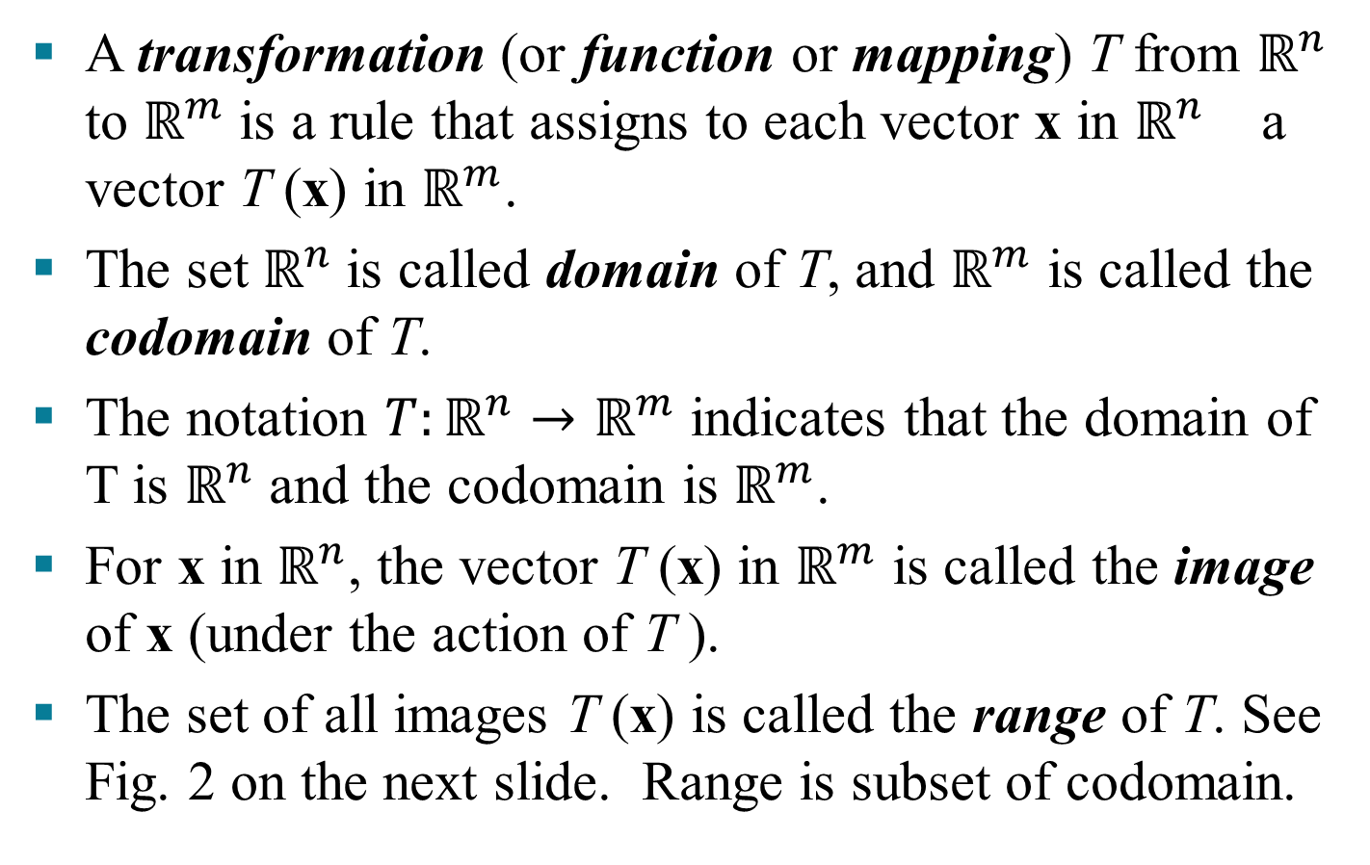
LINEAR TRANSFORMATIONS Prof Herron likes ☺
A transformation (or function or mapping) T from $ℝ^{n}$ to $ℝ^{m}$ is a rule that assigns to each vector x in $ℝ^{n}$ a vector T (x) in $ℝ^{m}$.
The set $ℝ^{n}$is called domain of T, and $ℝ^{m}$ is called the codomain of T.
The notation $T:ℝ^{n}→ℝ^{m}$ indicates that the domain of T is $ℝ^{n}$ and the codomain is $ℝ^{m}$.
For x in $ℝ^{n}$, the vector T (x) in $ℝ^{m}$ is called the image of x (under the action of T ).
The set of all images T (x) is called the range of T. See Fig. 2 on the next slide. Range is subset of codomain.

Slide 3
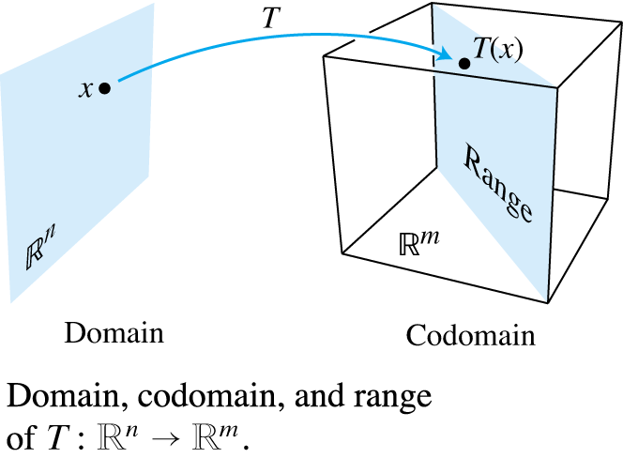
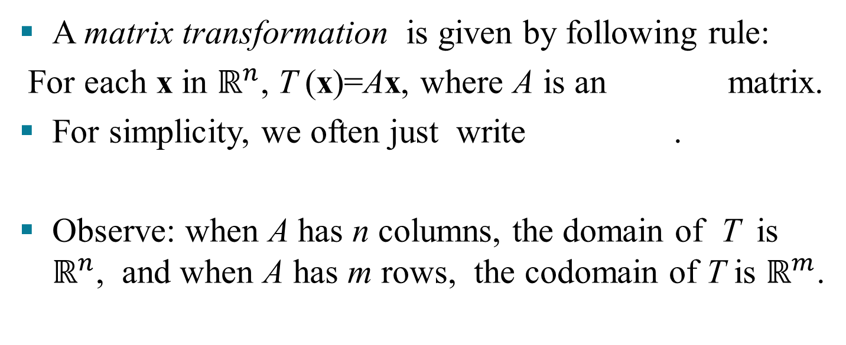
MATRIX TRANSFORMATIONS
A matrix transformation is given by following rule:
For each x in $ℝ^{n}$, T (x)=Ax, where A is an matrix.
For simplicity, we often just write .
Observe: when A has n columns, the domain of T is $ℝ^{n}$, and when A has m rows, the codomain of T is $ℝ^{m}$.

Slide 4

MATRIX TRANSFORMATIONS
The range of T is the set of all linear combinations of the columns of A, because each image T (x) is of the form Ax.
Example 1:
Let , , $b=\left[\begin{aligned}3 \\ 2 \\ −5\end{aligned}\right]$, c$=\left[\begin{aligned}3 \\ 2 \\ 5\end{aligned}\right]$.
Define a transformation $T:ℝ^{n}→ℝ^{m}$ by , so
.

Slide 5
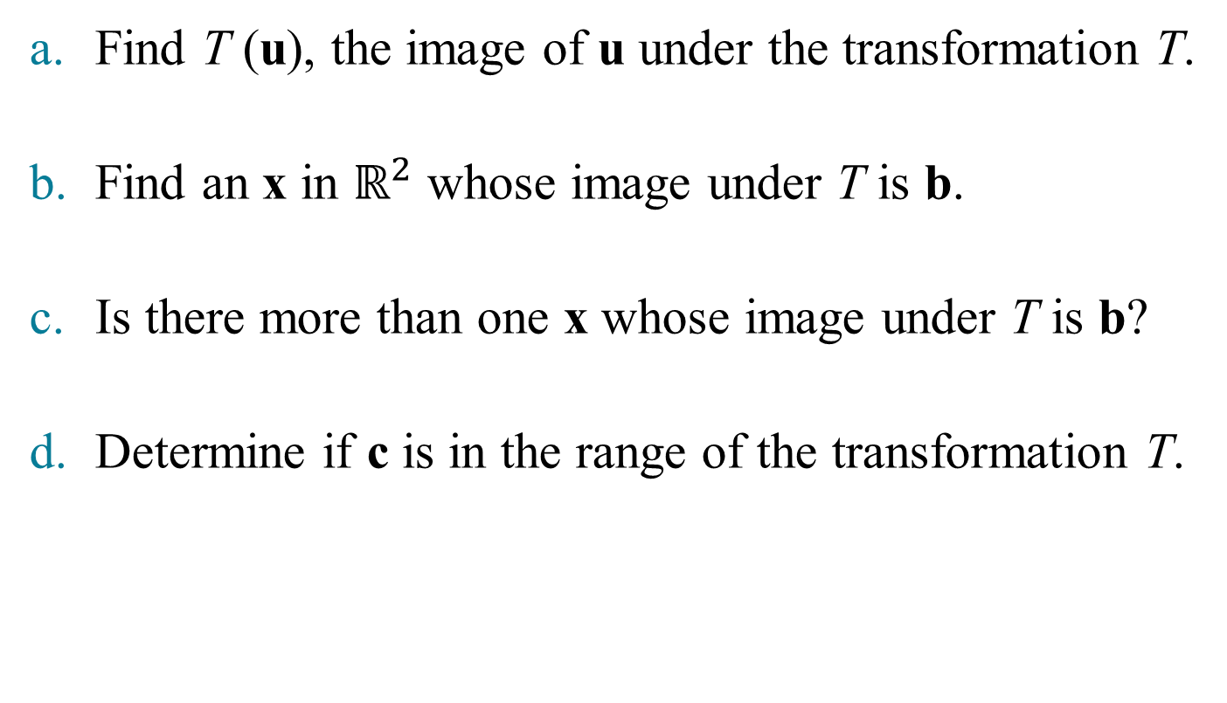
MATRIX TRANSFORMATIONS
Find T (u), the image of u under the transformation T.
Find an x in $ℝ^{2}$ whose image under T is b.
Is there more than one x whose image under T is b?
Determine if c is in the range of the transformation T.

Slide 6
MATRIX TRANSFORMATIONS
Solution:
Compute
    .
Solve for x. That is, solve , or
    (1)

Slide 7
MATRIX TRANSFORMATIONS
Row reduce the augmented matrix:
(2)
Hence , , and .
The image of this x under T is the given vector b.
~
~
~

Slide 8
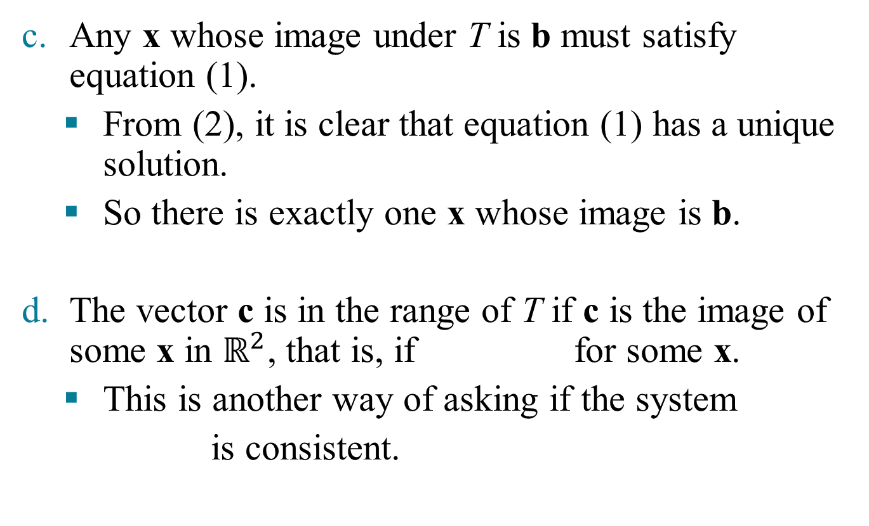
MATRIX TRANSFORMATIONS
Any x whose image under T is b must satisfy equation (1).
  From (2), it is clear that equation (1) has a unique solution.
  So there is exactly one x whose image is b.
The vector c is in the range of T if c is the image of some x in $ℝ^{2}$, that is, if for some x.
  This is another way of asking if the system
  is consistent.

Slide 9
MATRIX TRANSFORMATIONS
      To find the answer, row reduce the augmented matrix:
      The third equation, , shows that the system is inconsistent.
      So c is not in the range of T.
~
~
~

Slide 10
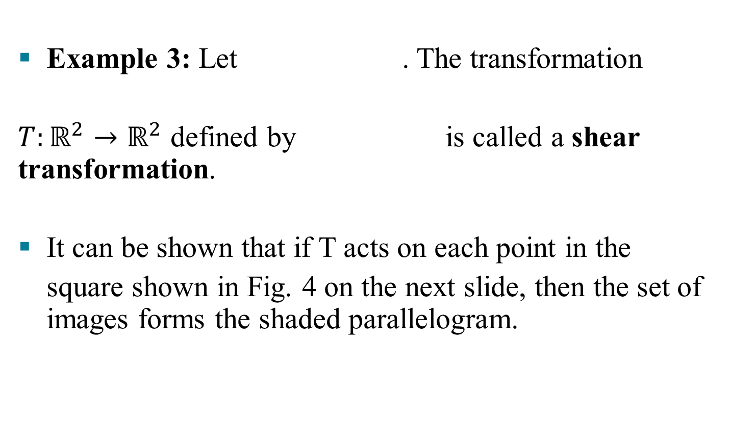
SHEAR TRANSFORMATION
Example 3: Let . The transformation
$T:ℝ^{2}→ℝ^{2}$ defined by is called a shear transformation.
It can be shown that if T acts on each point in the
square shown in Fig. 4 on the next slide, then the set of images forms the shaded parallelogram.

Slide 11
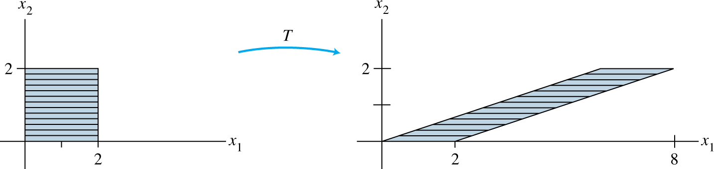
SHEAR TRANSFORMATION
The key idea is to show that T maps line segments onto line segments and then to check that the corners of the square map onto the vertices of the parallelogram.
For instance, the image of the point is
,

Slide 12
LINEAR TRANSFORMATIONS
and the image of is .
T deforms the square as if the top of the square were pushed to the right while the base is held fixed.
Definition: T is a linear transformation if:
    for all u, v in the domain of T; and,
    for all scalars c and all u in the domain of T.

Slide 13
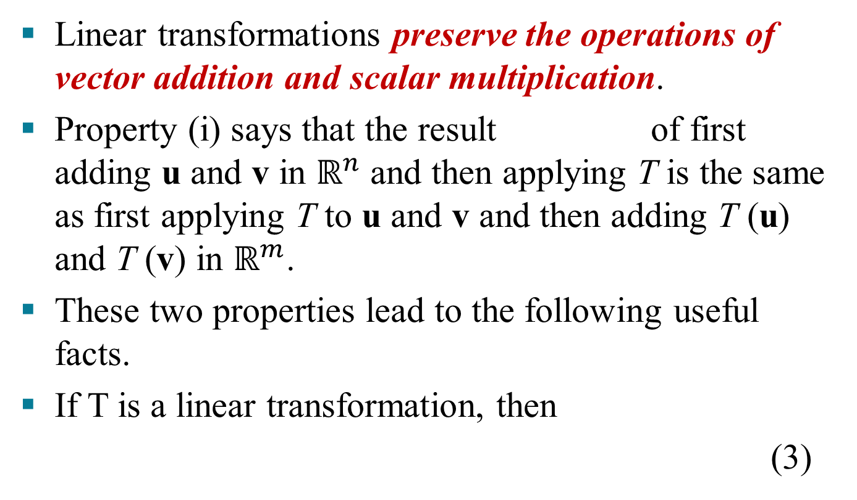
LINEAR TRANSFORMATIONS
Linear transformations preserve the operations of vector addition and scalar multiplication.
Property (i) says that the result of first adding u and v in $ℝ^{n}$ and then applying T is the same as first applying T to u and v and then adding T (u) and T (v) in $ℝ^{m}$.
These two properties lead to the following useful facts.
If T is a linear transformation, then
(3)

Slide 14
LINEAR TRANSFORMATIONS
and . (4)
for all vectors u, v in the domain of T and all scalars c, d.
Property (3) follows from condition (ii) in the definition, because .
Property (4) requires both (i) and (ii):
If a transformation satisfies (4) for all u, v and c, d, it must be linear.
(Set for preservation of addition, and set for
preservation of scalar multiplication.)

Slide 15
LINEAR TRANSFORMATIONS
Repeated application of (4) produces the useful linearity principle:
(5)
In engineering and physics, (5) is referred to as a superposition principle.
Think of v₁, …, v_{p} as signals that go into a system and T (v₁), …, T (v_{p}) as the responses of that system to the signals.

Slide 16
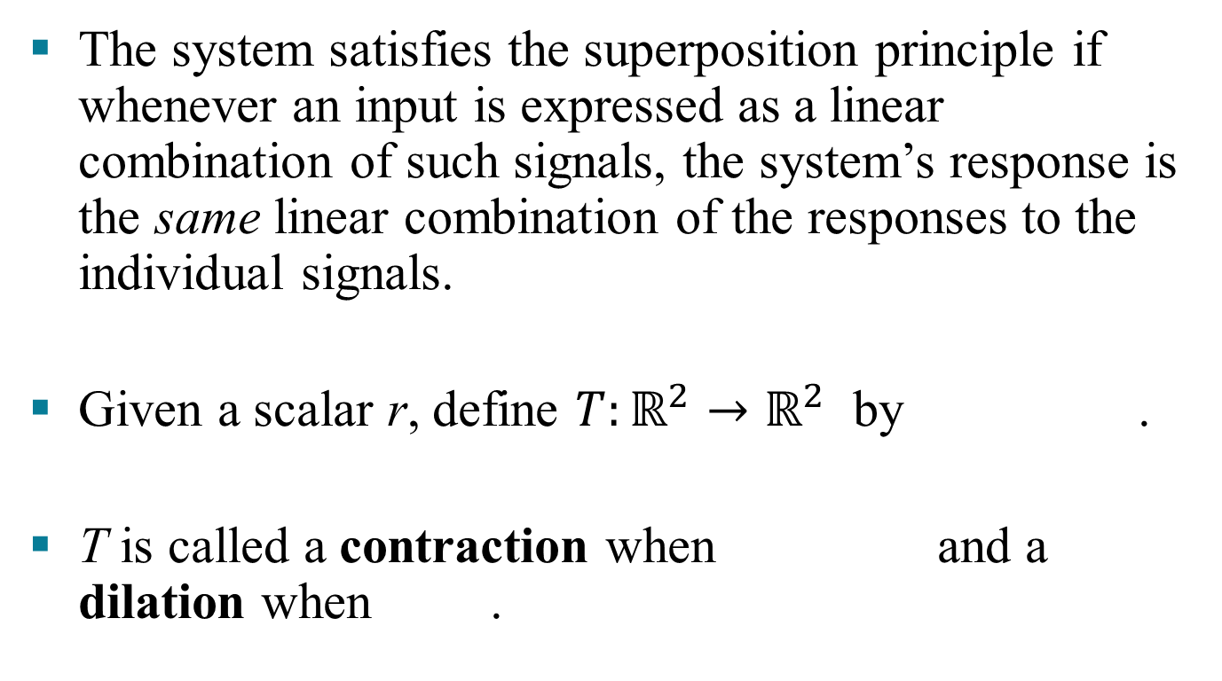
LINEAR TRANSFORMATIONS
The system satisfies the superposition principle if whenever an input is expressed as a linear combination of such signals, the system’s response is the same linear combination of the responses to the individual signals.
Given a scalar r, define $T:ℝ^{2}→ℝ^{2}$ by .
T is called a contraction when and a dilation when .

