Slide 1
Linear Equations in Linear Algebra
THE MATRIX EQUATION

Slide 2

MATRIX EQUATION
Definition: If A is an matrix, with columns a₁, …, a_{n}, and if x is in $ℝ^{n}$, then the product of A and x, denoted by Ax, is the linear combination of the columns of A using the corresponding entries in x as weights; that is,
.
Note that Ax is defined only if the number of columns of A equals the number of entries in x.

Slide 3
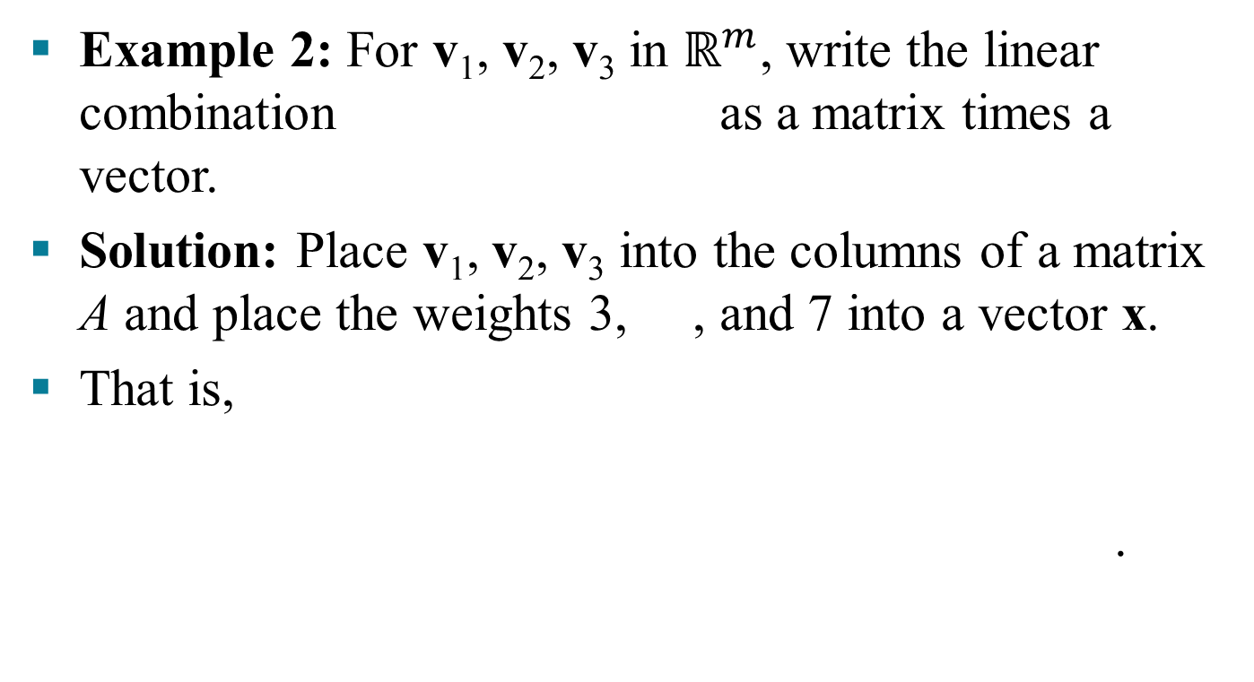
MATRIX EQUATION
Example 2: For v₁, v₂, v₃ in $ℝ^{m}$, write the linear combination as a matrix times a vector.
Solution: Place v₁, v₂, v₃ into the columns of a matrix A and place the weights 3, , and 7 into a vector x.
That is,
.

Slide 4
MATRIX EQUATION
Now, write the system of linear equations as a vector equation involving a linear combination of vectors.
For example, the following system
(1)
is equivalent to
. (2)

Slide 5
MATRIX EQUATION
As in the example, the linear combination on the left side is a matrix times a vector, so that (2) becomes
. (3)
Equation (3) has the form . Such an equation is called a matrix equation, to distinguish it from a vector equation such as shown in (2).

Slide 6
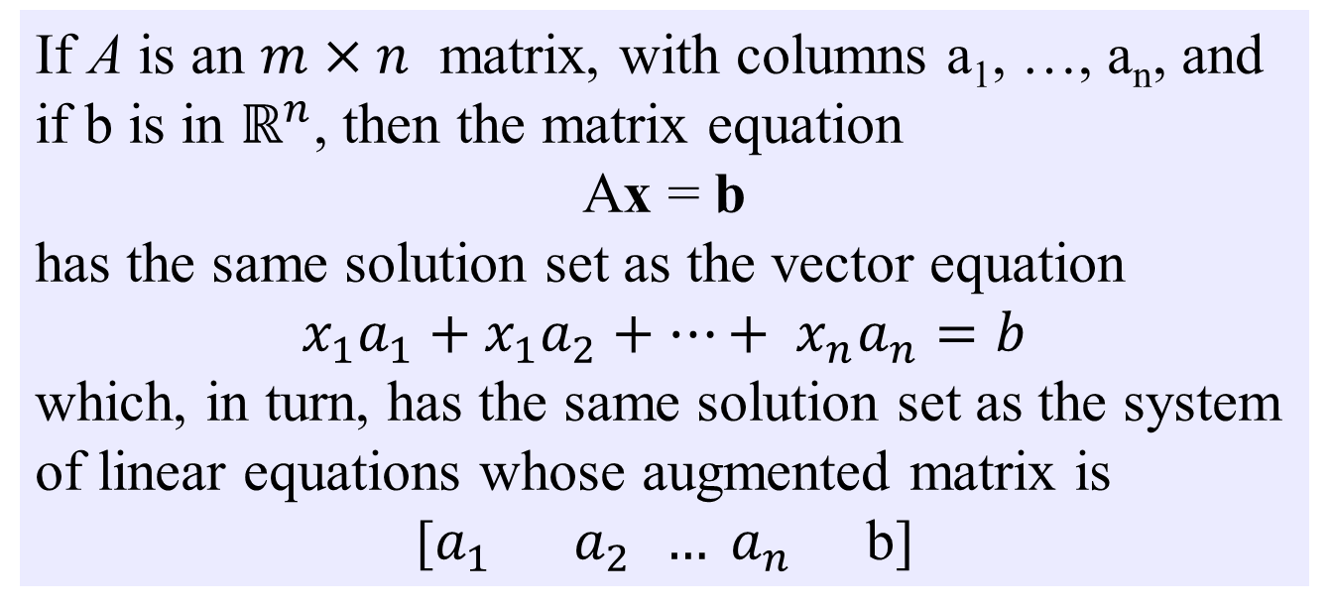
MATRIX EQUATION
THEOREM 3
If A is an $m×n$ matrix, with columns a₁, …, a_{n}, and if b is in $ℝ^{n}$, then the matrix equation
Ax = b
has the same solution set as the vector equation
$$x_{1}a_{1}+x_{1}a_{2}+…+ x_{n}a_{n}=b$$
which, in turn, has the same solution set as the system of linear equations whose augmented matrix is
[$a_{1}{ a}_{2 }{… a}_{n}$ b]

Slide 7
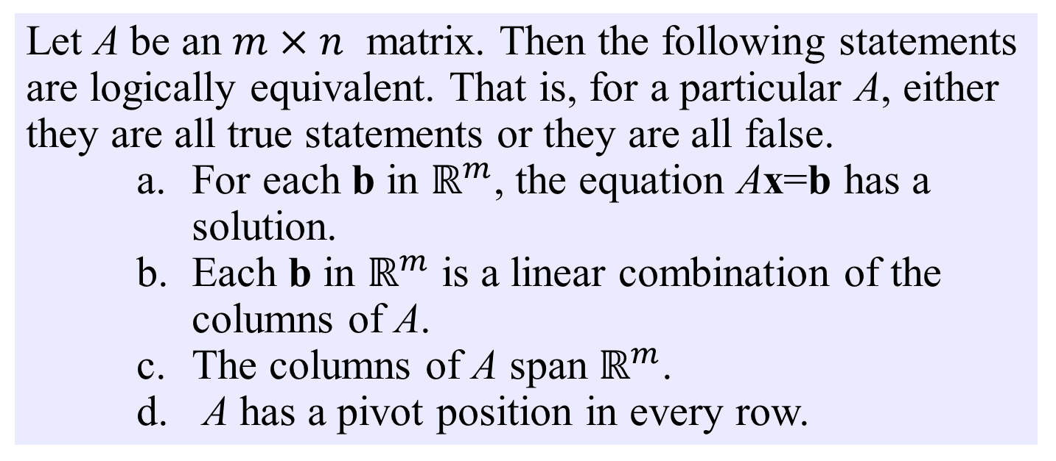
EXISTENCE OF SOLUTIONS
The equation has a solution if and only if b is a linear combination of the columns of A.
THEOREM 4
Let A be an $m×n$ matrix. Then the following statements are logically equivalent. That is, for a particular A, either they are all true statements or they are all false.
    For each b in $ℝ^{m}$, the equation Ax=b has a solution.
    Each b in $ℝ^{m}$ is a linear combination of the columns of A.
    The columns of A span $ℝ^{m}$.
    A has a pivot position in every row.

Slide 8
COMPUTATION OF Ax
Example 4: Compute Ax, where
and .
Solution: From the definition,

Slide 9
COMPUTATION OF Ax
(1)
.
The first entry in the product Ax is a sum of products (sometimes called a dot product), using the first row of A and the entries in x.

Slide 10
COMPUTATION OF Ax
That is, .
Similarly, the second entry in Ax can be calculated by multiplying the entries in the second row of A by the corresponding entries in x and then summing the resulting products.

Slide 11
ROW-VECTOR RULE FOR COMPUTING Ax
Likewise, the third entry in Ax can be calculated from the third row of A and the entries in x.
If the product Ax is defined, then the ith entry in Ax is the sum of the products of corresponding entries from row i of A and from the vector x.
The matrix with 1’s on the diagonal and 0’s elsewhere is called an identity matrix and is denoted by I.
For example, is an identity matrix.

Slide 12
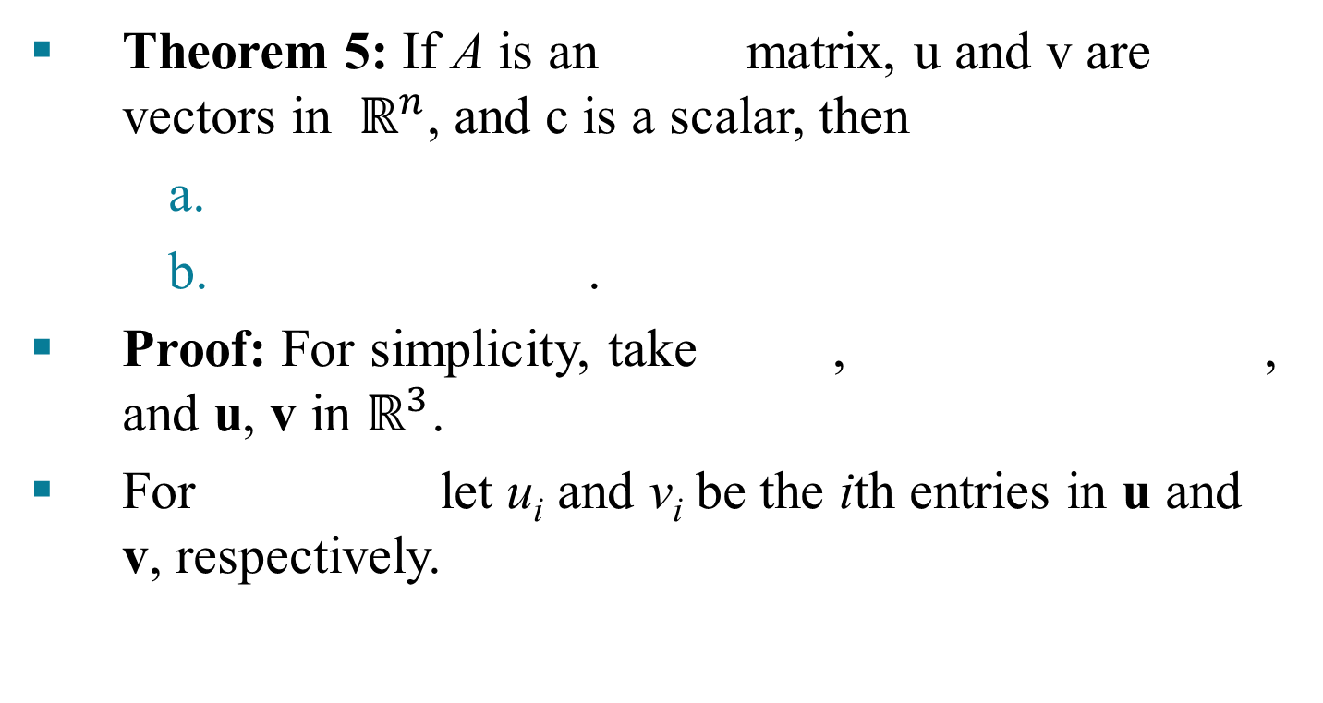
PROPERTIES OF THE MATRIX-VECTOR PRODUCT Ax
Theorem 5: If A is an matrix, u and v are vectors in ${ ℝ}^{n}$, and c is a scalar, then
    .
Proof: For simplicity, take , , and u, v in $ℝ^{3}$.
For let u_{i} and v_{i} be the ith entries in u and v, respectively.

Slide 13
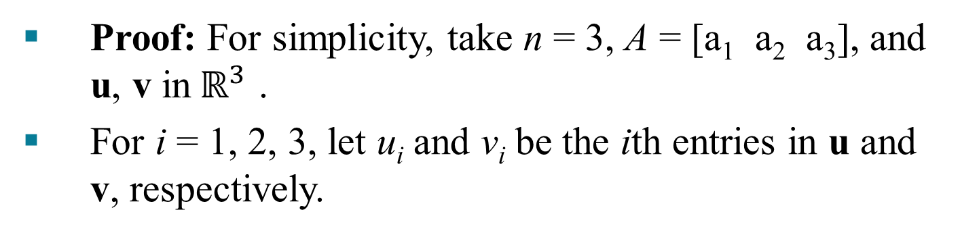
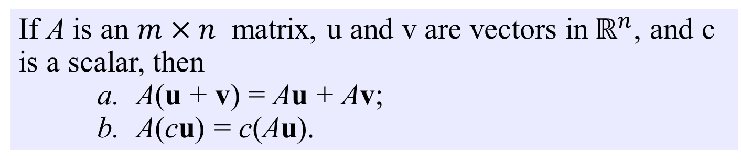
PROPERTIES OF THE MATRIX-VECTOR PRODUCT Ax
THEOREM 5
If A is an $m×n$ matrix, u and v are vectors in${ ℝ}^{n}$, and c is a scalar, then
    A(u + v) = Au + Av;
    A(cu) = c(Au).
Proof: For simplicity, take n = 3, A = [a₁ a₂ a₃], and u, v in${ ℝ}^{3}$ .
For i = 1, 2, 3, let u_{i} and v_{i} be the ith entries in u and v, respectively.

Slide 14

PROPERTIES OF THE MATRIX-VECTOR PRODUCT Ax
To prove statement (a), compute as a linear combination of the columns of A using the entries in
as weights.
Entries in
Columns of A

Slide 15
PROPERTIES OF THE MATRIX-VECTOR PRODUCT Ax
To prove statement (b), compute as a linear combination of the columns of A using the entries in cu as weights.

