Slide 1
Linear Equations in Linear Algebra
VECTOR EQUATIONS

Slide 2
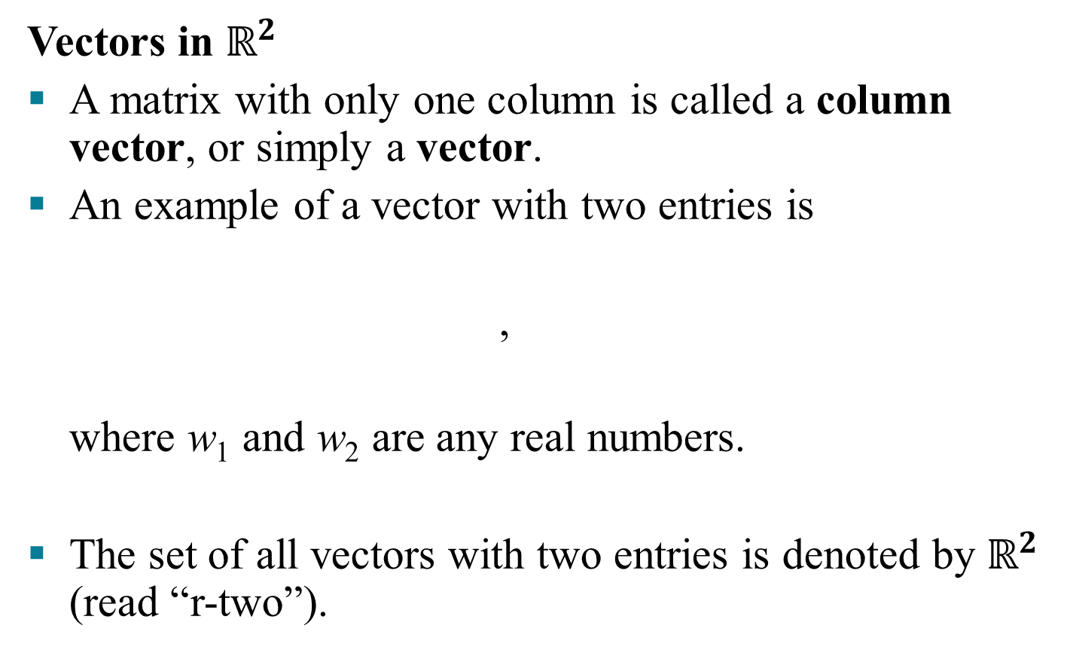
VECTOR EQUATIONS
Vectors in $ℝ^{2}$
A matrix with only one column is called a column vector, or simply a vector.
An example of a vector with two entries is
,
where w₁ and w₂ are any real numbers.
The set of all vectors with two entries is denoted by $ℝ^{2}$ (read “r-two”).

Slide 3
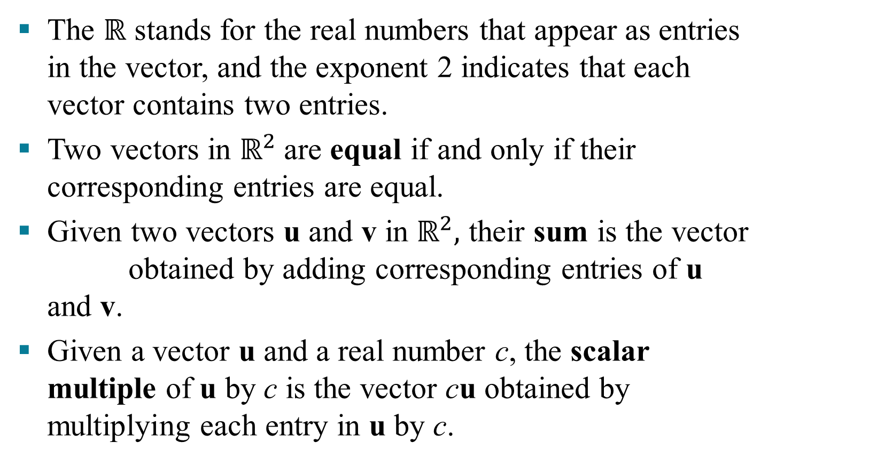
VECTOR EQUATIONS

Slide 4
VECTOR EQUATIONS
Example 1: Given and , find
4u, , and .
Solution: , and

Slide 5

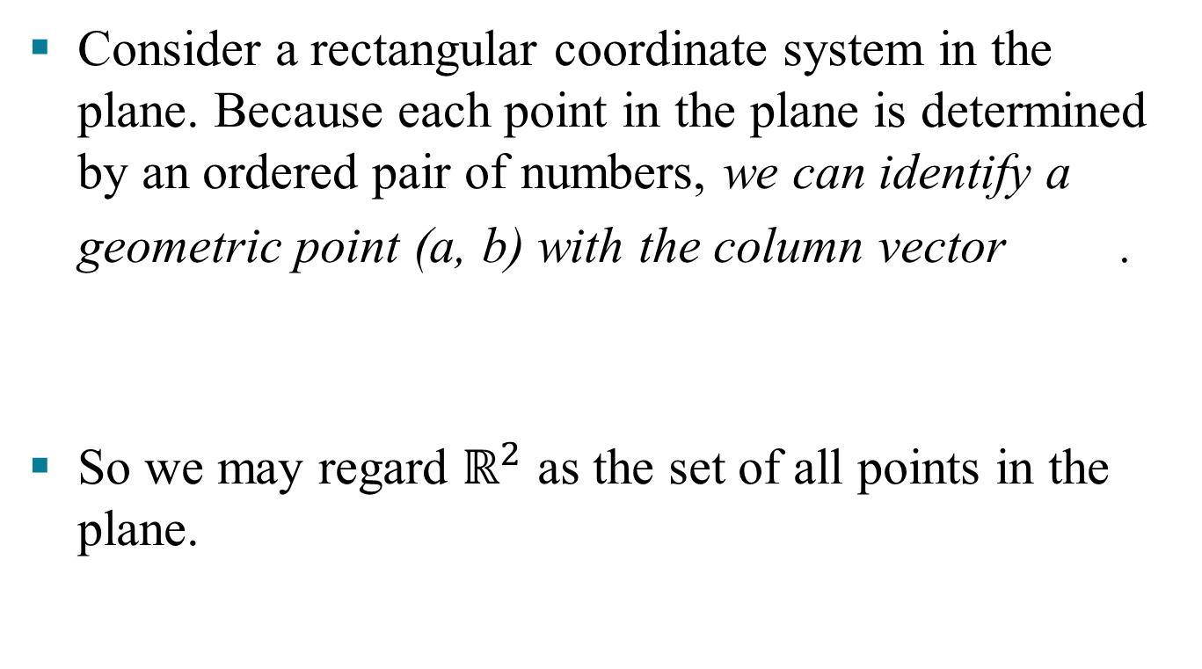

Slide 6
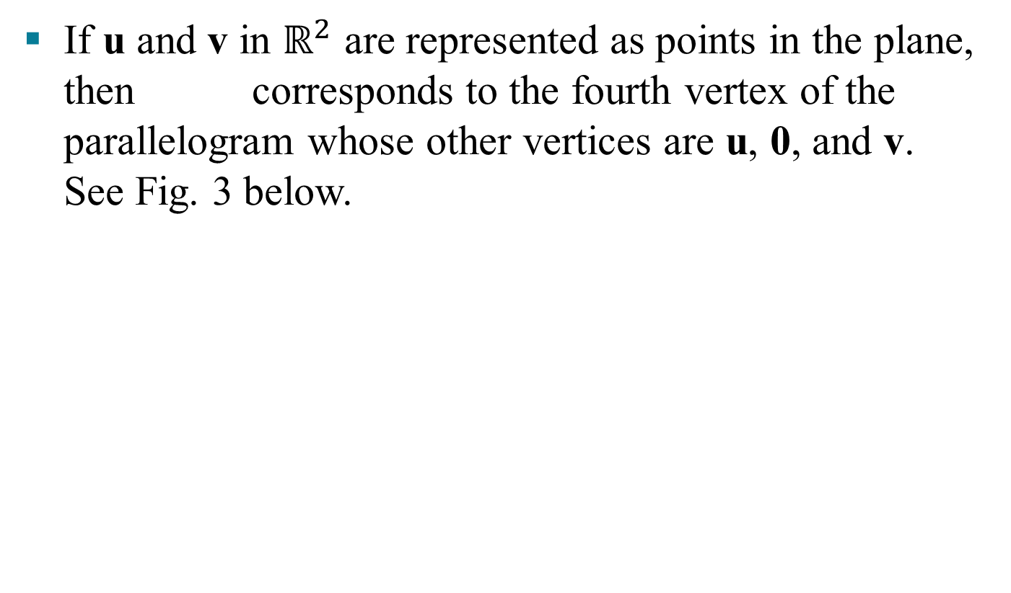
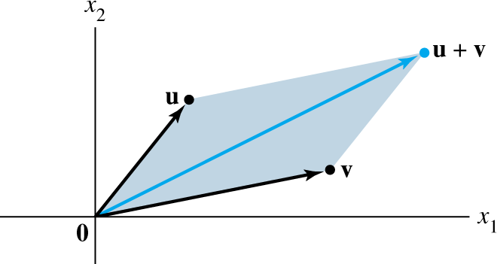
PARALLELOGRAM RULE FOR ADDITION

Slide 7

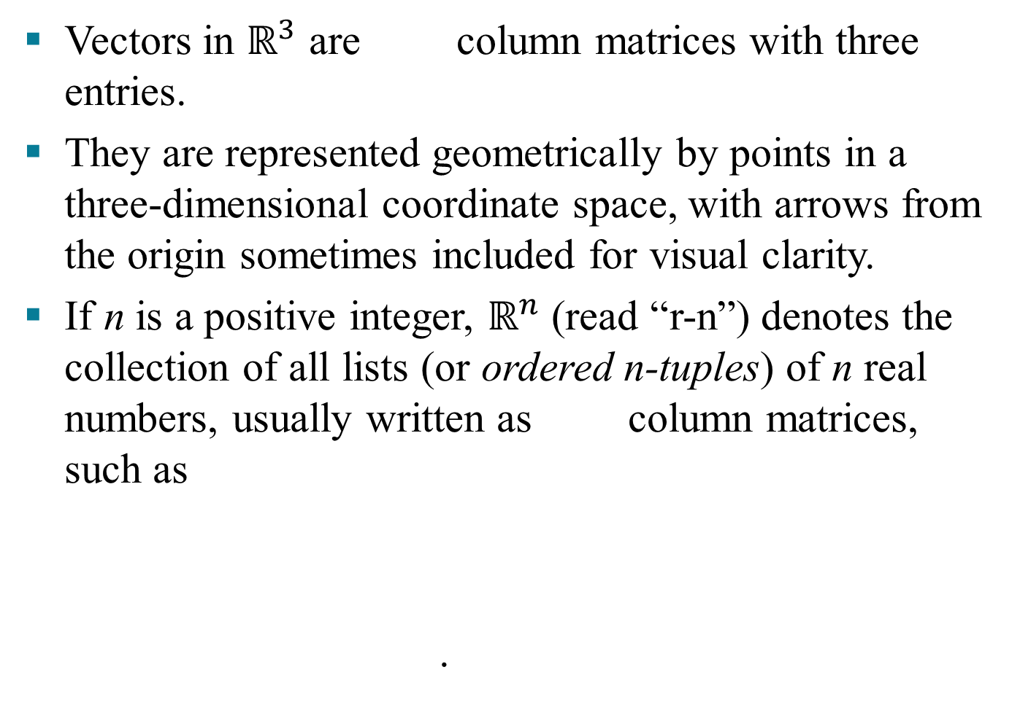

Slide 8

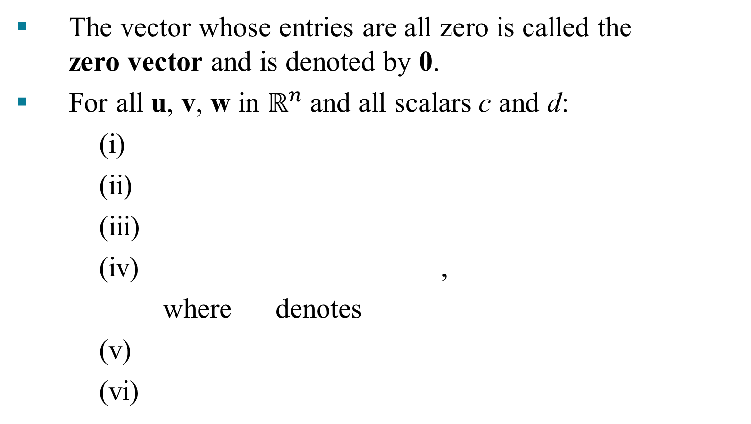

Slide 9
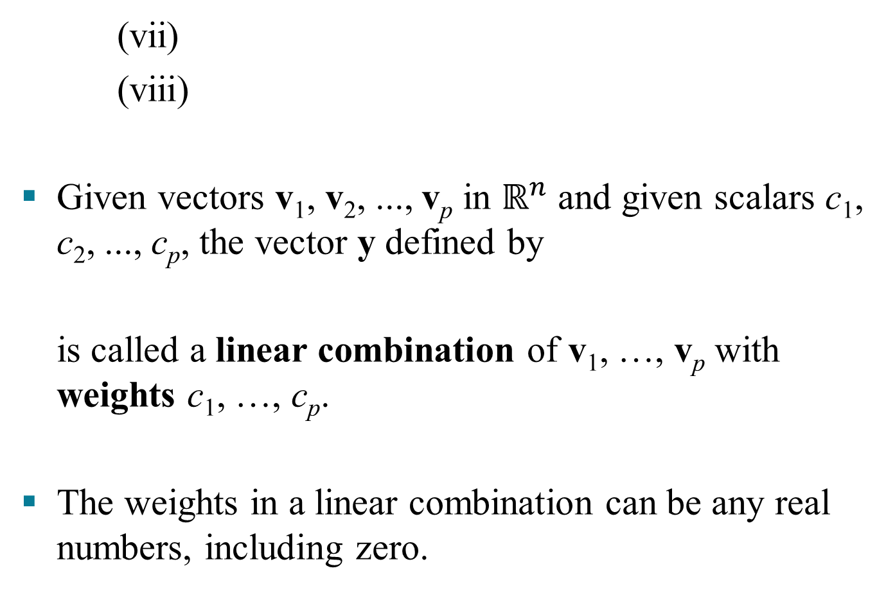
LINEAR COMBINATIONS
© 2016 Pearson Education, Inc.

Slide 10
LINEAR COMBINATIONS
Example 5: Let , and .
Determine whether b can be generated (or written) as a linear combination of a₁ and a₂. That is, determine whether weights x₁ and x₂ exist such that
(1)
If vector equation (1) has a solution, find it.
© 2016 Pearson Education, Inc.

Slide 11

LINEAR COMBINATIONS
Solution: Use the definitions of scalar multiplication and vector addition to rewrite the vector equation
,
which is same as
a₁
a₂
b
© 2016 Pearson Education, Inc.

Slide 12
LINEAR COMBINATIONS
and
. (2)
The vectors on the left and right sides of (2) are equal if and only if their corresponding entries are both equal. That is, x₁ and x₂ make the vector equation (1) true if and only if x₁ and x₂ satisfy the following system.
(3)
© 2016 Pearson Education, Inc.

Slide 13
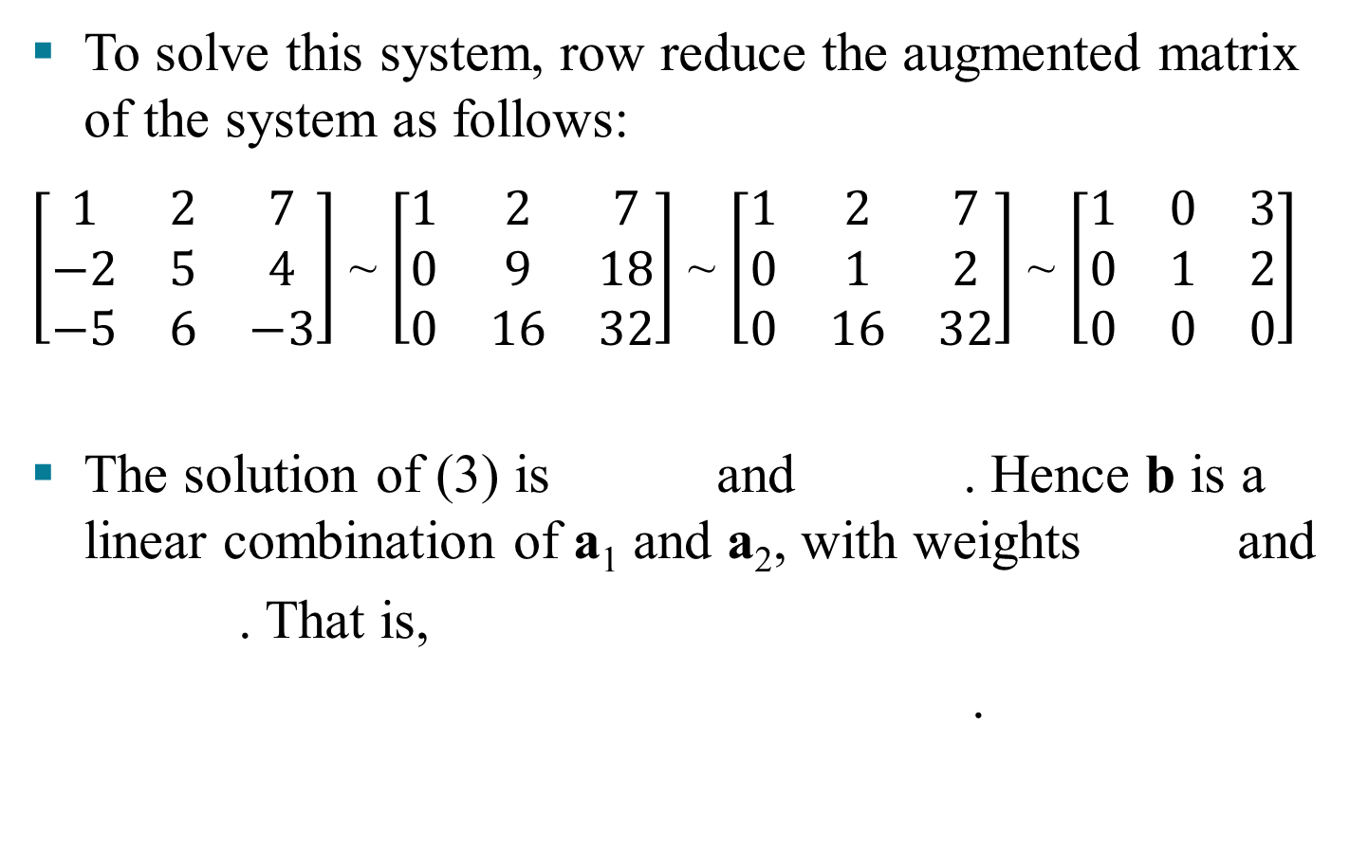
LINEAR COMBINATIONS
© 2016 Pearson Education, Inc.

Slide 14
LINEAR COMBINATIONS
Now, observe that the original vectors a₁, a₂, and b are the columns of the augmented matrix that we row reduced:
Write this matrix in a way that identifies its columns.
(4)
a₁
a₂
b
© 2016 Pearson Education, Inc.

Slide 15
LINEAR COMBINATIONS
A vector equation
has the same solution set as the linear system whose augmented matrix is
(5)
In particular, b can be generated by a linear combination of a₁, …, a_{n} if and only if there exists a solution to the linear system corresponding to the matrix (5).
© 2016 Pearson Education, Inc.

Slide 16
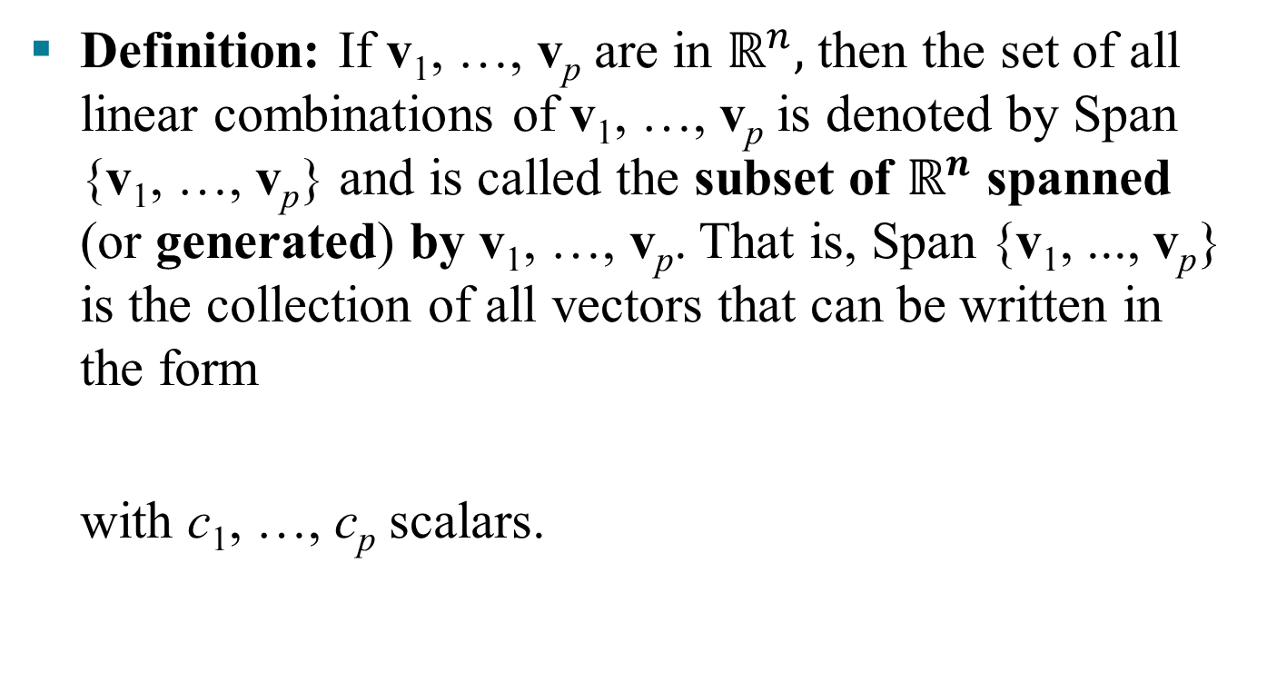
LINEAR COMBINATIONS
© 2016 Pearson Education, Inc.

Slide 17
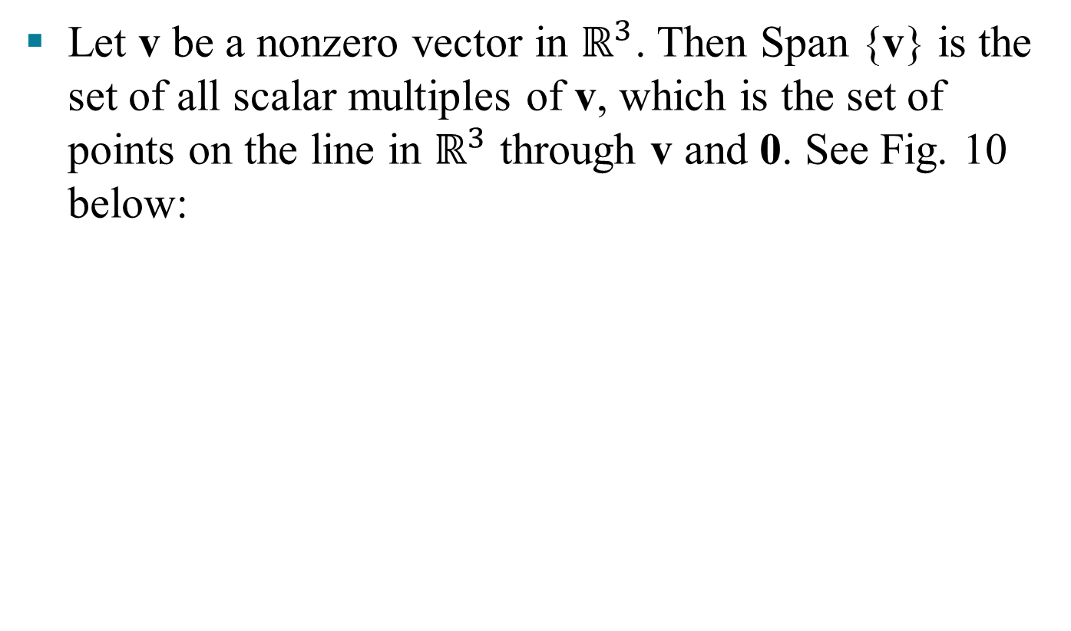
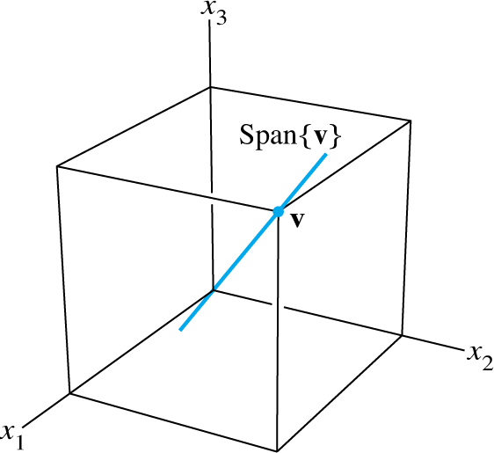
A GEOMETRIC DESCRIPTION OF SPAN {V}
© 2016 Pearson Education, Inc.

Slide 18
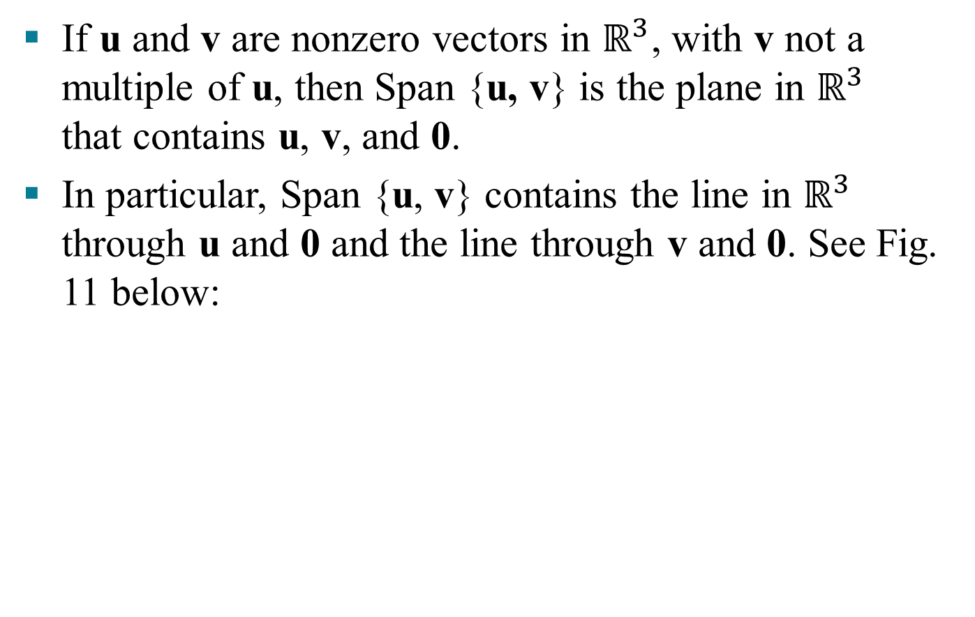
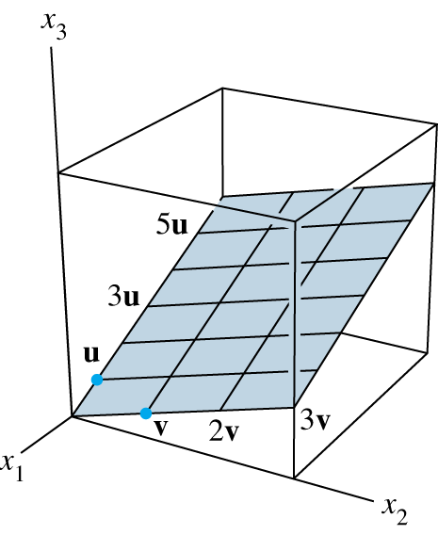
A GEOMETRIC DESCRIPTION OF SPAN {U, V}
© 2016 Pearson Education, Inc.

