Slide 1
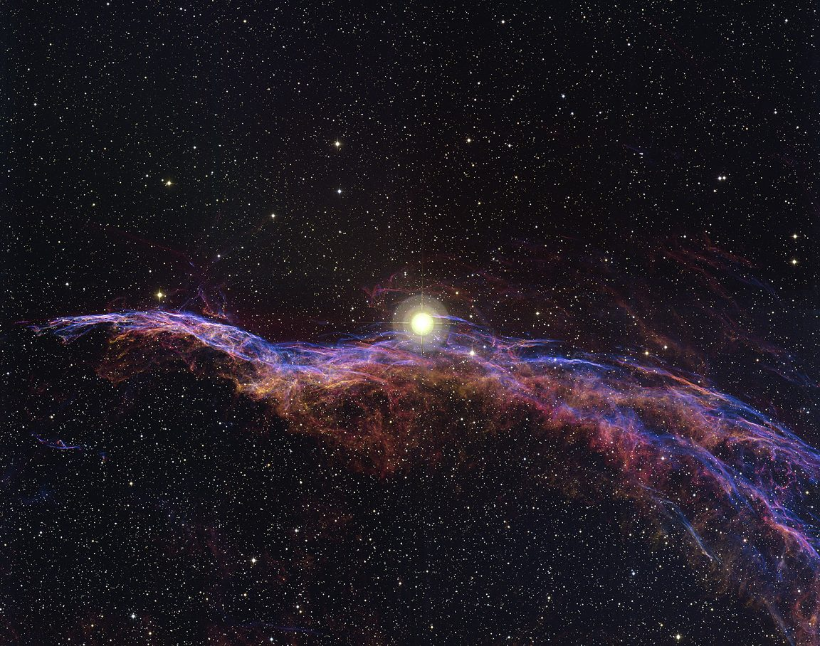
7 - Stellar Evolution-II

Slide 2
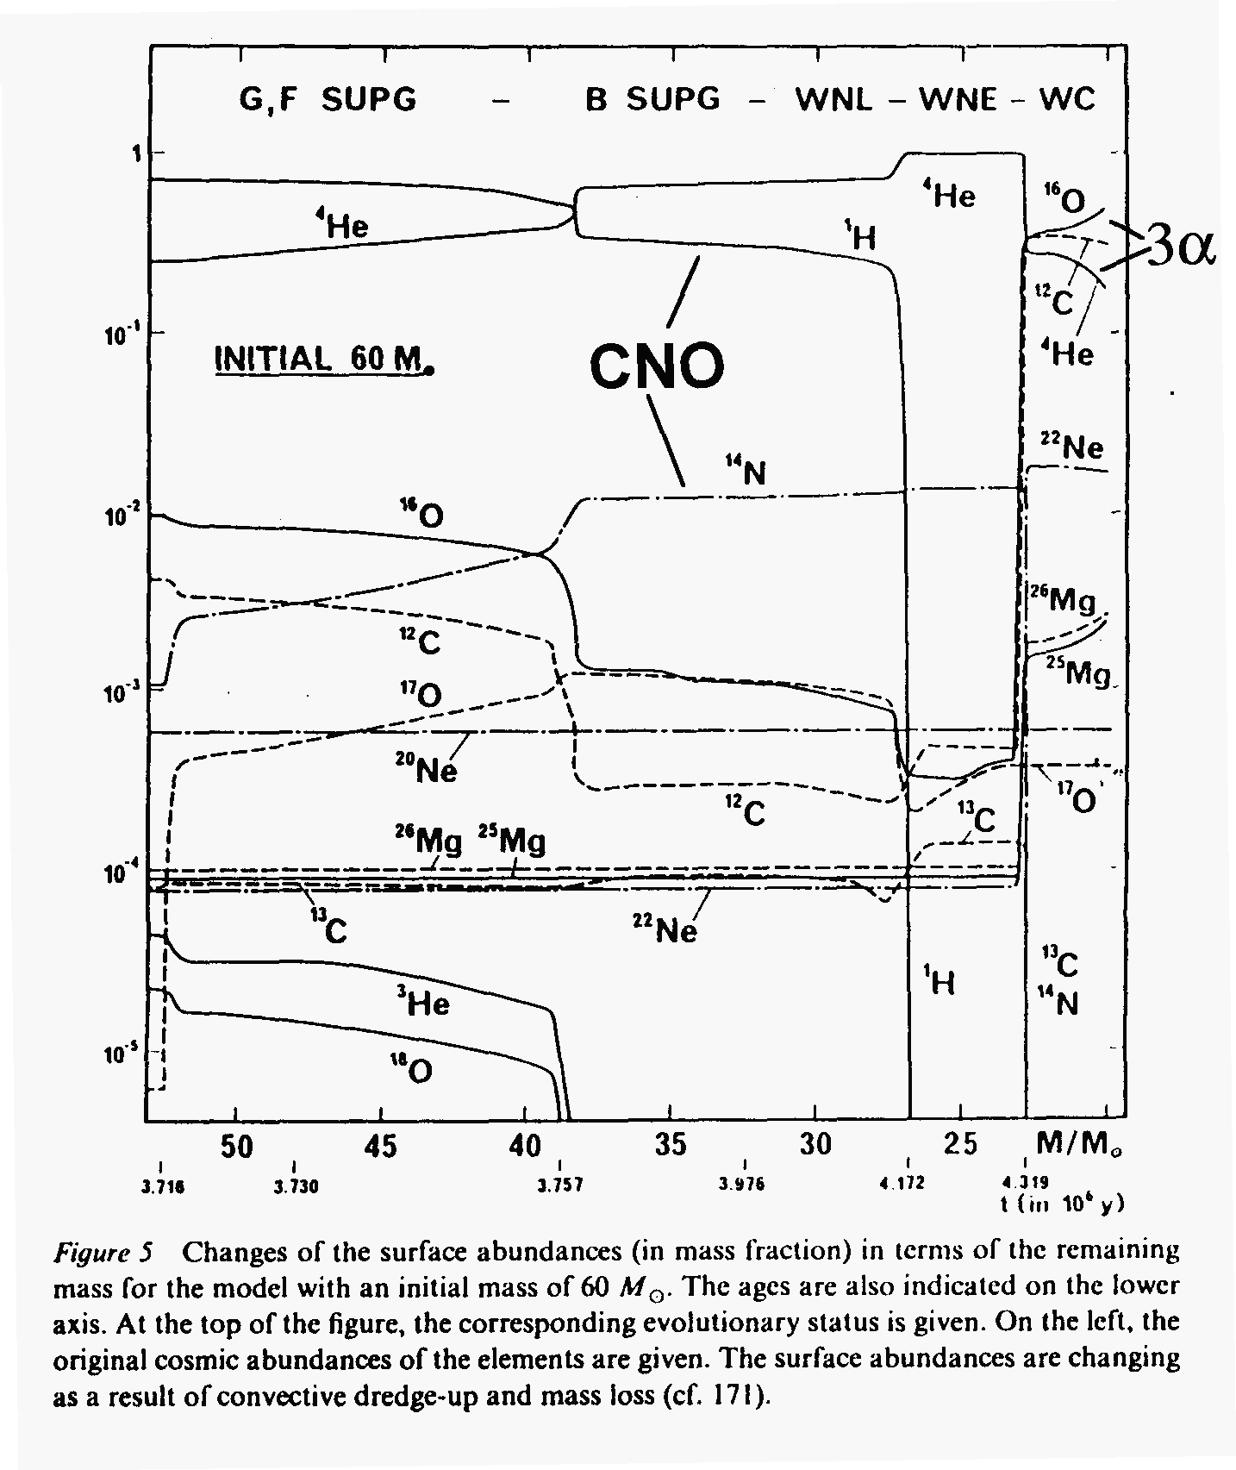
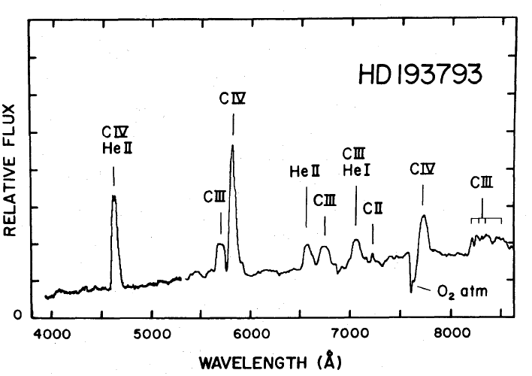
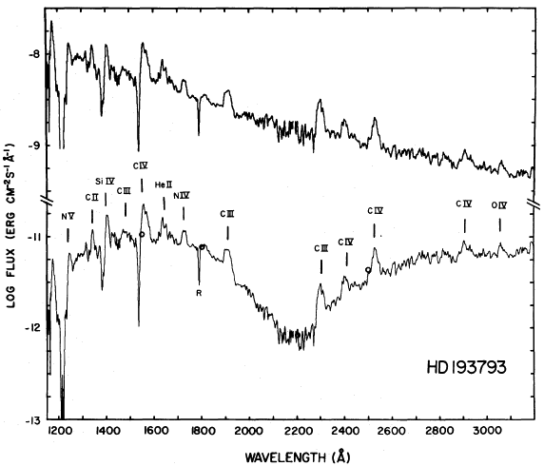
What’s at the surface
Surface abundances vs. time and mass loss
time

Slide 3
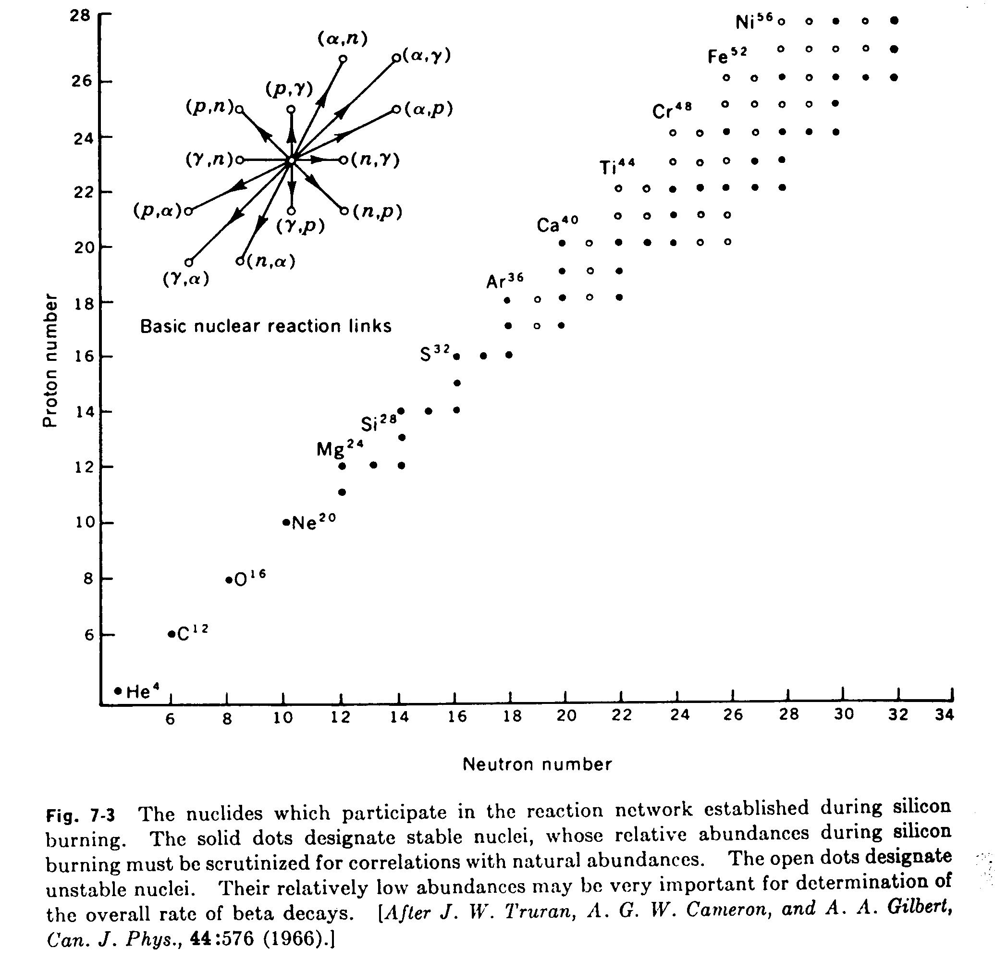

Slide 4
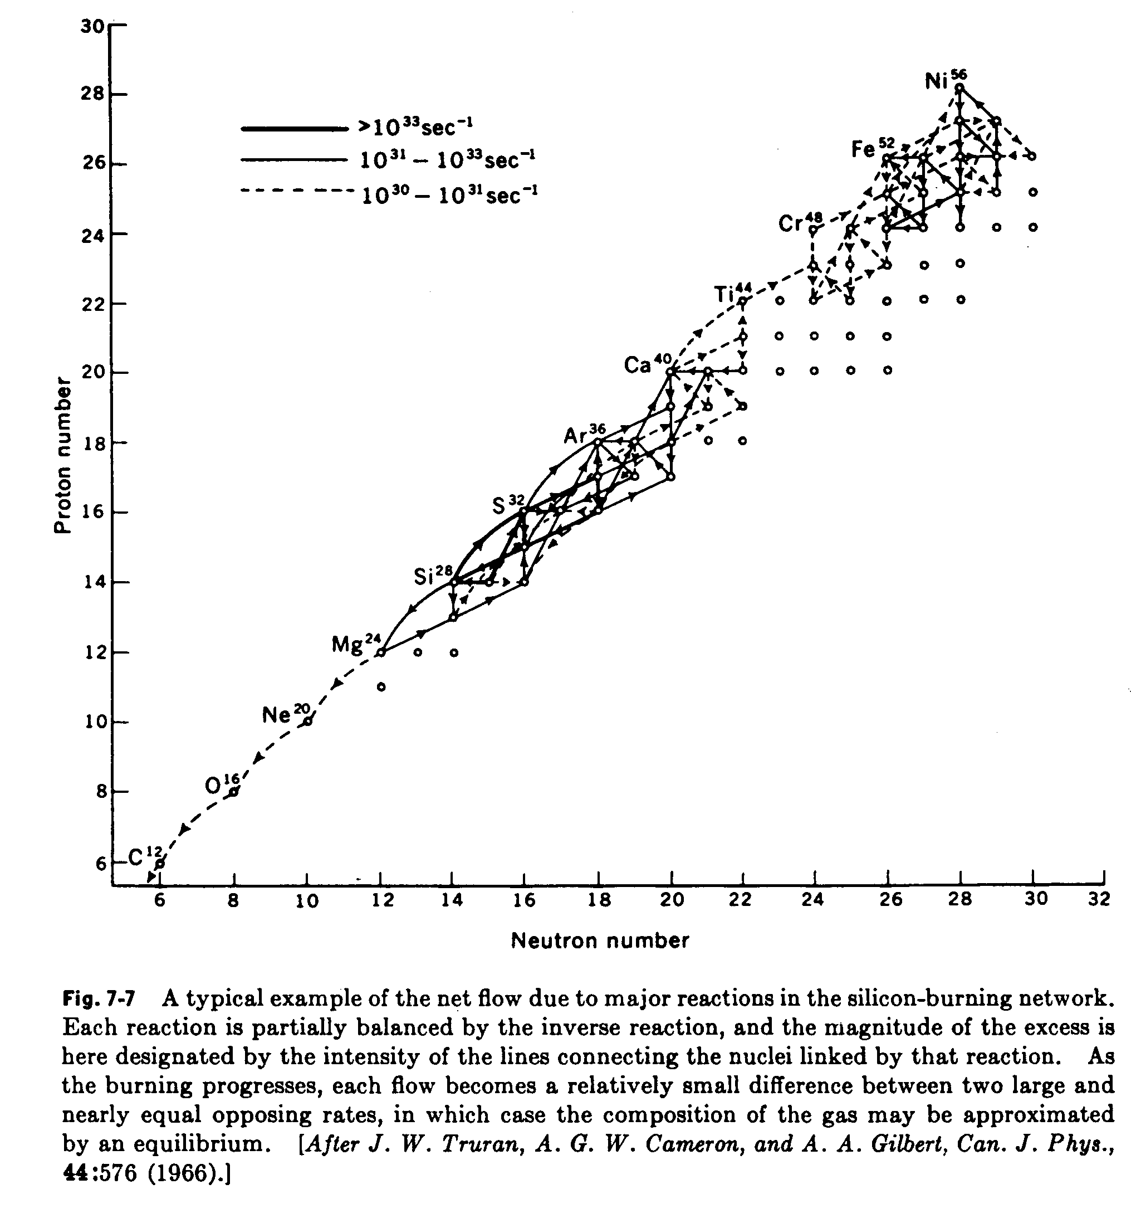
“Si-burning”

Slide 5
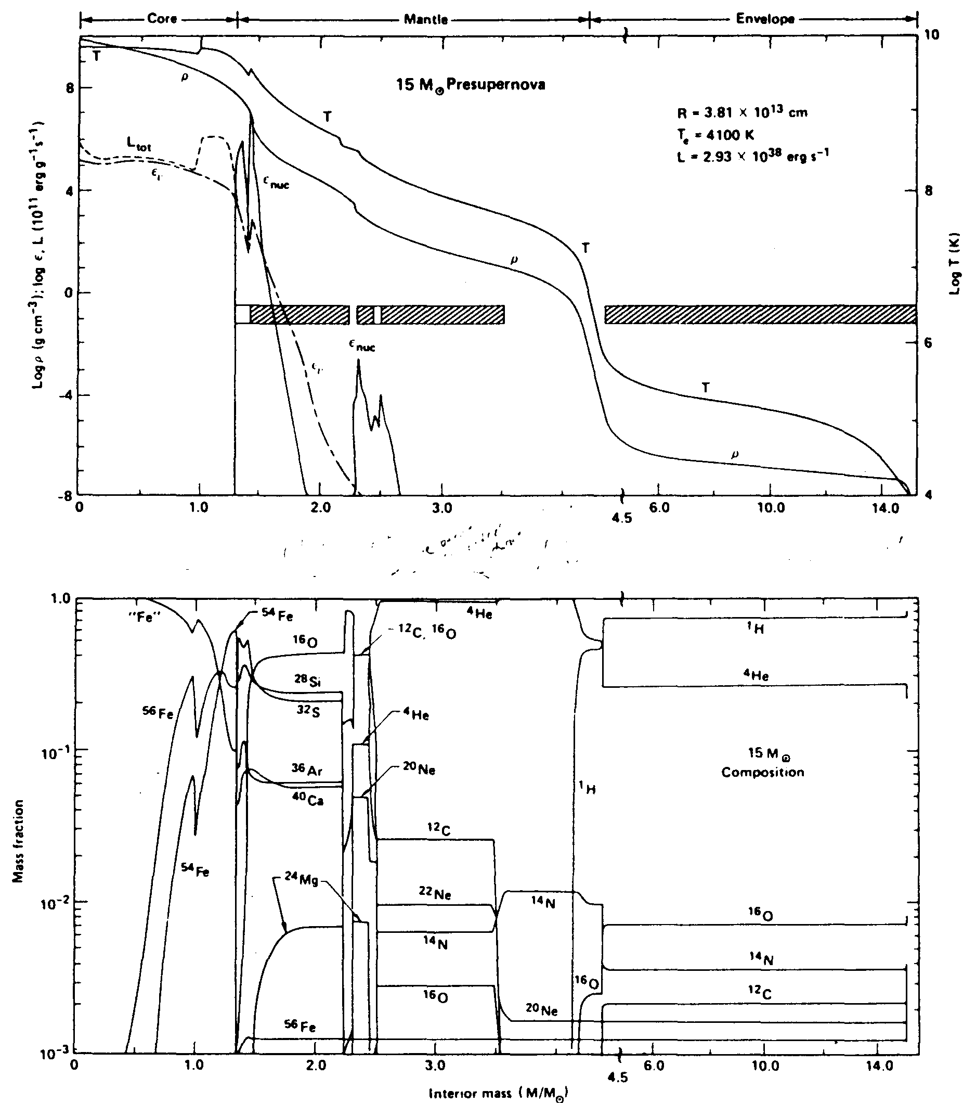
Pre-supernova structure for 15 solar-mass star
core
surface

Slide 6
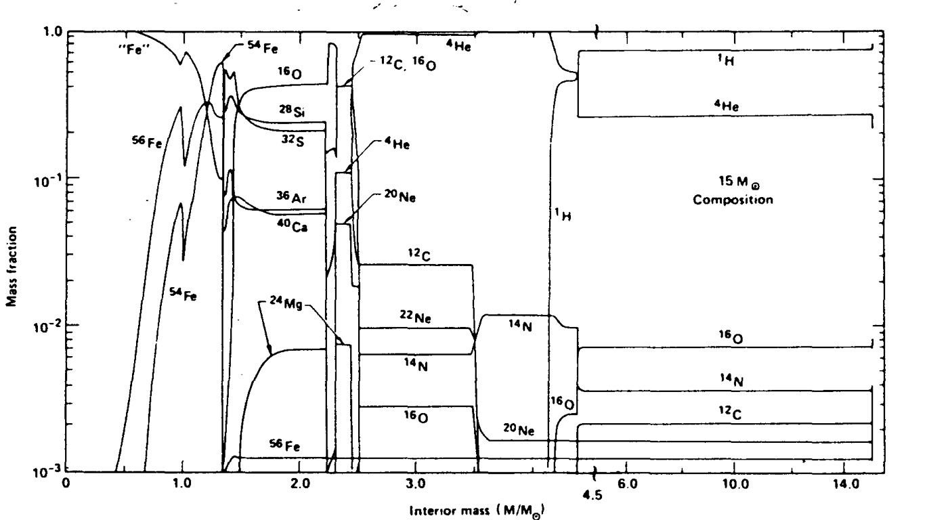
3He
C,O
original
O
S,P,Mg,Si
CNO cycle
Si
C
Ne,Mg,O
all kinds of stuff
Ne
Mg,O

Slide 7
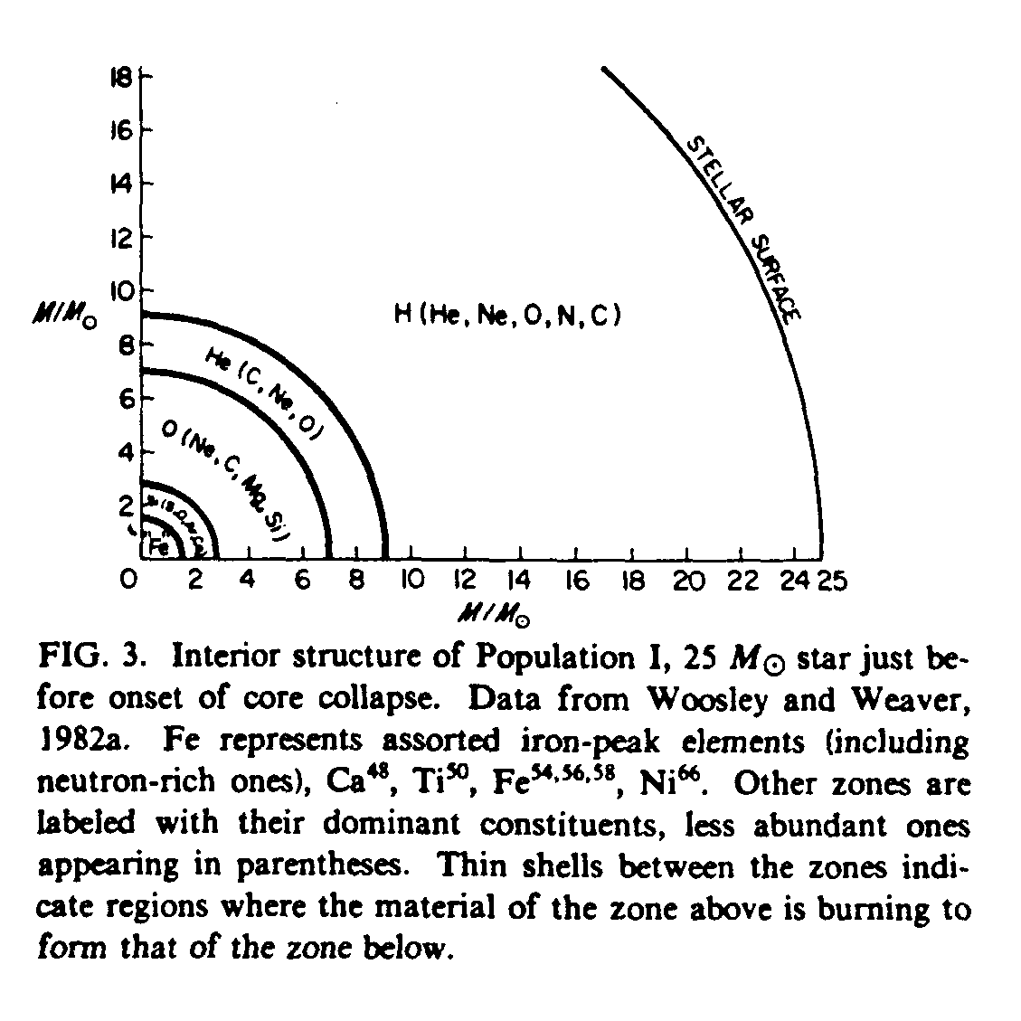

Slide 9
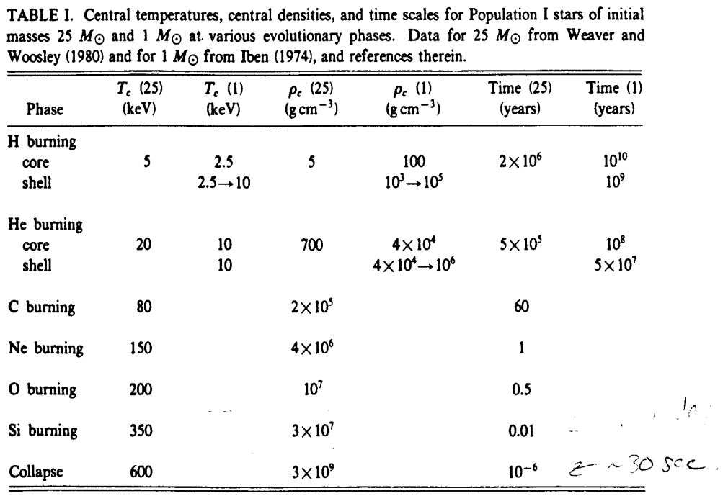

Slide 10
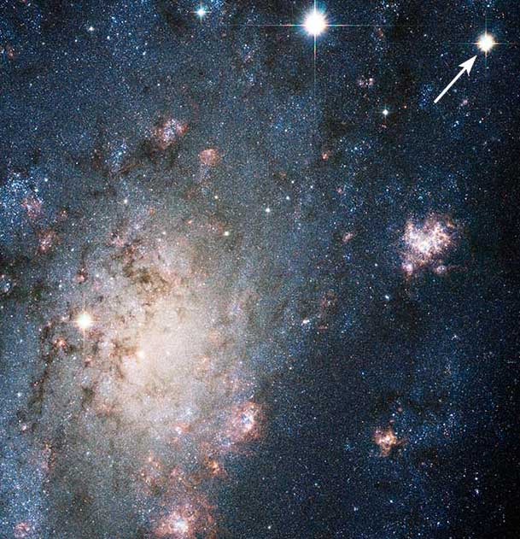
Supernovae Type II (young massive stars)

Slide 11
White Dwarfs
Non-relativistic degenerate electrons
Relativistic degenerate electrons

Slide 12
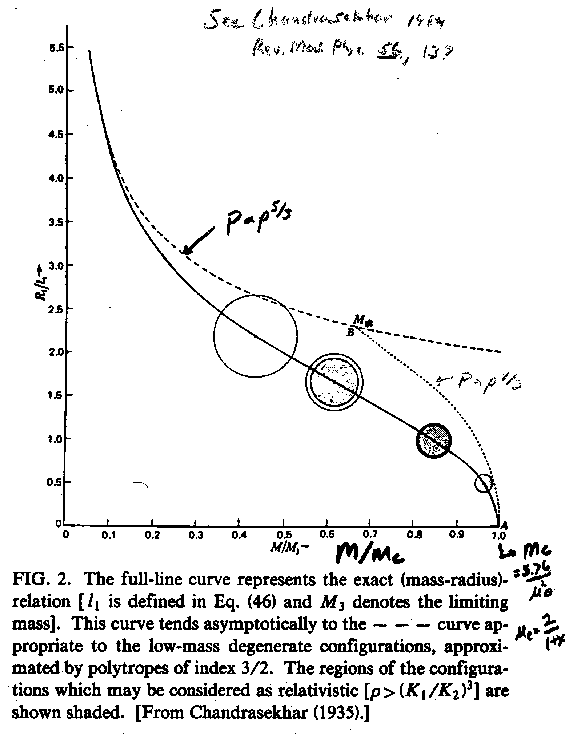
Mass-Radius Relation & Chandrasekhar Mass
NOTE!

Slide 13
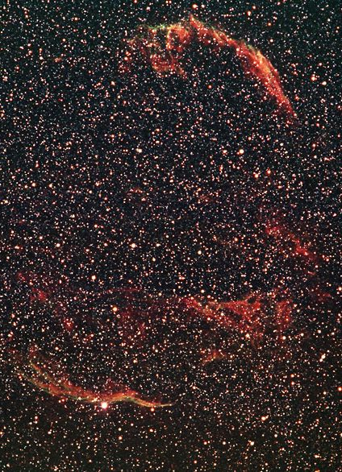
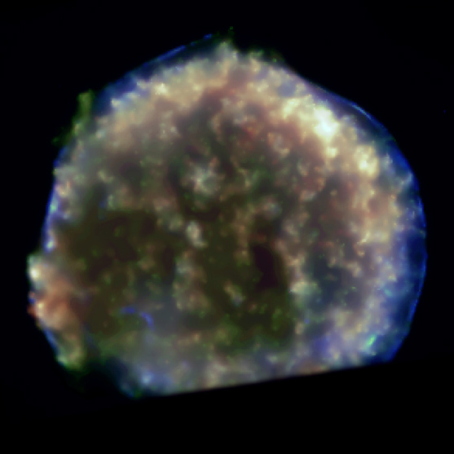
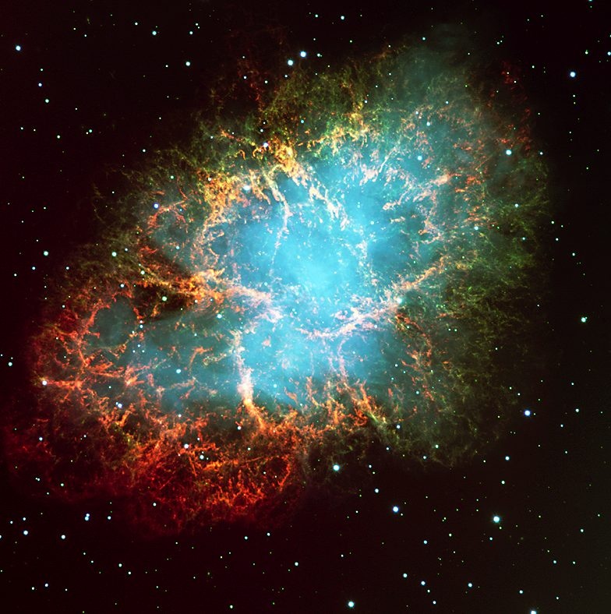
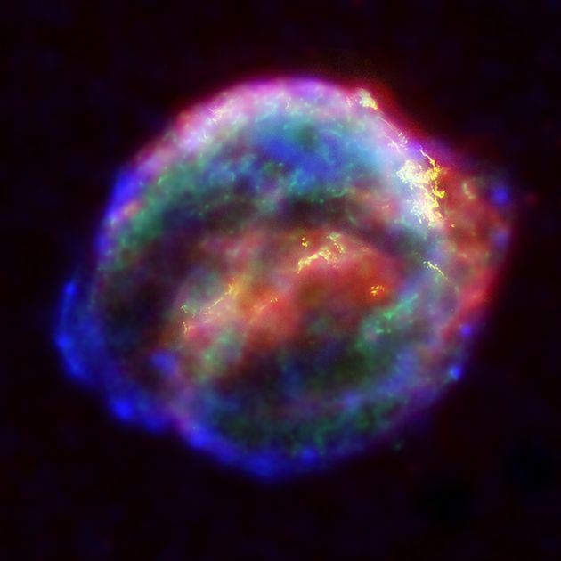
“Veil Nebula”
Tycho’s SN
(X-rays - Chandra)
Massive Stars - Post-Collapse
Cygnus Loop
Plus “Supernova Remnant” (SNR)
Crab Nebula (visible light - VLT)
Kepler’s SN (X-rays - Chandra)

Slide 14
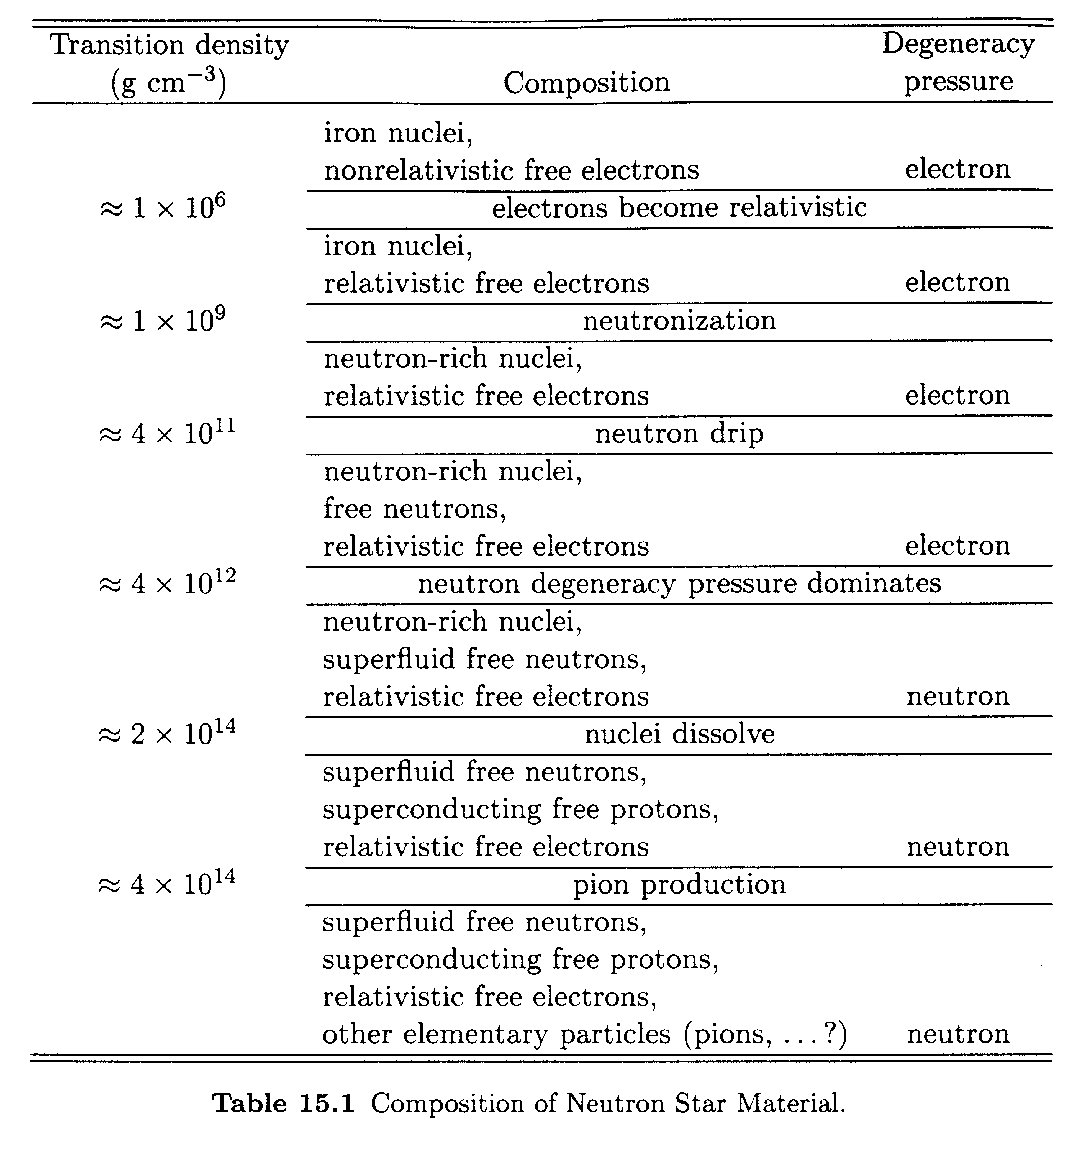
Neutron Stars

Slide 15
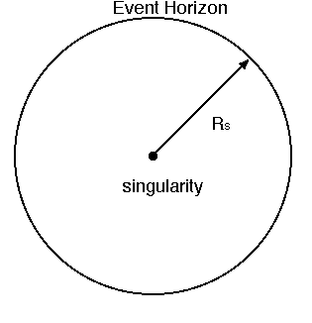
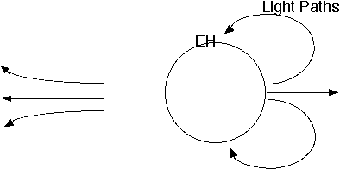
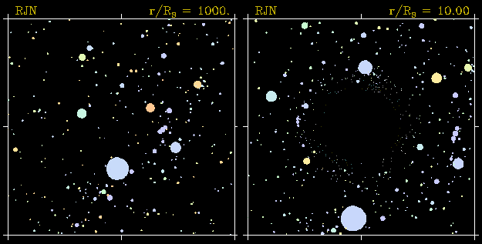
Black Holes

Slide 16
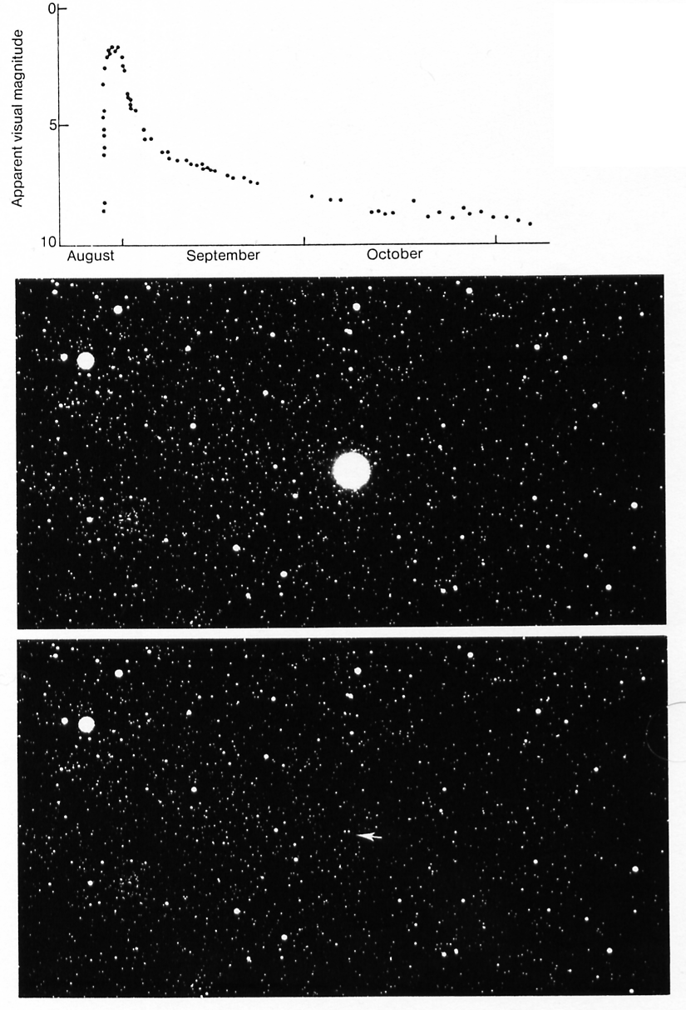
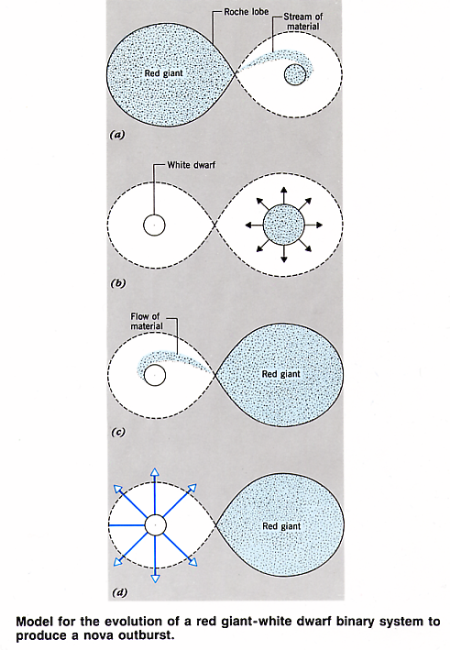
Novae (plural of nova)
Nova Cyg 1975

Slide 17
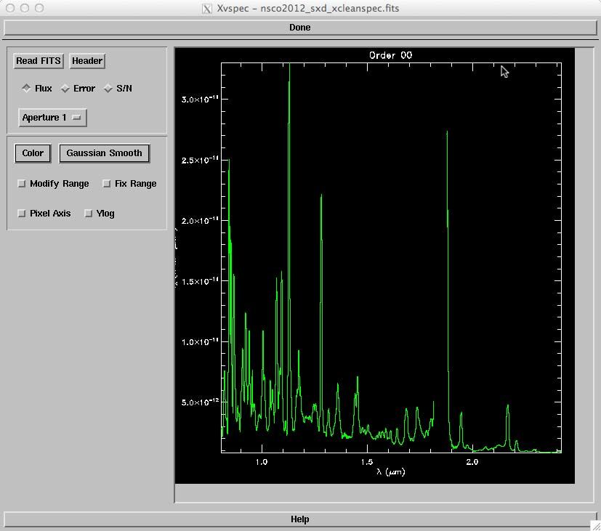
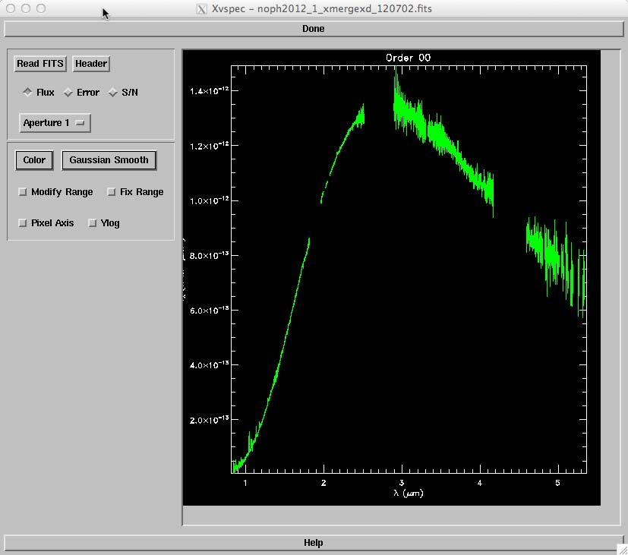
Examples of spectra of novae at near IR wavelengths
gas emission lines
dust production

Slide 18
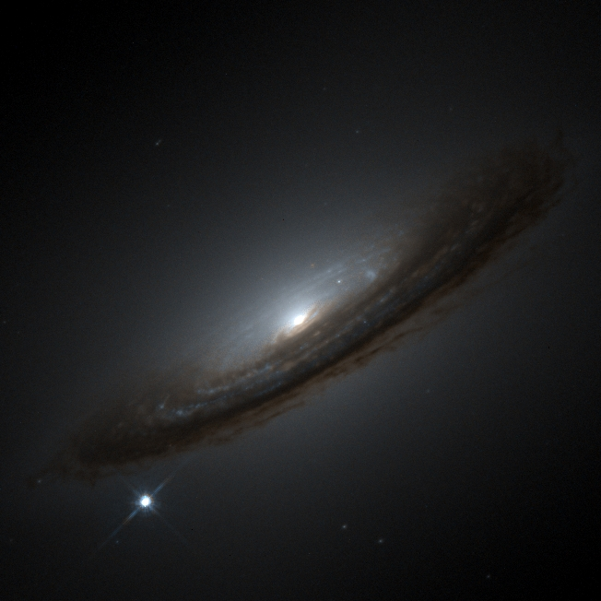
Supernovae Ia
Accretion onto WD sends it over the Chandrasekhar Limit
Animation SN Ia
One problem: getting these to actually explode the right way has been a challenge.
I recent years, the idea of colliding white dwarf stars in binary, or better yet, triple star systems has become much more attractive.

