Slide 1
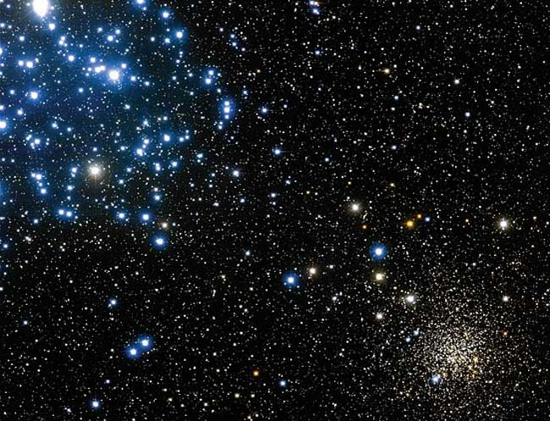
6 - Stellar Evolution-I

Slide 2
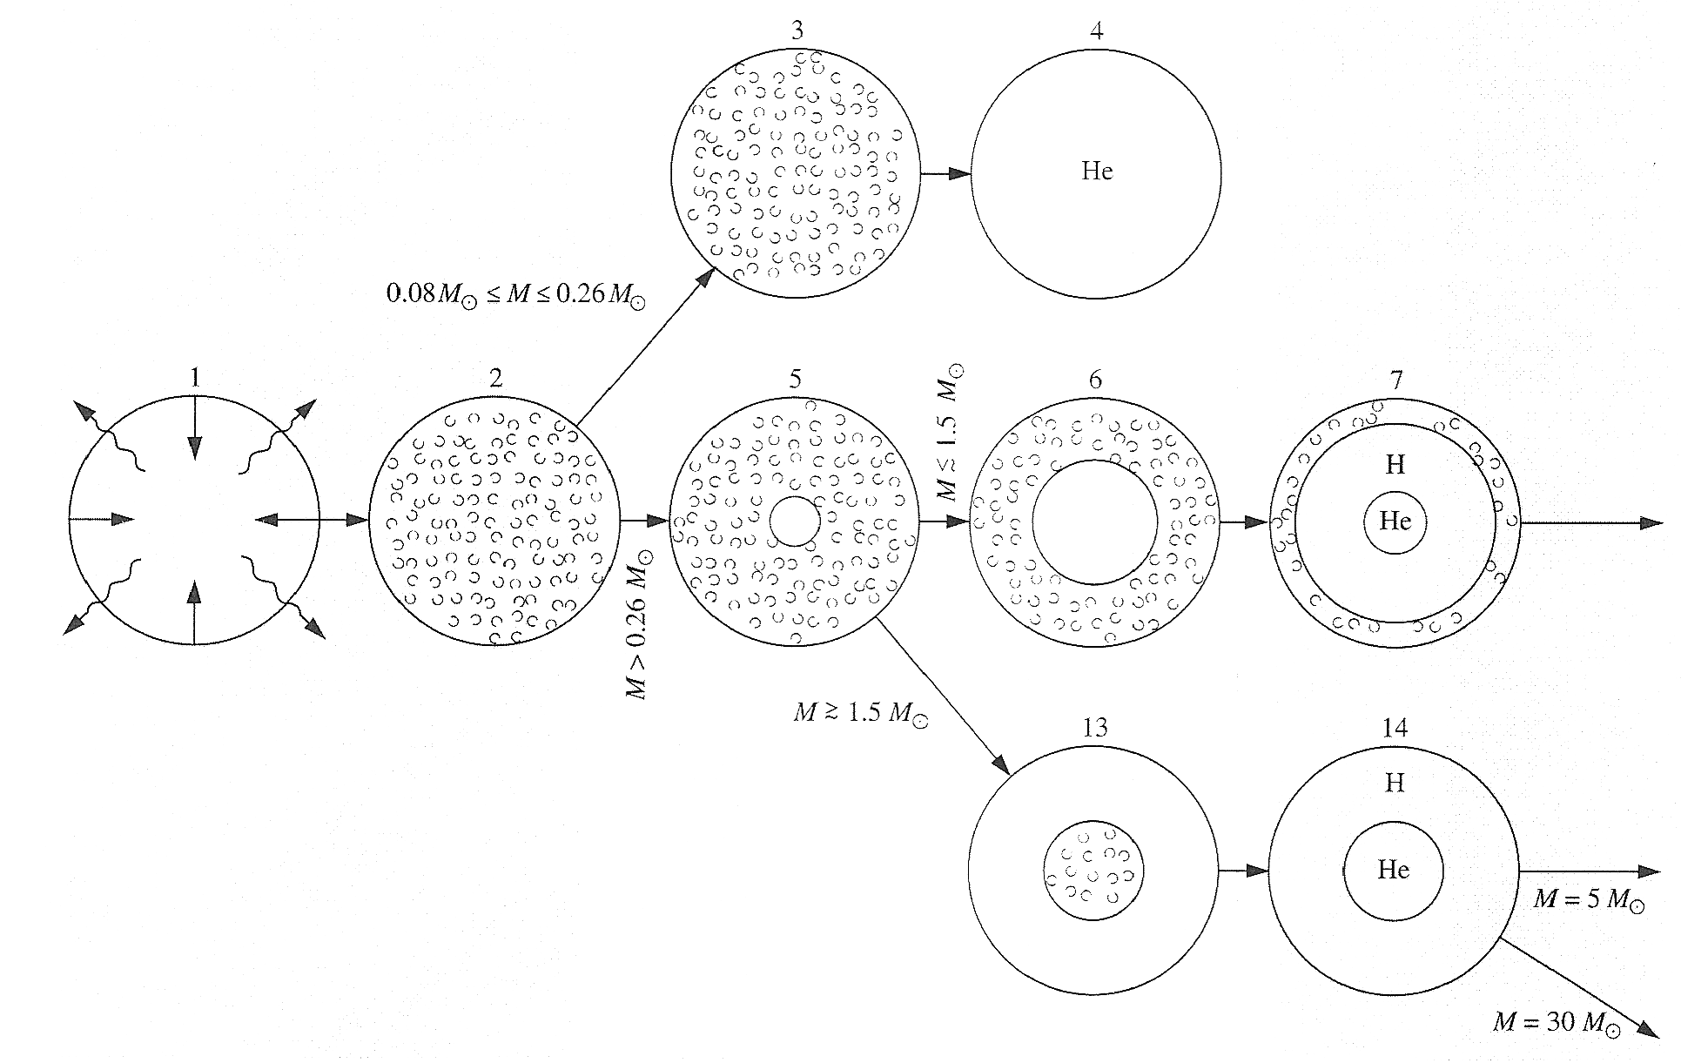
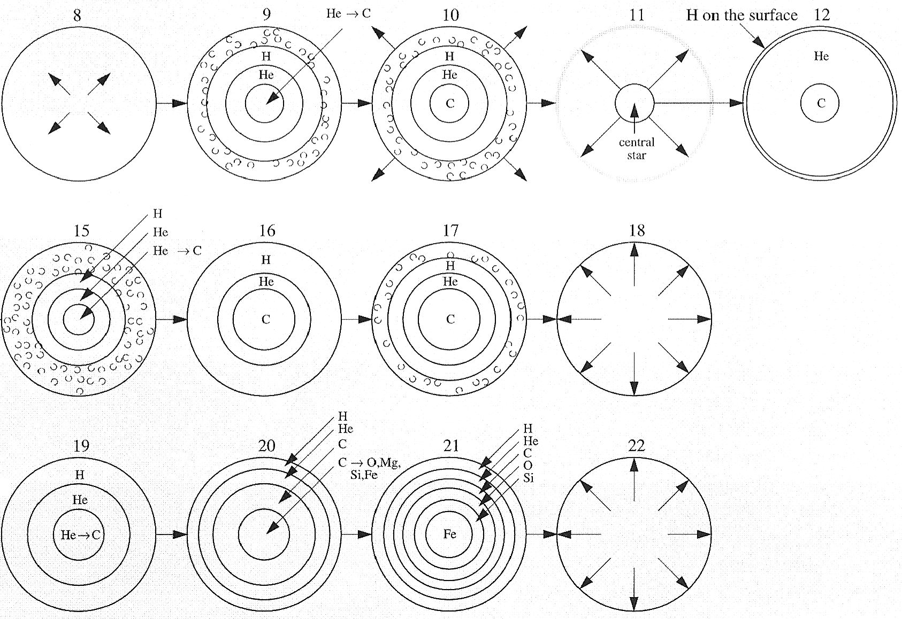
The life history of a star is determined by its mass…..

Slide 3
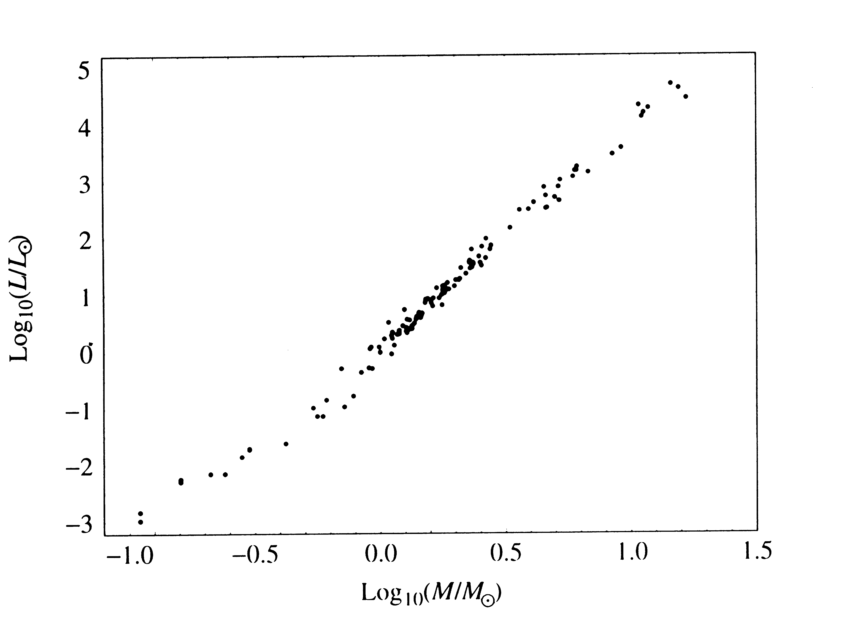
First fuel in stellar cores is hydrogen “burning” via pp or CNO reactions. The rate of energy production is:
If the fuel available for before the structure changes is, say, 0.1 M*, then the lifetime
of the star (the time over which this can occur) is:
From the mass-luminosity relation for MS stars (of solar mass and somewhat larger):

Slide 4
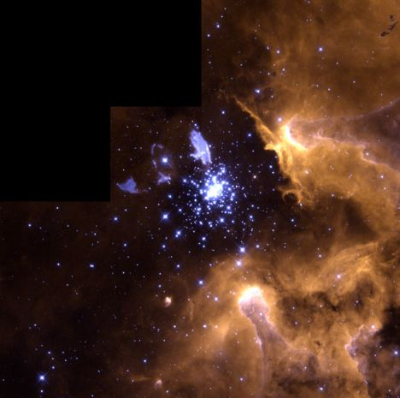
2 Important Basic Conclusions:
We should expect any very massive star to be young, and found near its place of formation.

Slide 5
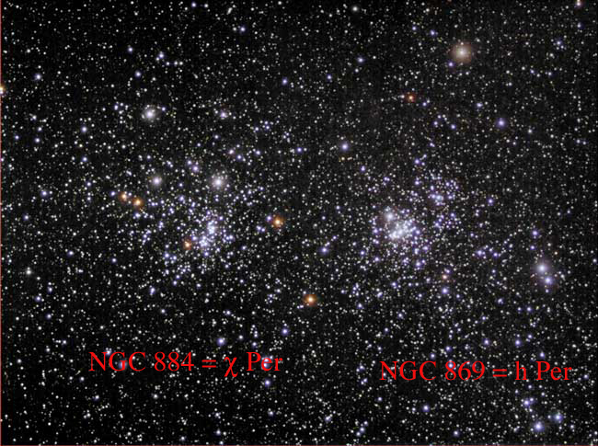
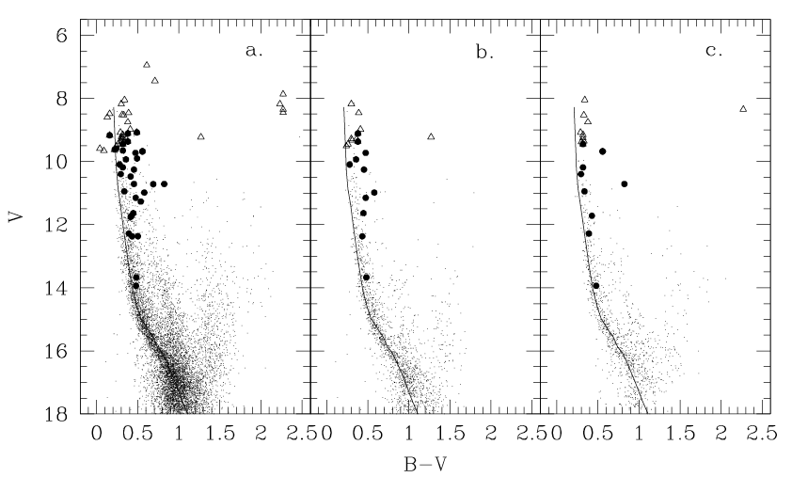
For a group of stars formed at the same approximate time, the more luminous ones should evolve faster than the less-luminous ones.

Slide 6
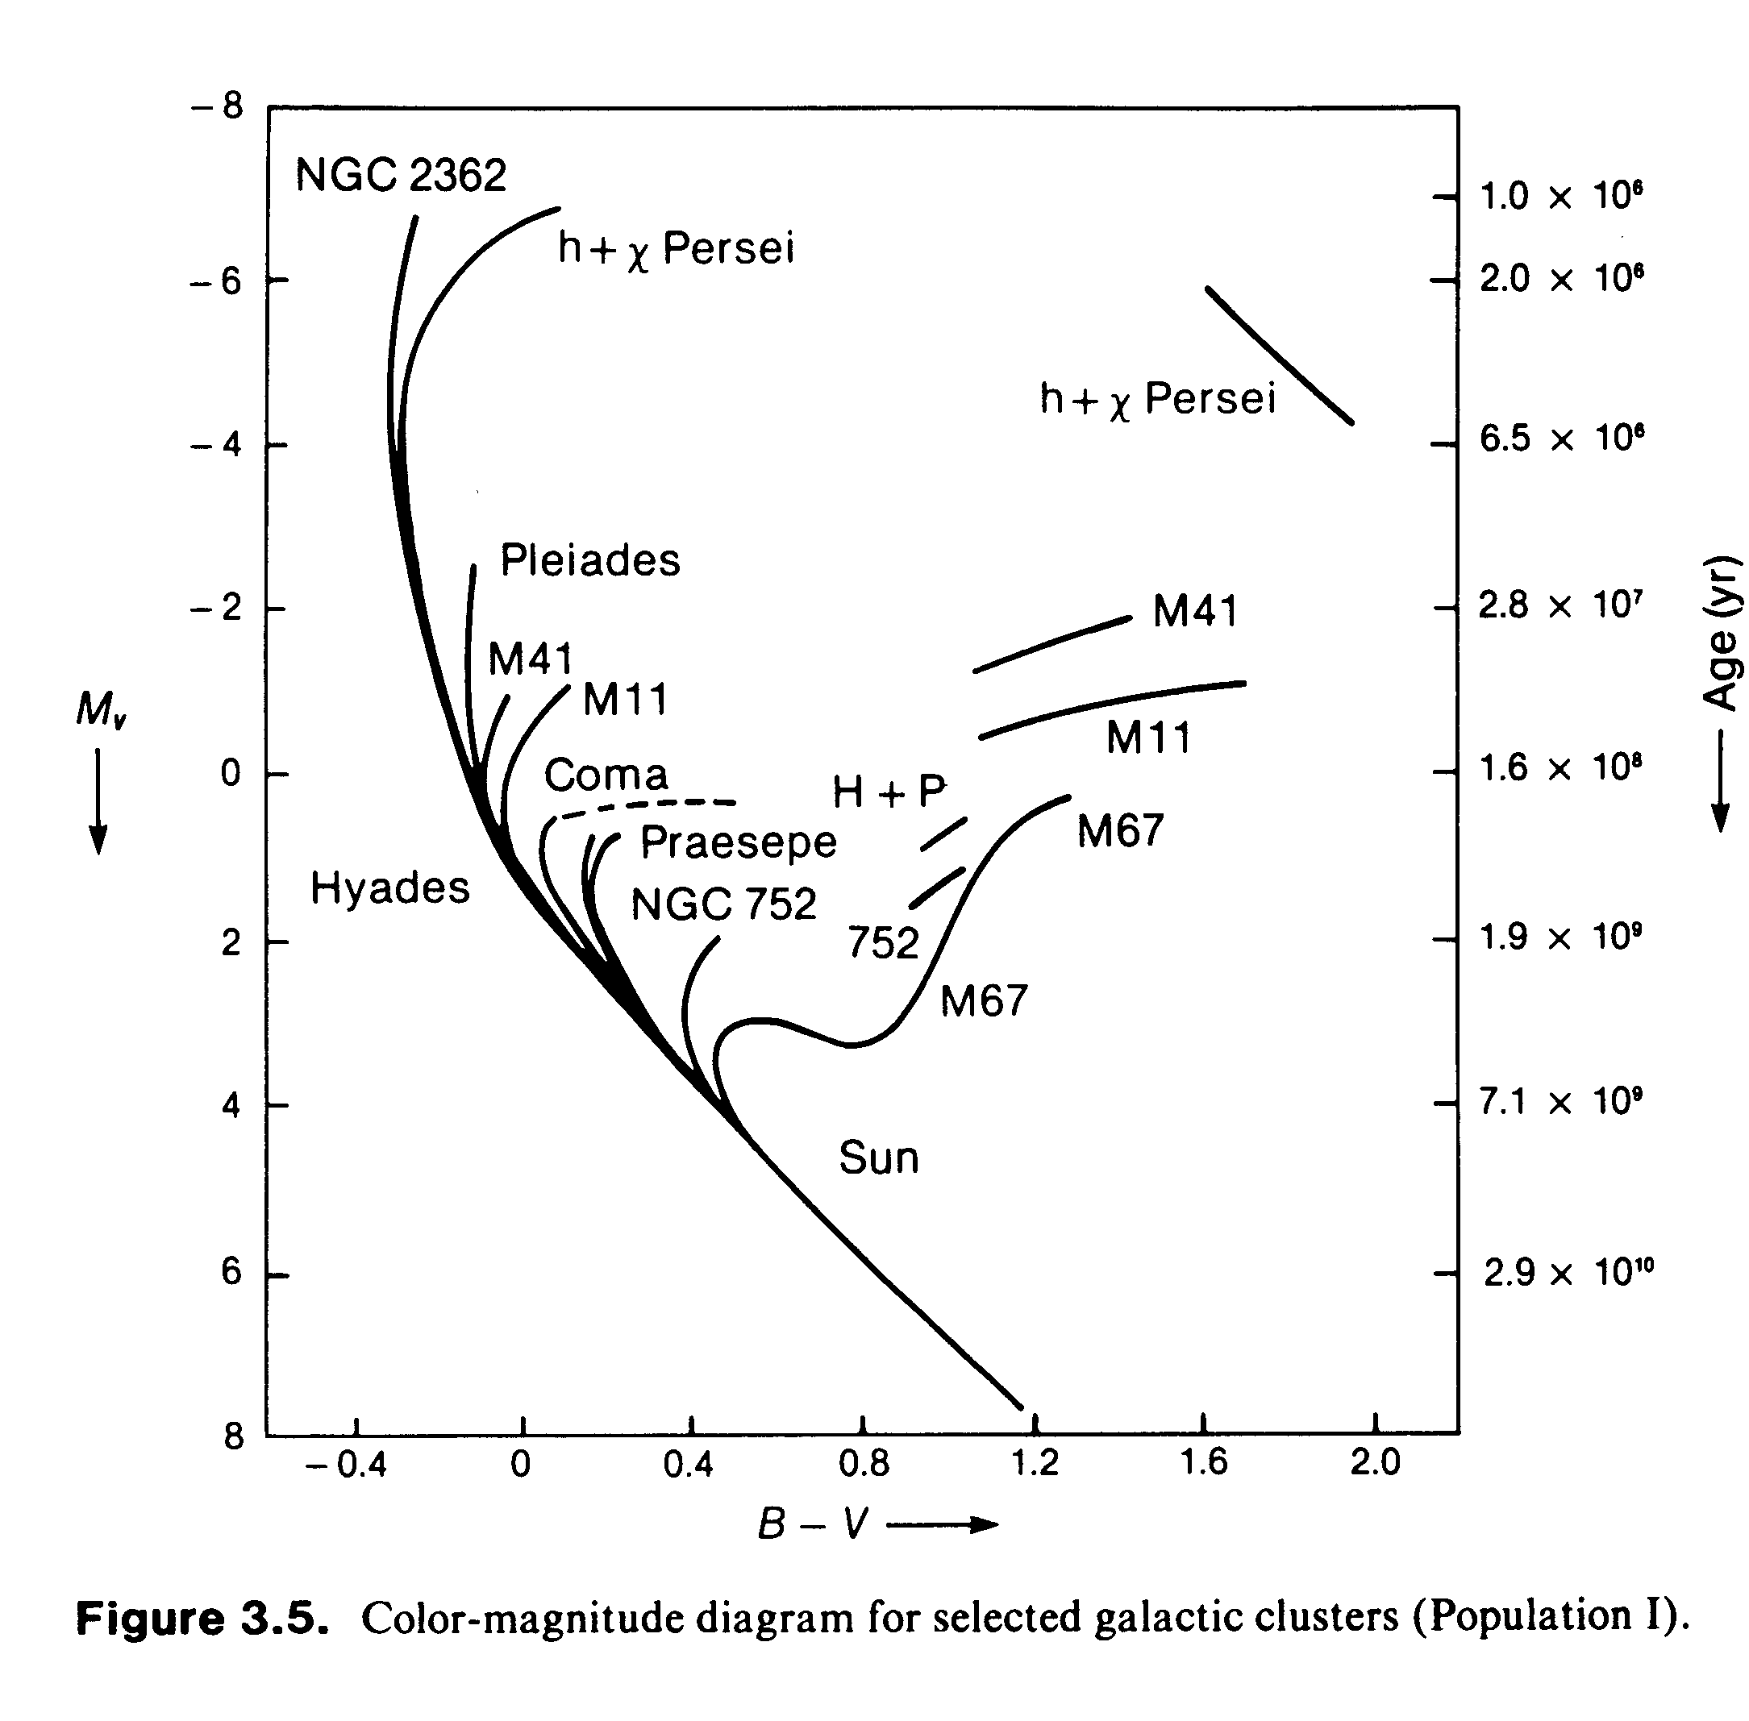
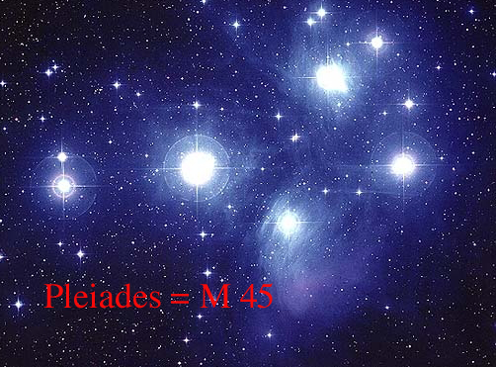
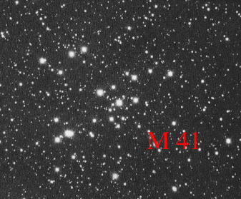
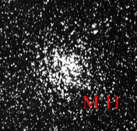
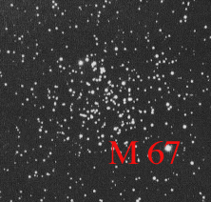

Slide 7
Why Do Stars Evolve?
Nuclear fusion changes the chemical composition of the core, which in turn changes the mean molecular weight μ, which governs the equation of state.
For a star like the sun where the energy generation goes as
It can be shown that for a chemically uniform star the surface T and net L go approximately like:

Slide 8
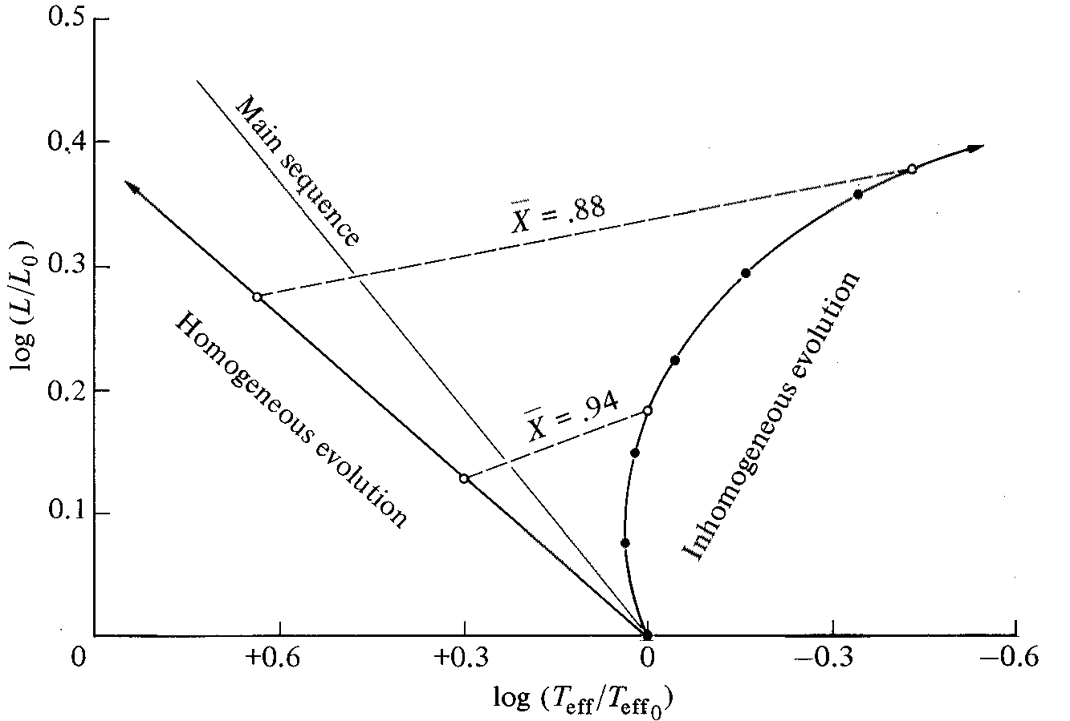
Homogeneously-mixed stars should evolve toward upper left. But real stars are stratified chemically…..

Slide 9
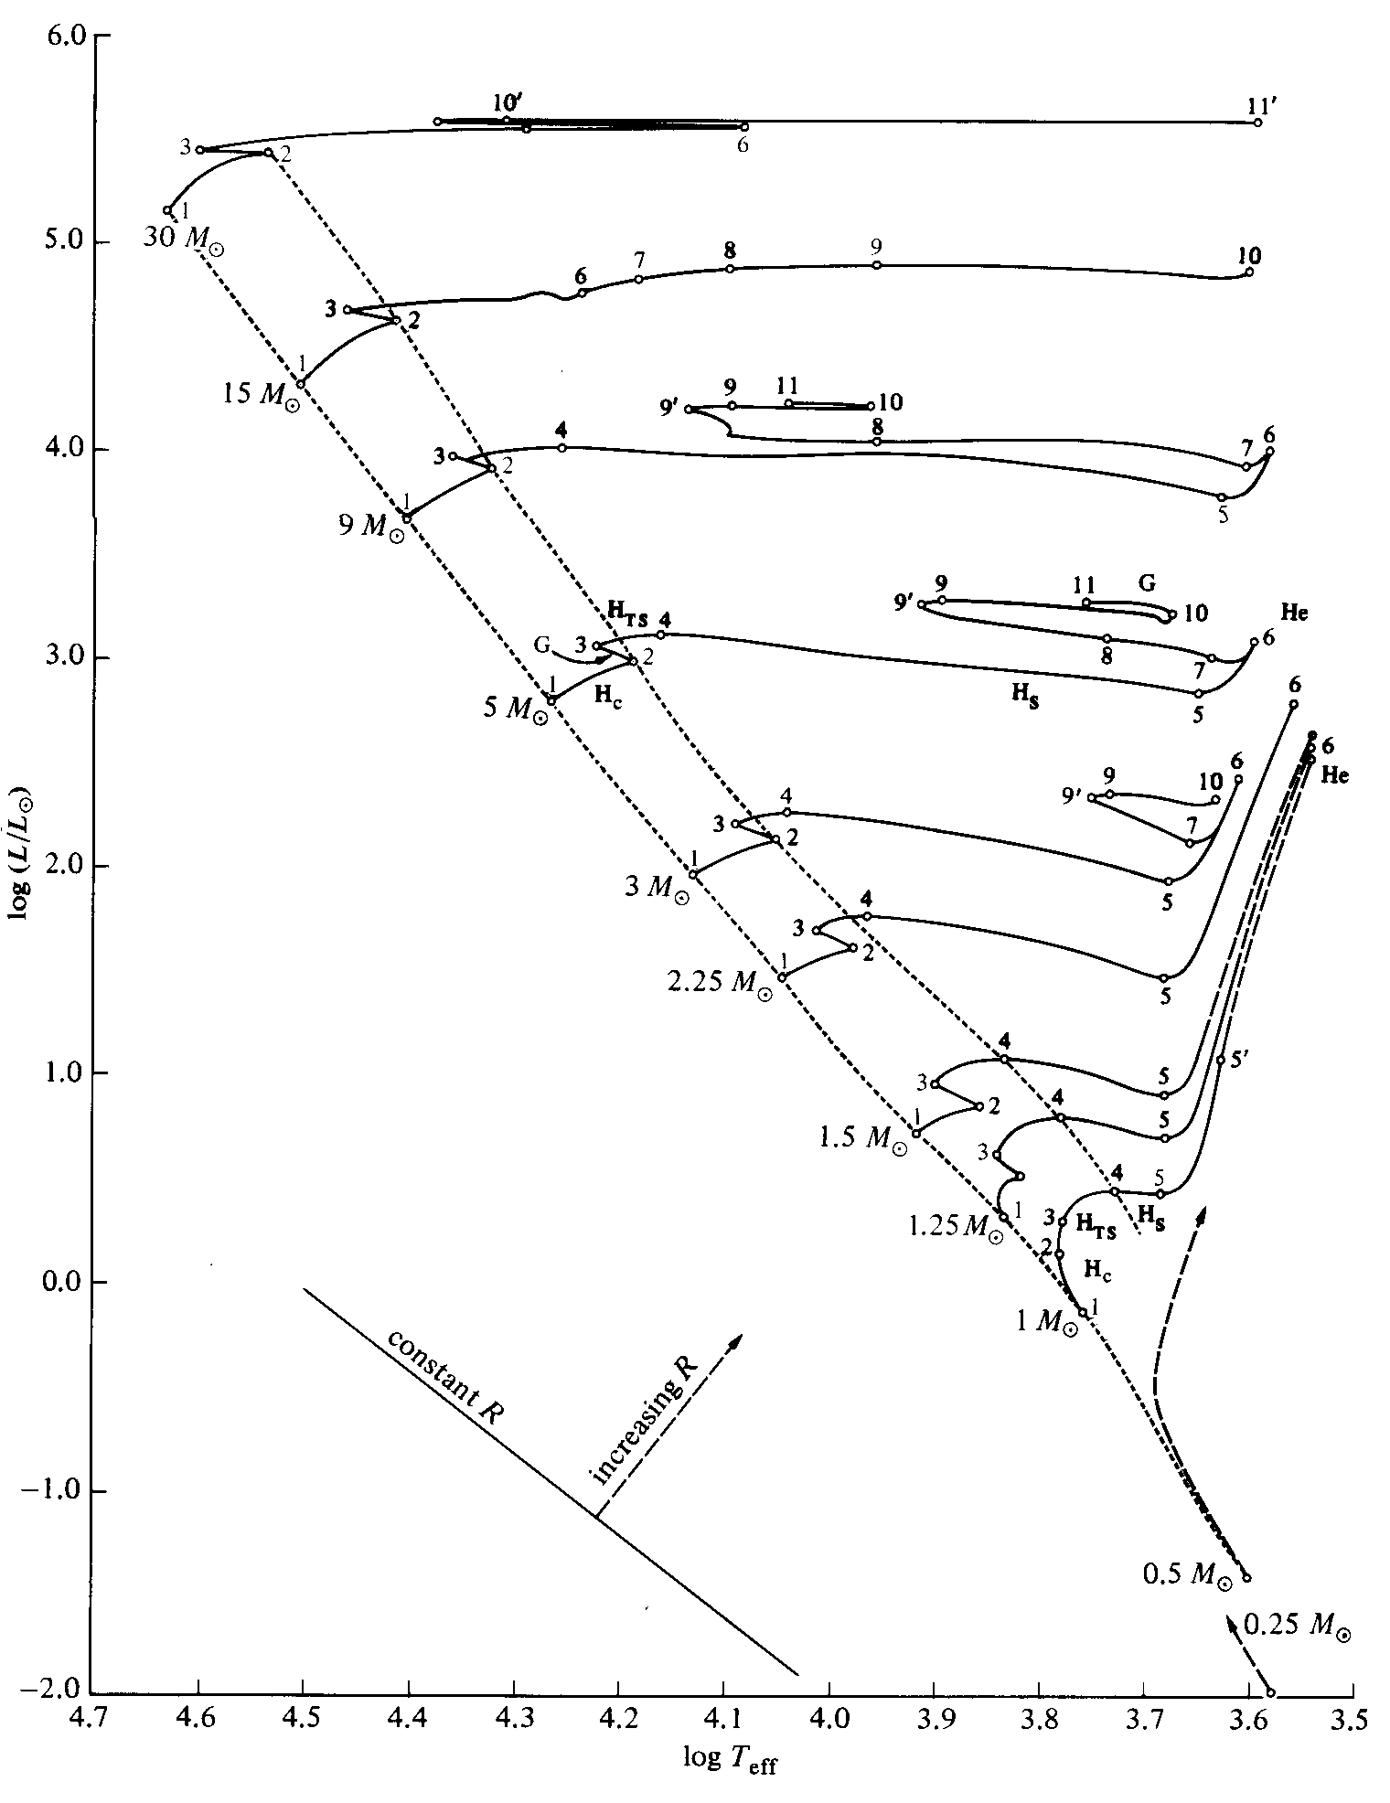
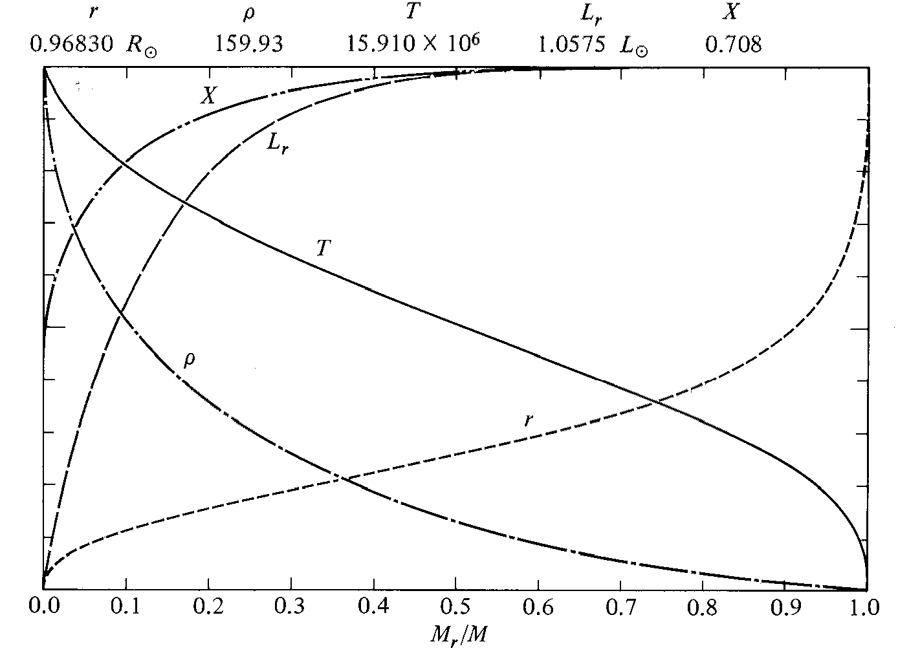
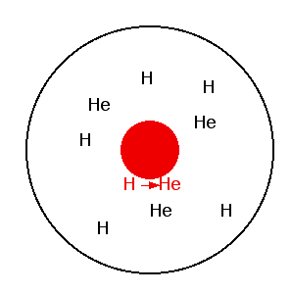
ZAMS
Low-mass Stars:
Radiative cores
Convective envelopes

Slide 10
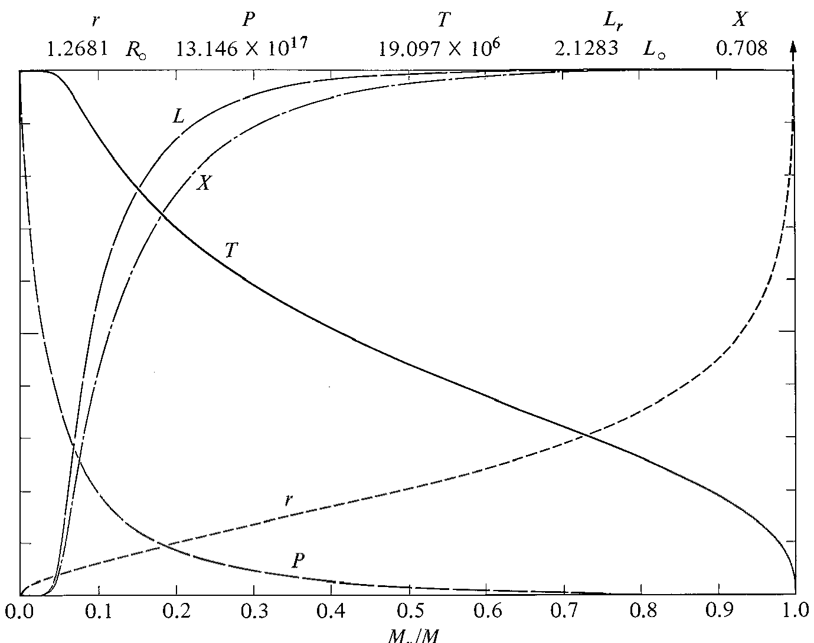
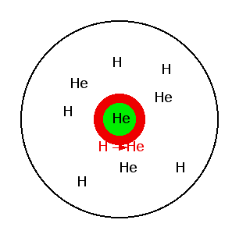

Slide 11
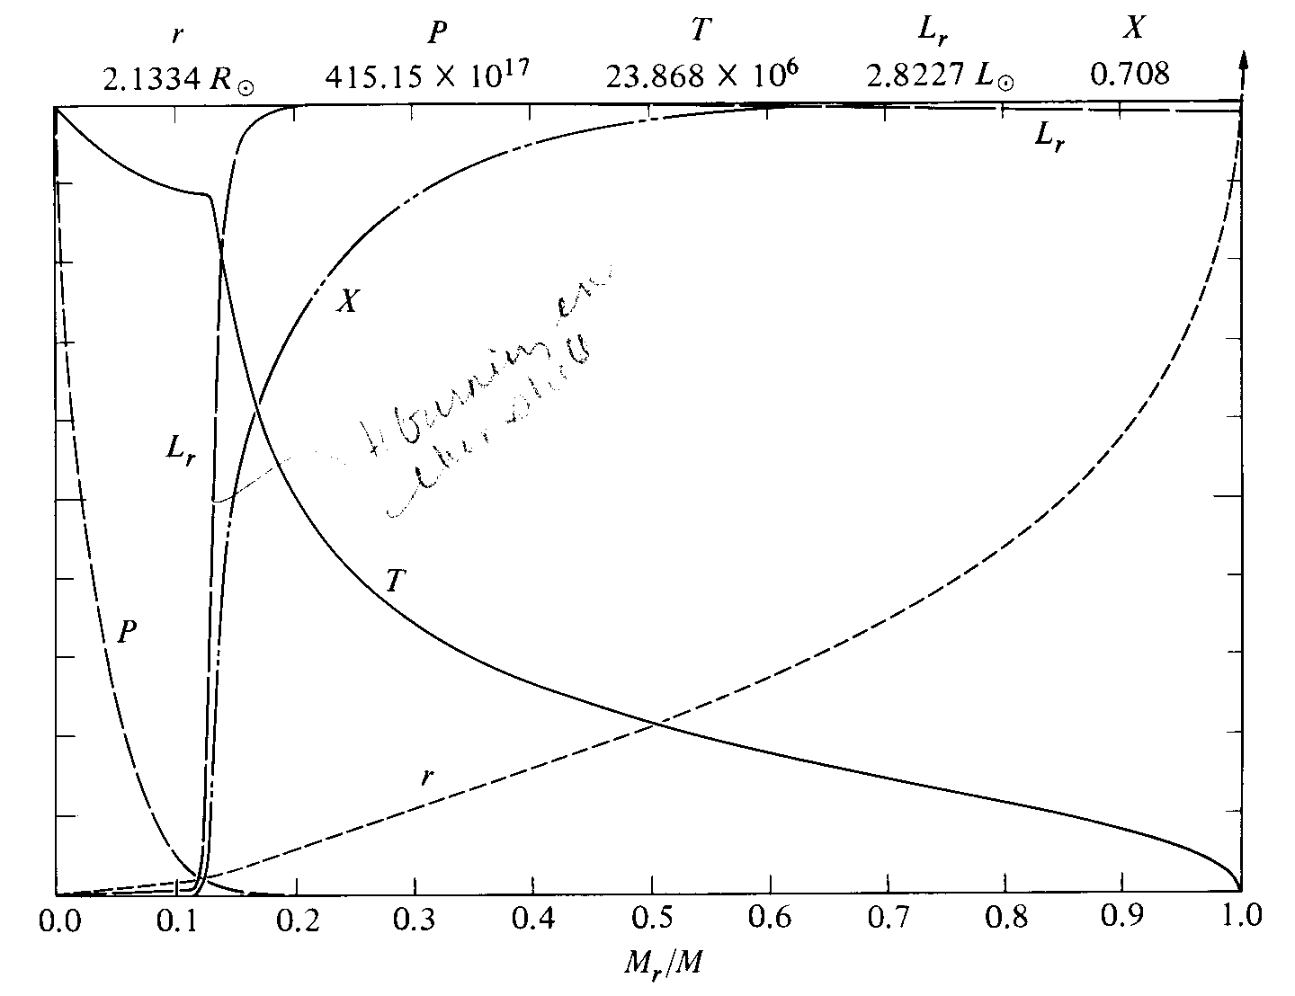
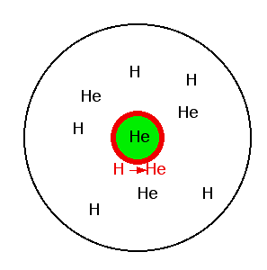

Slide 12
“to flash, or not to flash….”
Lower-mass stars - He-ignition begins in electron degenerate core
Heating does not expand the gas in the core, merely raises T, increasing reaction rates
Explosive reaction ensues - “He (core) Flash” - core briefly reaches ~10¹¹ L_{sun}?? (NOTE: This is not visible to the outside observer)
Degeneracy is lifted and “normal” He-burning follows.

Slide 13
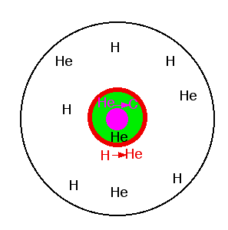
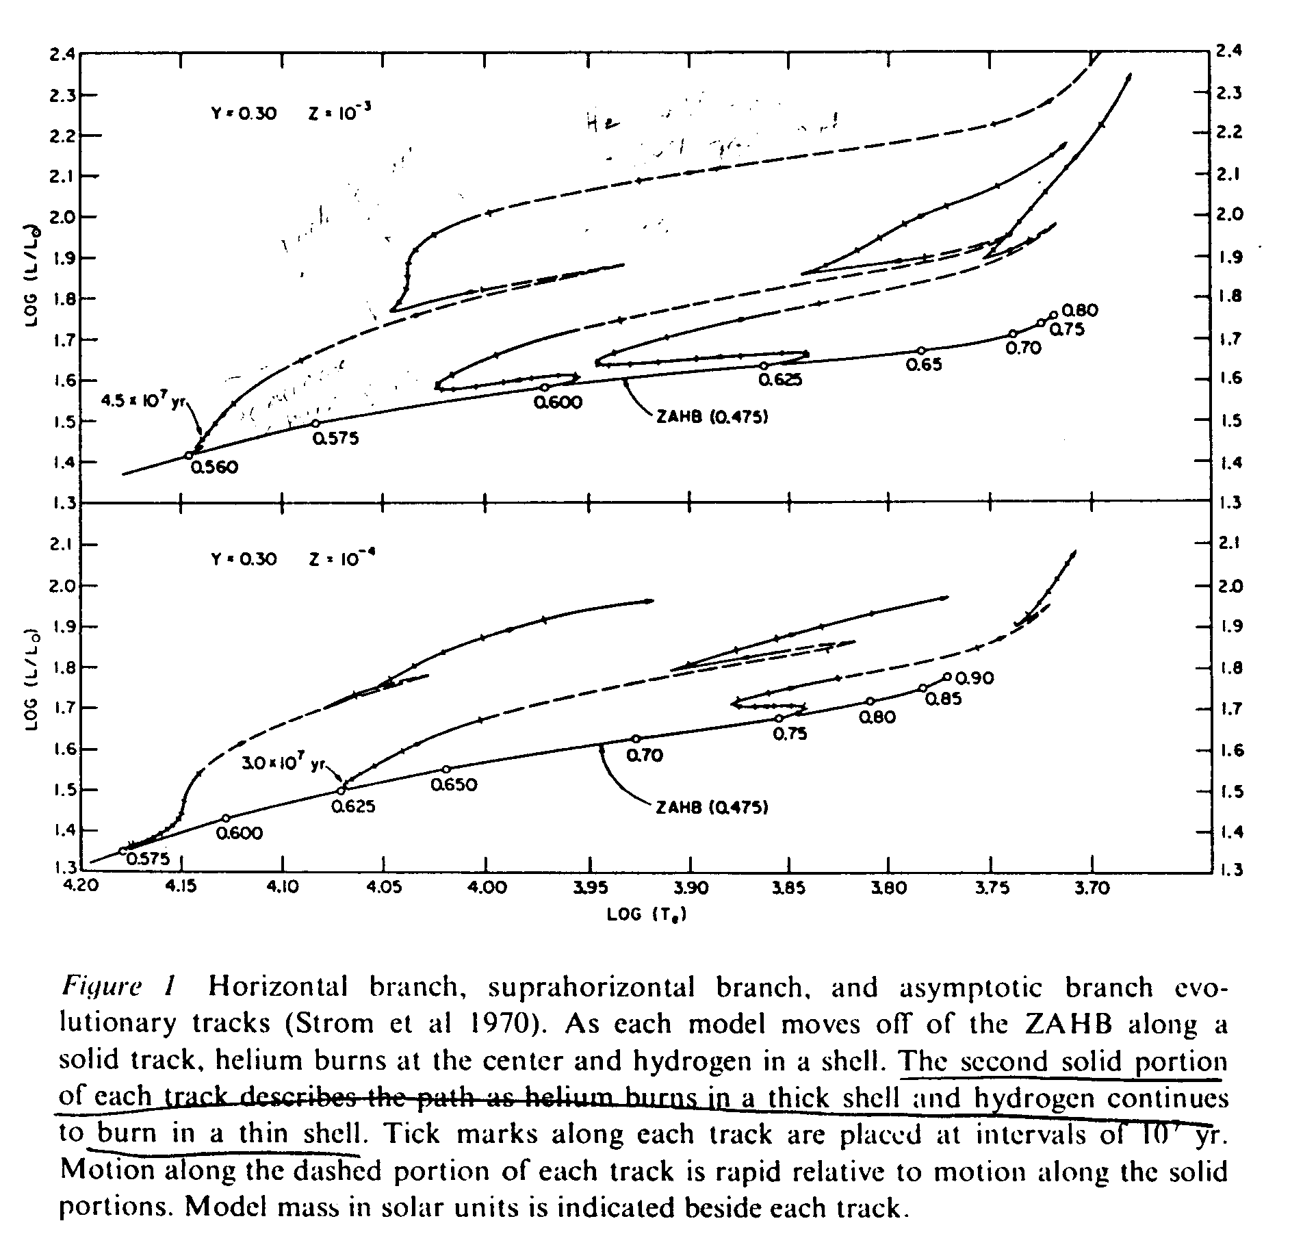
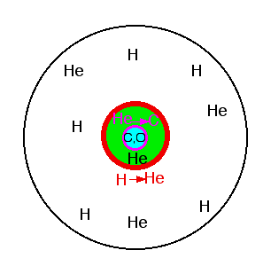
“Horizontal Branch”

Slide 14
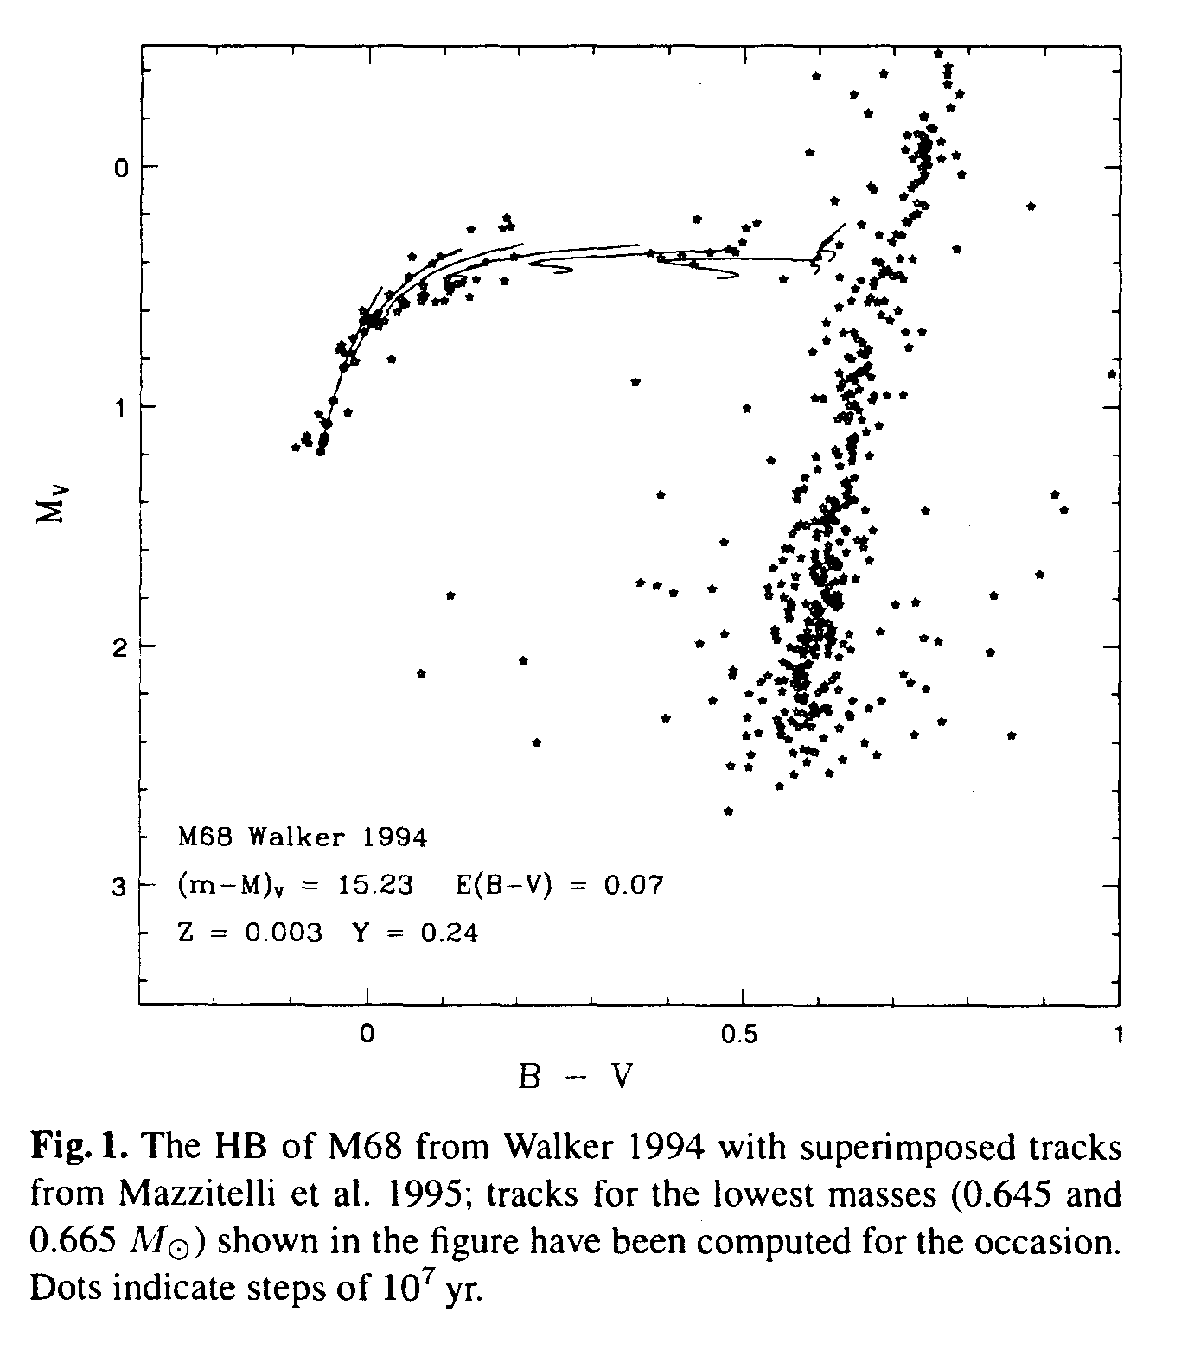
Instability Strip (Cepheids & RR Lyrae Stars)

Slide 15
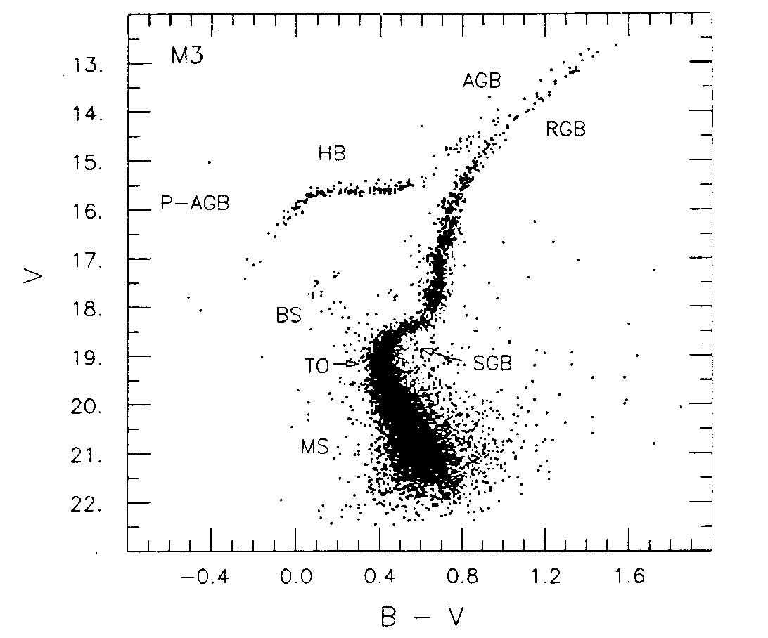
Asymptotic Giant Branch (AGB)

Slide 16
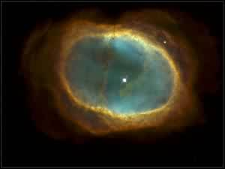
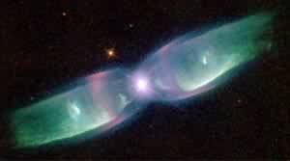
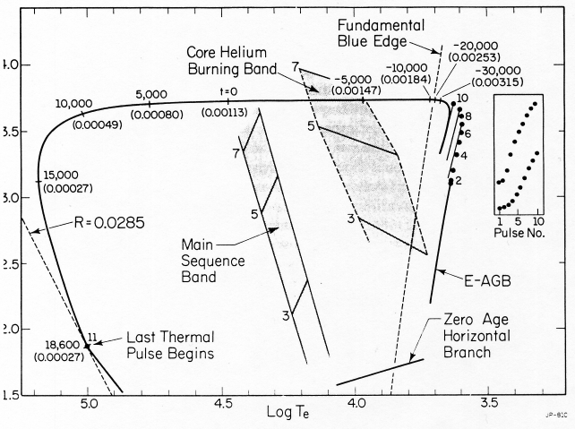
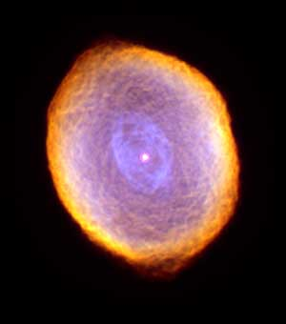
Mass in H-rich envelope

Slide 17
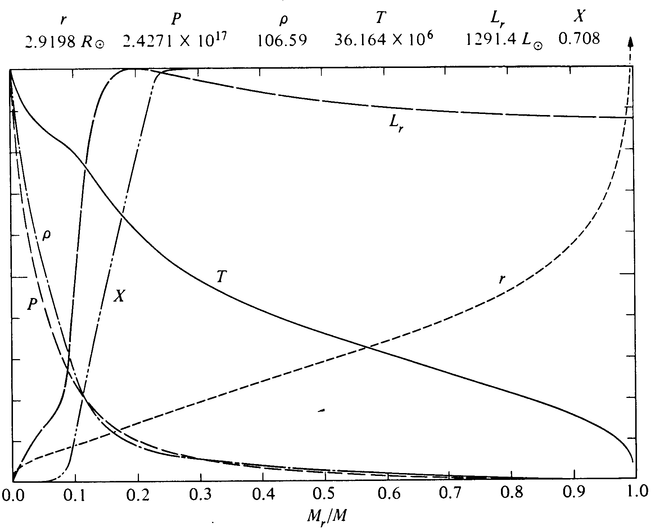
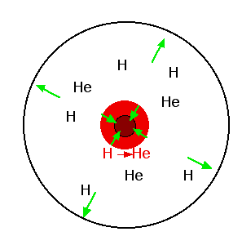
Massive Stars:
Convective cores
Radiative envelopes

Slide 18
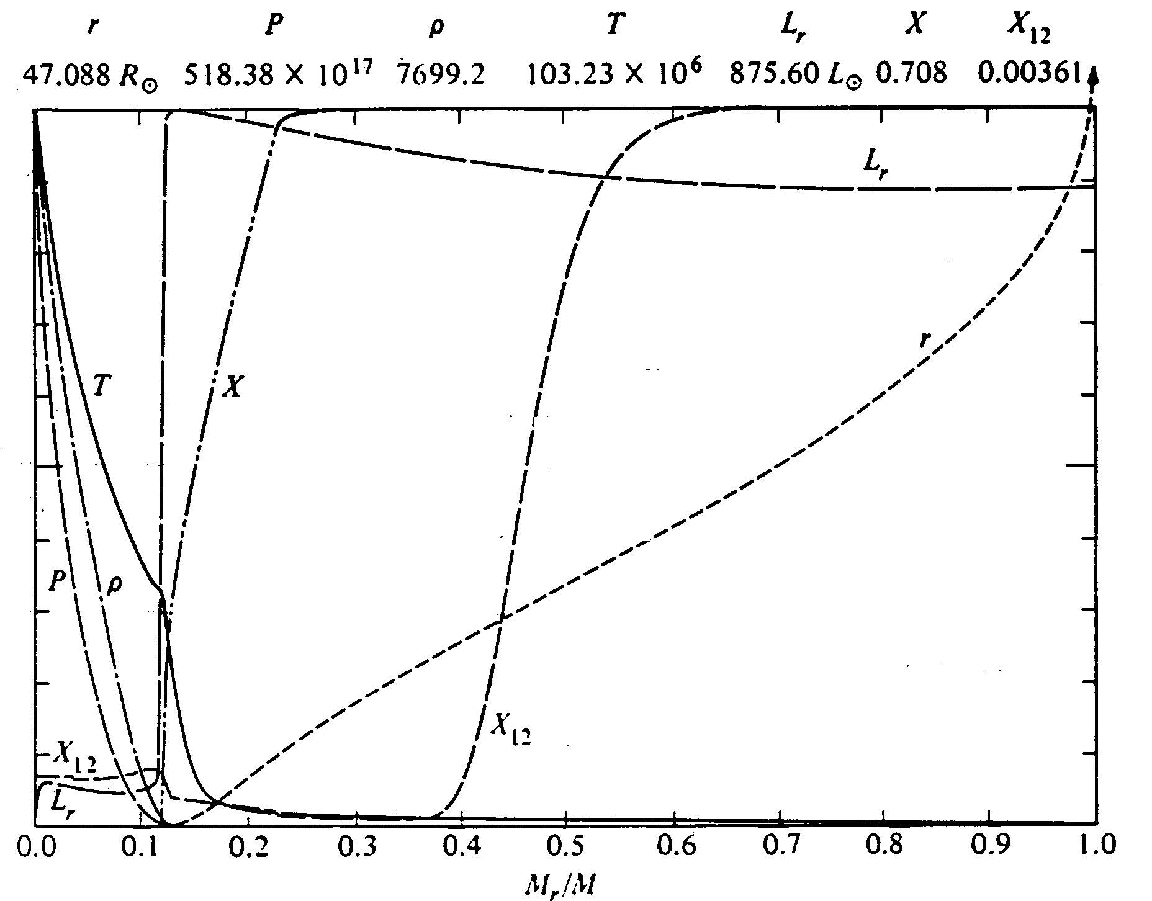

Slide 19
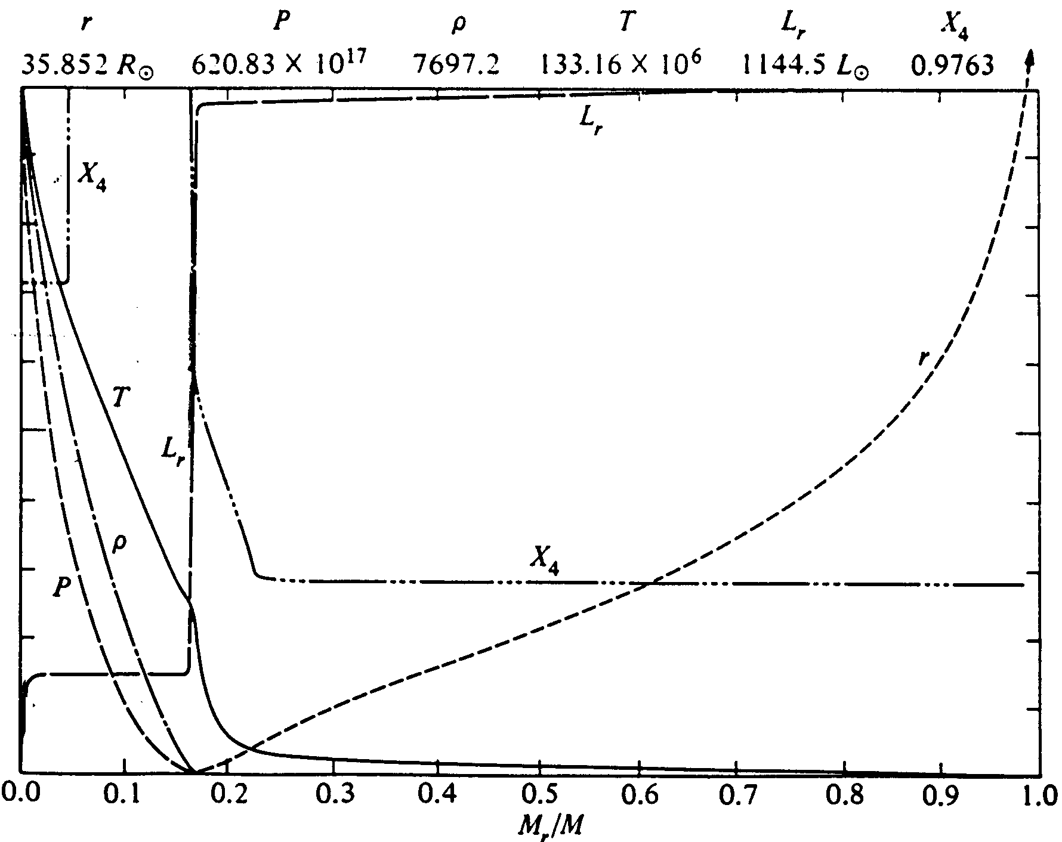
convective core

Slide 20
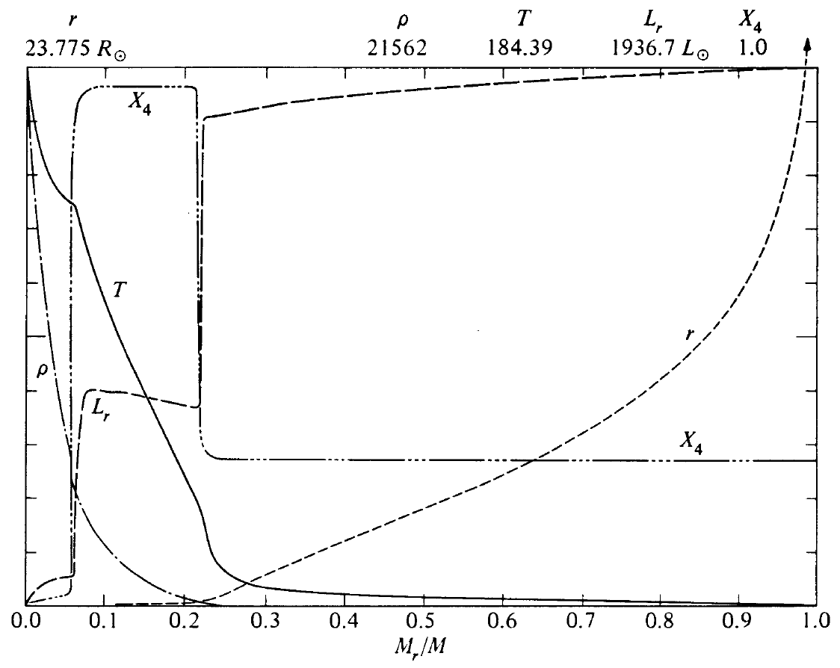

Slide 21
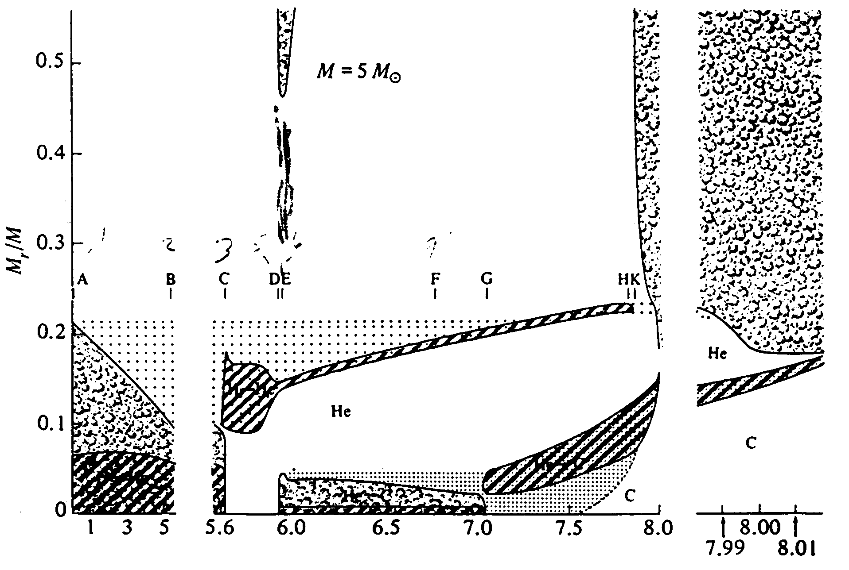
3rd dredge-up on its way!
1st dredge-up
2nd dredge-up
Time (units of 10⁷ years)

