Slide 1
Ch. 22 Cosmology - Part 1
The Beginning

Slide 2
Beginnings
???? - Newton suggested that for the stars not to have coalesced, the universe must be infinite and static.
1823 - Olbers - noted that in an infinite universe, every line of sight intercepts a stellar surface, so the sky should be as bright as the Sun. It Is Not - Olbers’ Paradox.
1901 - Kelvin realizes that universe would need to be 10¹⁴ pc in size and about 3x10¹⁴ years old for light from most distant star to reach us. Olbers’ Paradox is avoided if these conditions are not met. (Note: Same viewpoint elucidated in 1848 by american poet Edgar Allen Poe!)

Slide 3
Basic Model Assumptions
Universality of Physical Laws and Constants
Homogeneity
Isotropy
1+2+3=“Cosmological Principle”
4. Uniformity with Time
1+2+3+4=“Perfect Cosmological Principle” - ruled out!

Slide 4
Early Timeline
~1914 - Slipher publishes work on velocities of galaxies
1915 - Einstein solves structure of the universe, believed to be static, using GR. This closed, static, geometrically “spherical” model requires a repulsive term, “the cosmological constant” Λ to offset gravity.
1917 - de Sitter also solves structure of universe including expansion
1922 - Friedmann develops general solution to a GR universe which is homogeneous, isotropic, but not static.
~1927 - Lemaître proposes an exploding “Primeval Atom” to explain the origin of cosmic rays - expanding spherical model with a cosmological constant.
1929 - Hubble & Humason publish work on expanding universe. Einstein retracts cosmological constant, no longer needed.

Slide 5
Implications of the Hubble Law
The universe is expanding
All observers see the same expansion
Everything was closer together, denser, in the past
t₁
t₂

Slide 6
Age of the Universe
If there is no acceleration,
H₀=v/R=1/t_{age} t_{age}=1/H₀ “The Hubble Time”
Hubble’s own value was H₀=550 km/s/Mpc implying t_{age}=2x10⁹ yrs. This was smaller than the age of the Earth, so this presented a problem!
Slope=H
Slope=1/H=t_{age}
v
R
R
v

Slide 7
The Basic Metric
In a static flat Euclidean spacetime, two events are separated by a space-time distance interval:
Δs² = (c Δt)² – (Δx²+ Δy²+ Δz²)
t
2
1
x
(note sign!!)
In a uniformly expanding universe, we may define the x, y, z as being “co-moving” with the objects in it, while the increasing distance between them is described by a scale factor R(t):
Δs² = (c Δt)² - R²(t)(Δx²+ Δy²+ Δz²)

Slide 8
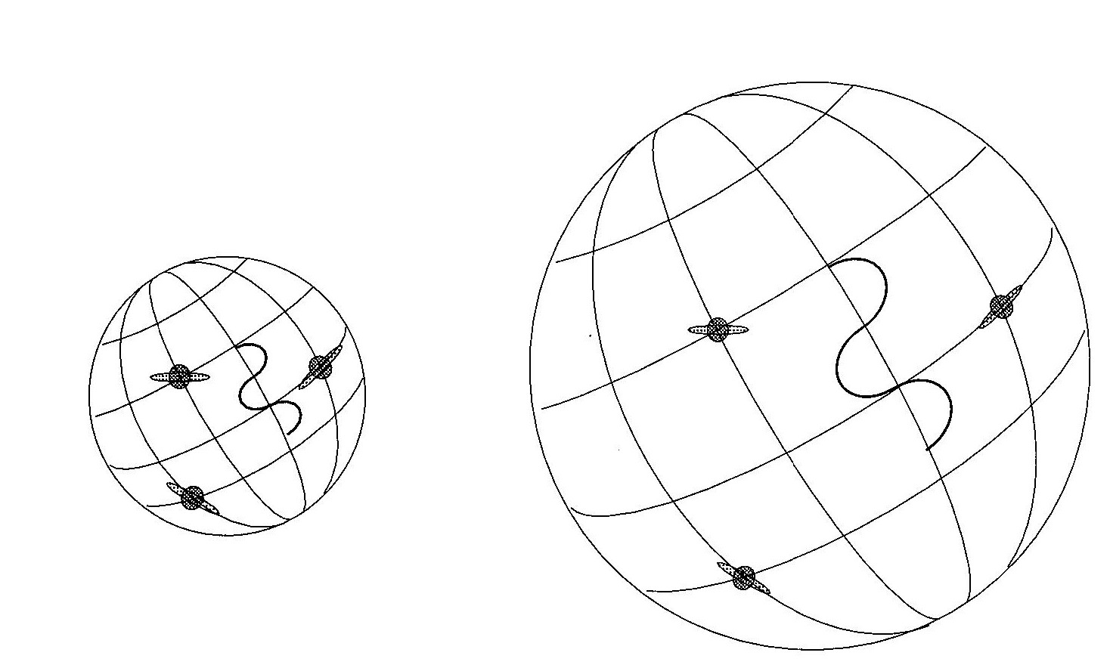
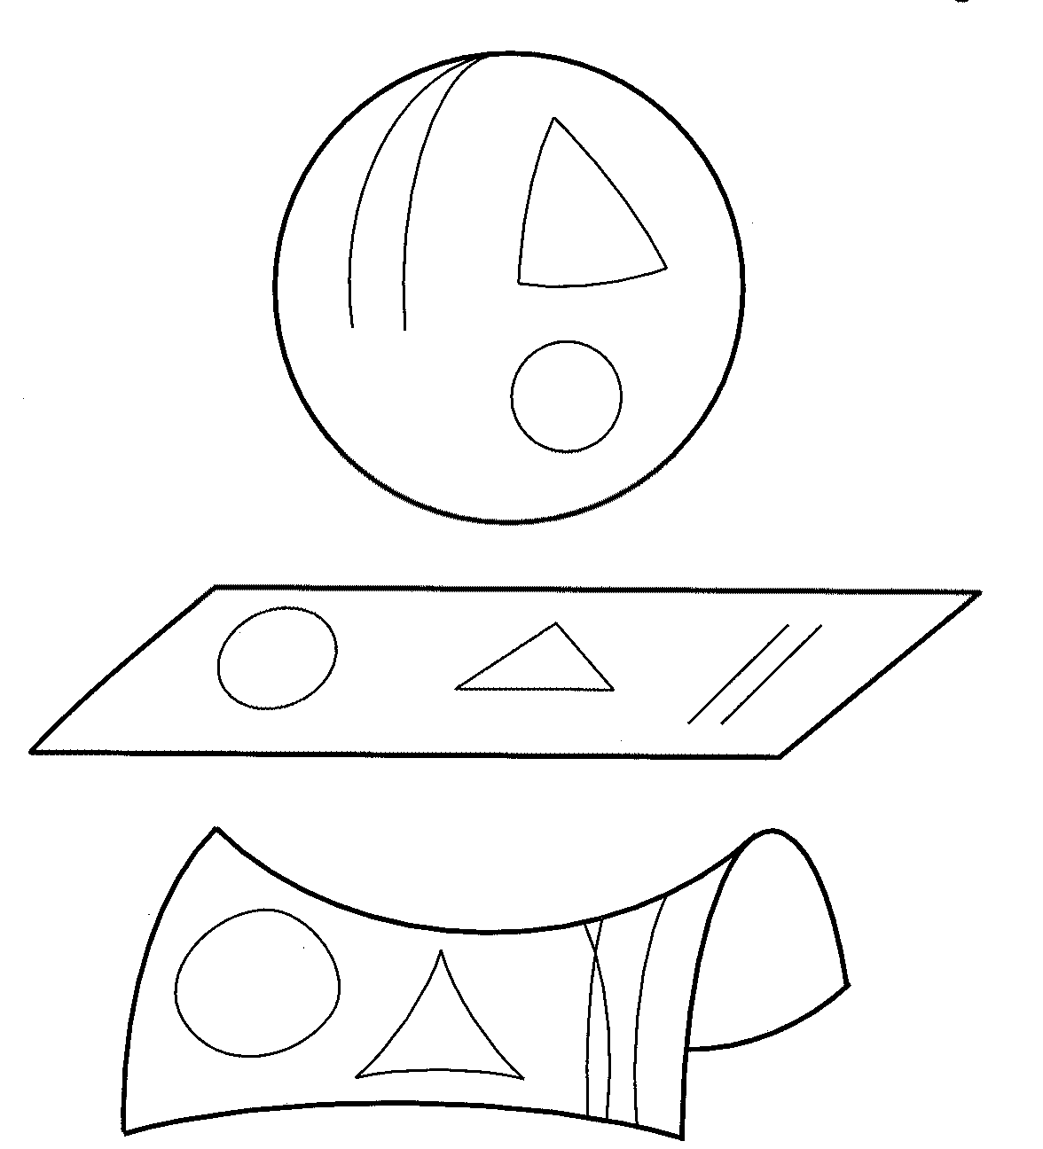
R(t) and the Cosmological Redshift
The Robertson-Walker Metric and Curved Spacetime
Curvature constant k:
k > 0 spherical geometry (as in above case)
k = 0 flat (euclidean) geometry
k < 0 hyperbolic geometry (“saddle-shaped”)

Slide 9
“Newtonian Universe”
v
m
R
M

Slide 10
3 General Possible Outcomes
The unique limiting value of the mass (or mass-energy) density ρ where E=0 is called the critical density ρ_{c:}
The model with ρ = ρ_{c} is often called the “Einstein-de Sitter” model.

Slide 11
Re-writing this in terms of the energy per unit mass and the radius R:
If we had worked this out in relativistic fashion with R-W metric:
Here, k has the same meaning as before, but we now recognize that it is related to the sign on the total energy/mass term. (Note: we can adjust coordinate system so that k is an integer):
k = +1 E < 0 spherical geometry re-collapses
k = 0 E = 0 flat geometry
k = -1 E > 0 hyperbolic geometry expands forever
Note: There is a one-to-one correspondence between the geometry and fate of the universe in the so-called standard models, which have Λ = 0.

Slide 12
Standard Models
How do we tell which kind of universe we live in?
1. Measure H₀ and ρ. Compute ρ_{c} from H₀. Find the ratio of ρ and ρ_{c}:
Ω> 1 means the universe is spherical and will eventually re-collapse.
Ω=1 means the universe is flat and
Ω<1 means the universe is hyperbolic and will expand forever
2. Measure the deceleration of the universe over lookback time:

Slide 13
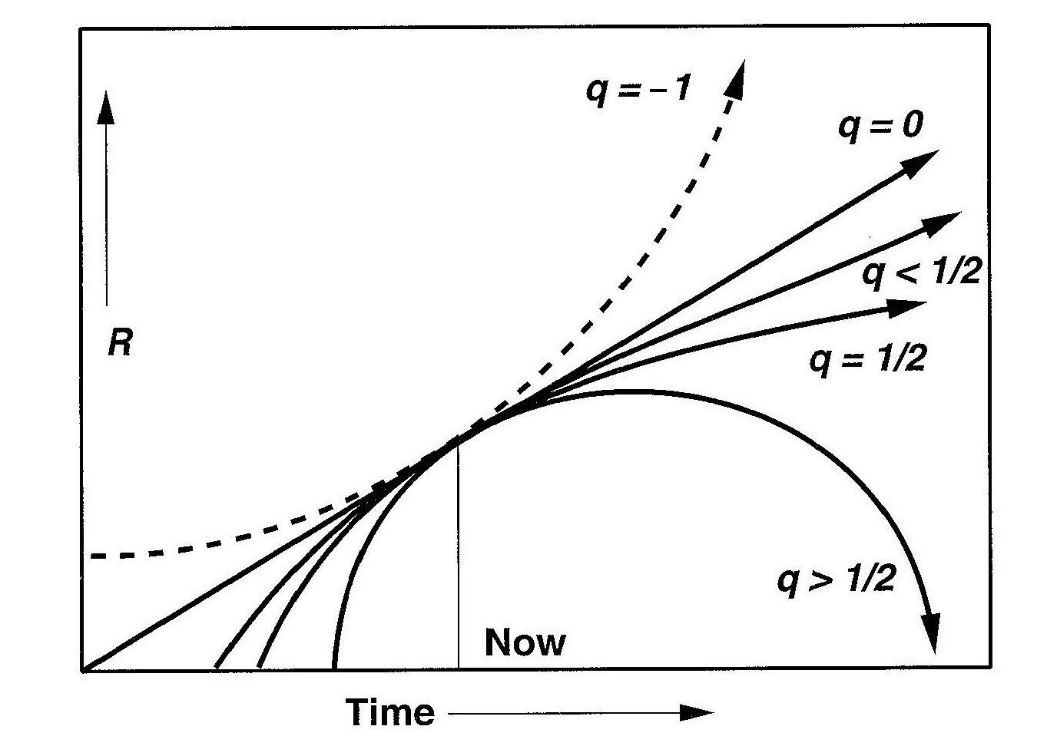
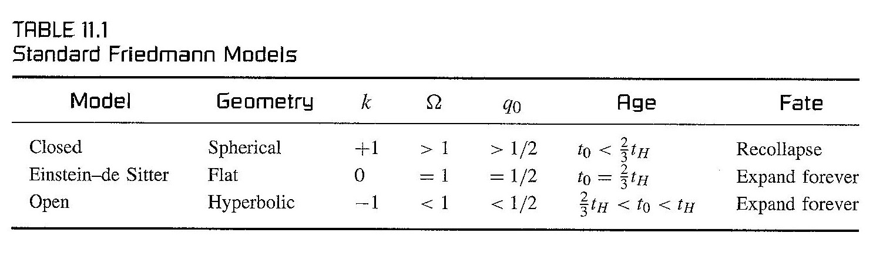
Unfortunately, we do not measure lookback time directly!
We will see later on that if we have “standard candles” to use, we can do the equivalent: redshift versus brightness.
H₀ = slope now
Summary of Standard Models:

Slide 14
Models with Λ
In the “Newtonian” model, we could write the acceleration (or deceleration) as:
If we were to include the effect of a cosmological constant Λ, we get:
If Λ > 0 it acts like a repulsive force to counteract gravity.
If Λ < 0 it supplements gravity.
Regardless of sign, if the universe becomes large enough, ρR (= ρR³/R² = M_{R}/R²), the first term on the right becomes small, and the Λ-term dominates.

Slide 15
R(t) in a Universe with a Cosmological Constant
In the most general case for the total energy E (i.e. the -kc² term) and Λ we get for the expansion rate:
and
and
Einstein Model: H=0 and q=0 so
De Sitter Model: k=0 and ρ=0 and Λ>0, so q = -1 (accelerating universe) and H is a true constant, not a function of time:

Slide 16
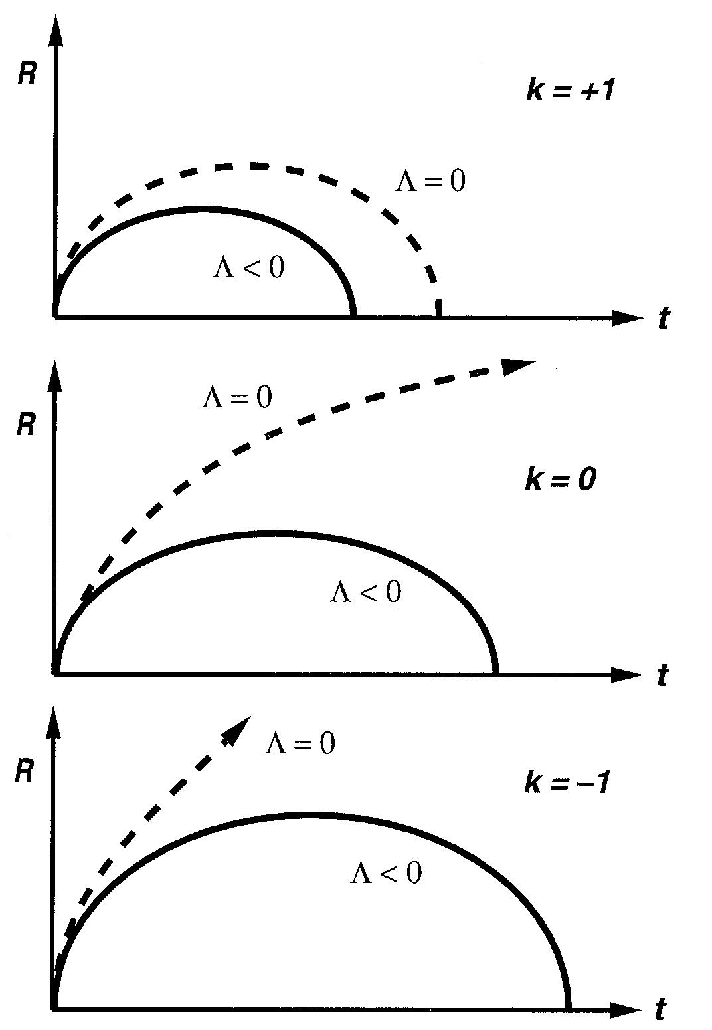
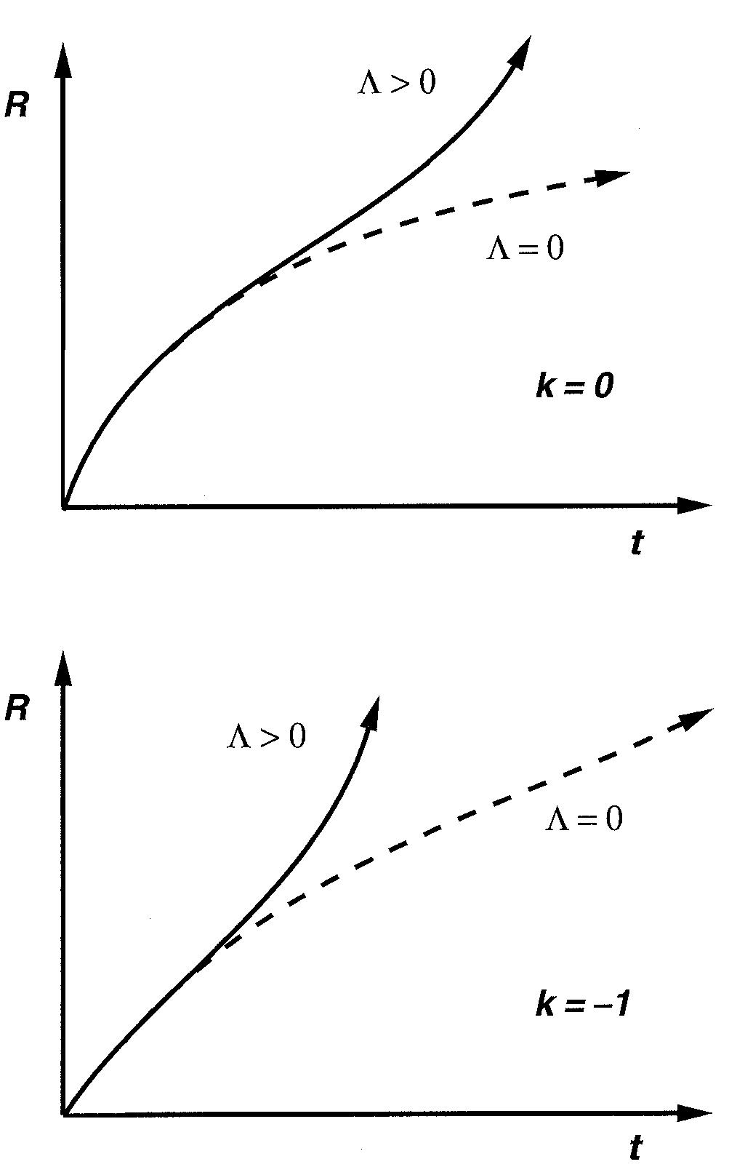
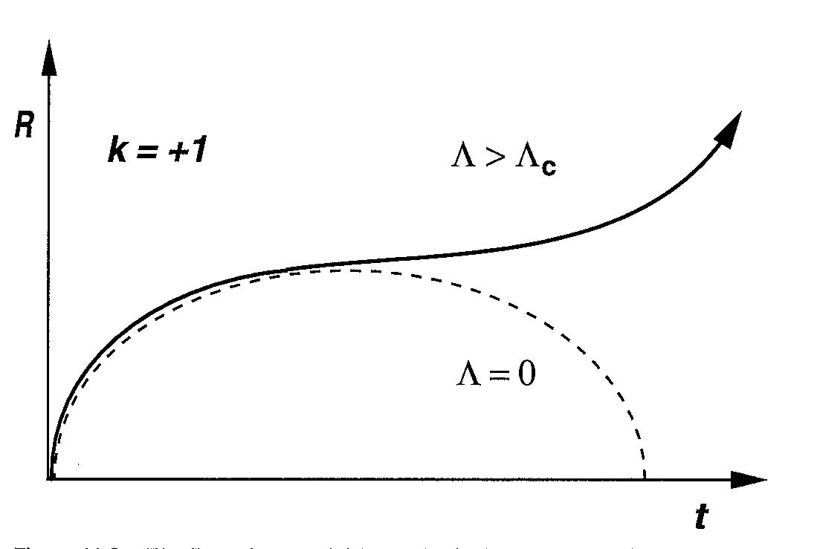
Possible Models with Various k and Λ
Negative Λ Positive Λ
Positive Λ in a positively curved universe will lead to acceleration eventually if Λ> Λ_{c}, but will recollapse if Λ< Λ_{c.} This is the model of Lemaître.
Negative (attractive) Λ always results in re-collapse, regardless of geometry
Positive (repulsive) Λ leads to accelerating universe for open & flat geometries

Slide 17
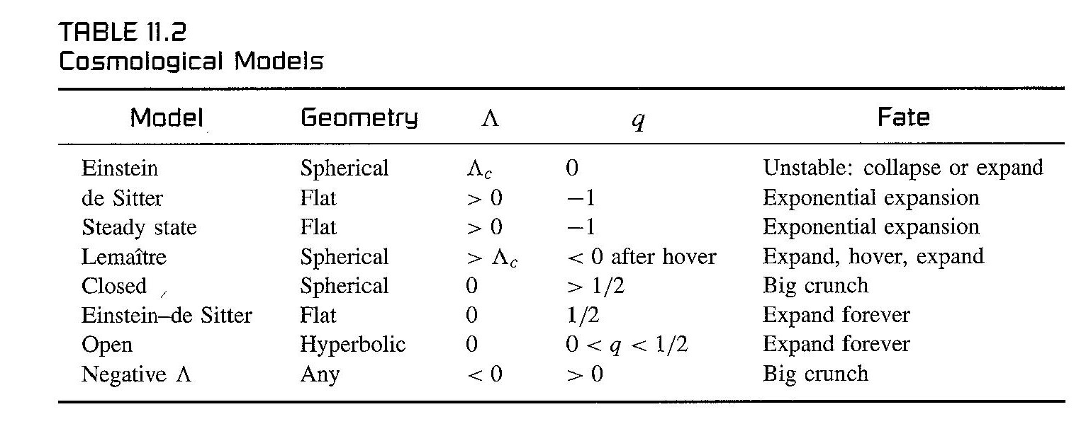
Unlike the “standard” (Λ=0) models, where geometry and fate are the same thing, those with Λ≠0 are more complex.
Which sort of universe do we live in?
Before “answering” that, let’s do one more thing:

Slide 18
From our original equation for the expansion R(t):
Let us divide by R² to get
Define
and let the total density be
Then we find that the curvature constant is

Slide 19
What Kind of Universe do We Live In?

Slide 20
Measuring the Curvature -
Angular Sizes (and number counts) of Galaxies

Slide 21
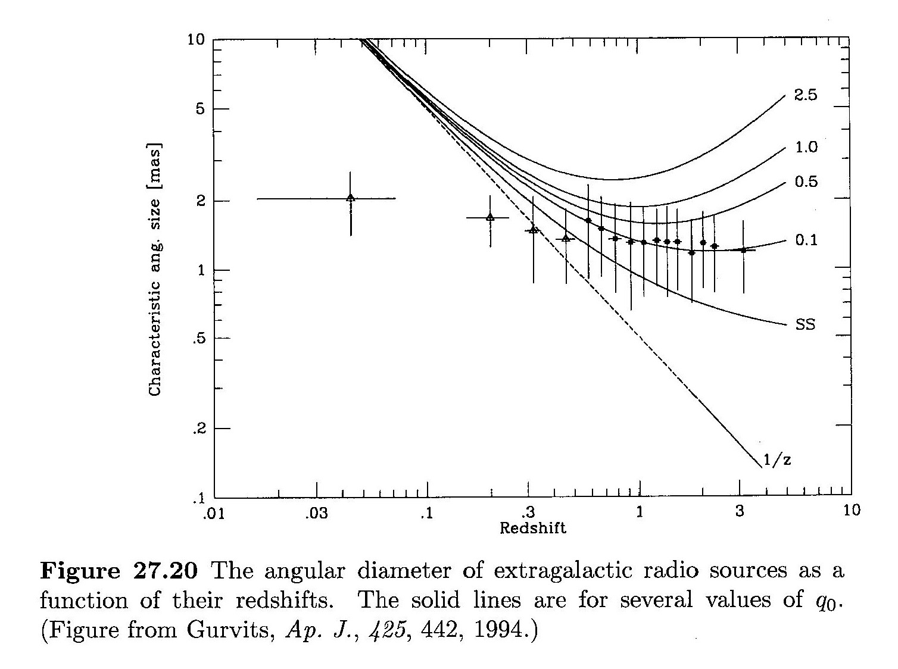

Slide 22
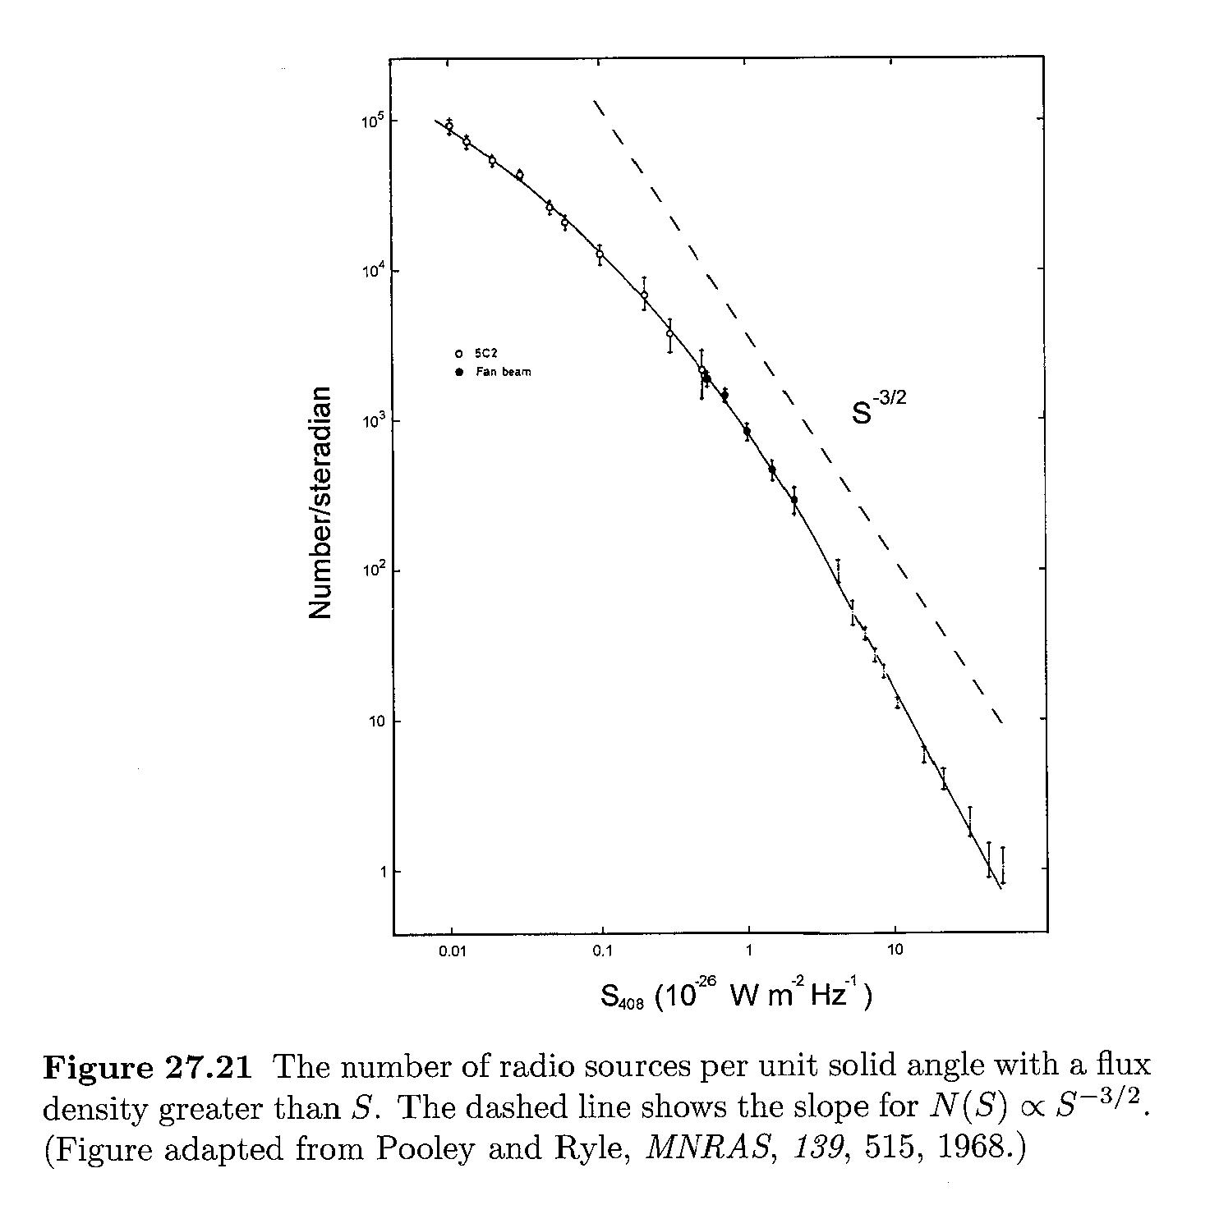

Slide 23
Measuring Density
Measured baryonic density ~ 0.05ρ_{c}.
Measured dark matter density ~ 0.3ρ_{c}
So, ρ_{matter}~ ρ_{c} to within a factor of ~3 today.
However,
So at the time of recombination (z~1000) Ω=1 to within 1 part it 10³, at the time of nucleosynthesis Ω=1 to within 1 part in 10¹², and at the Planck time Ω=1 to within 1 part in 10⁶⁰!
Coincidence?! Maybe Ω=1 precisely??? WHY???????

Slide 24
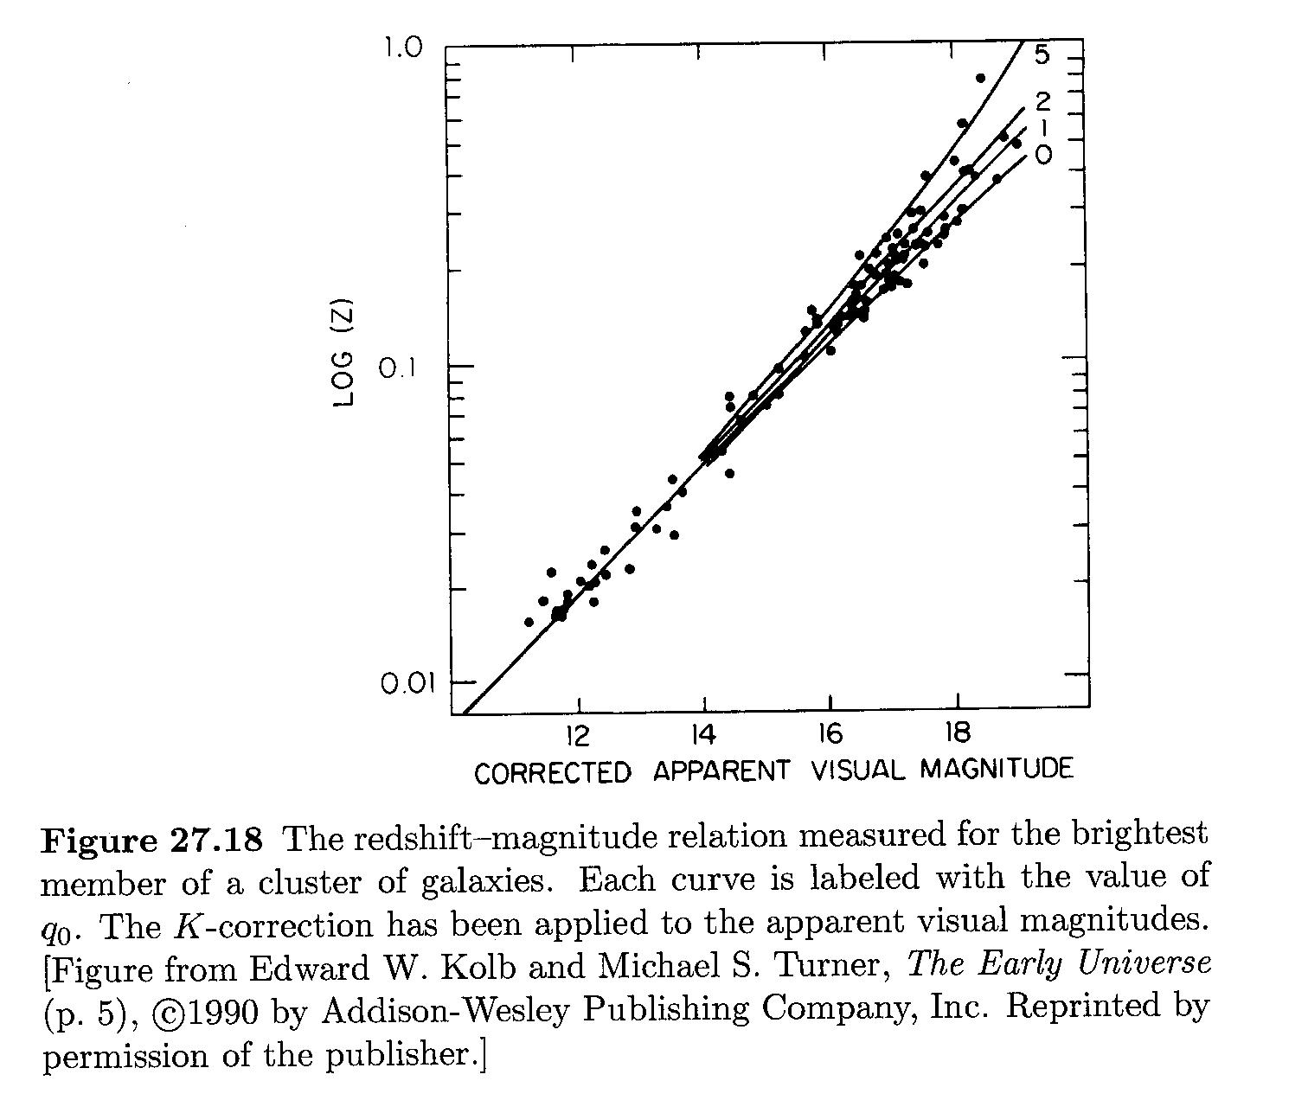
Measuring the Deceleration

Slide 25
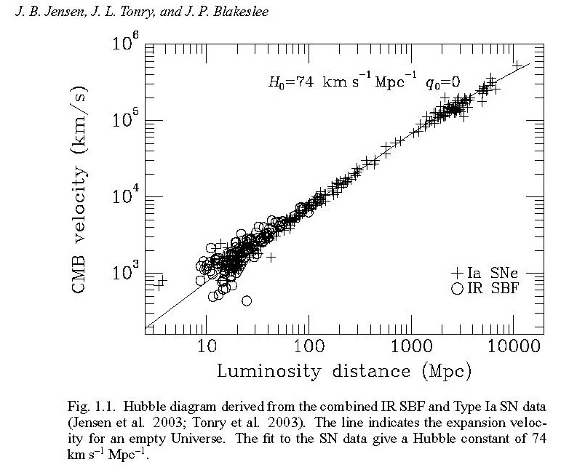

Slide 26
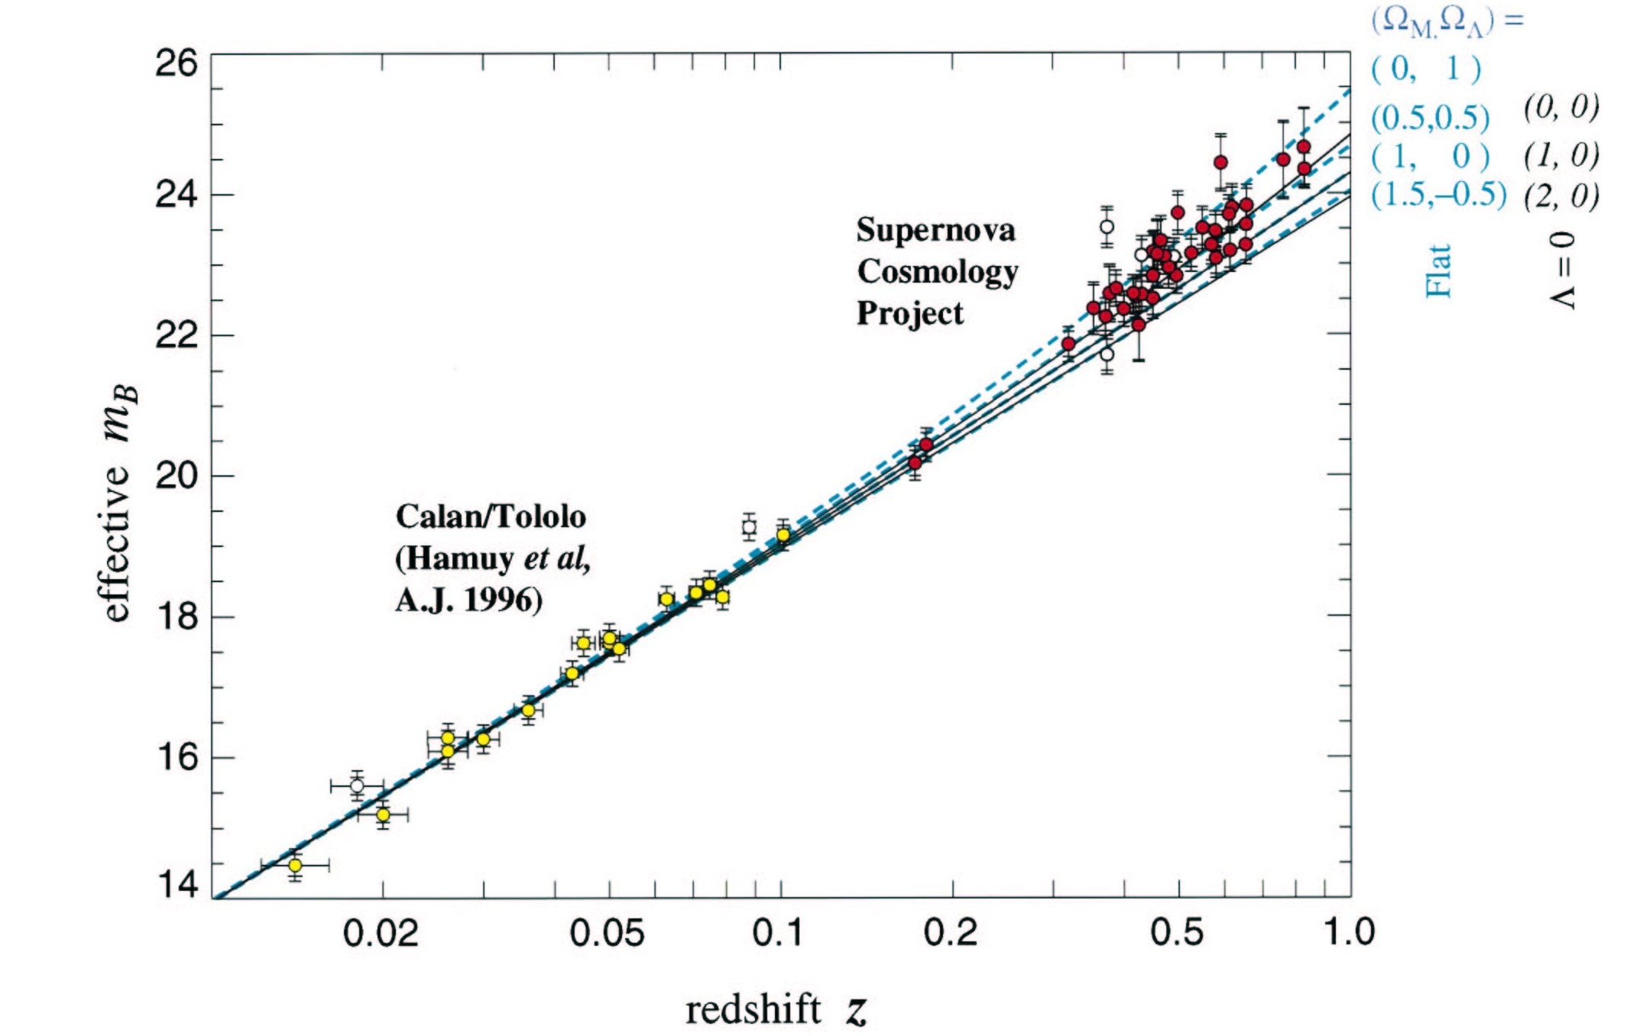
SN Ia Programs:

Slide 27
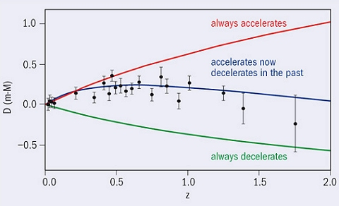

Slide 28
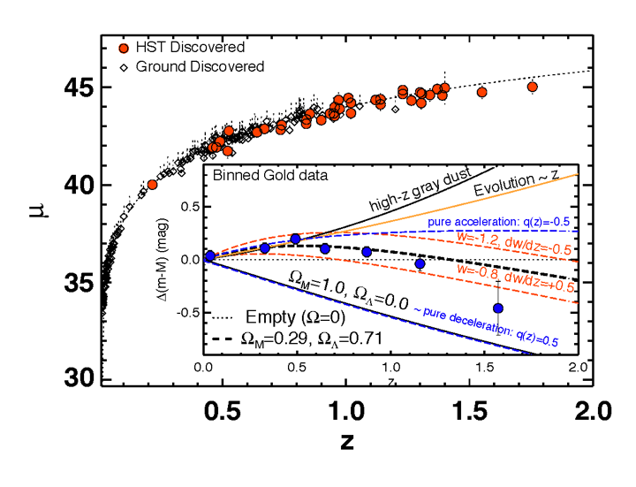
= m-M
28

Slide 29
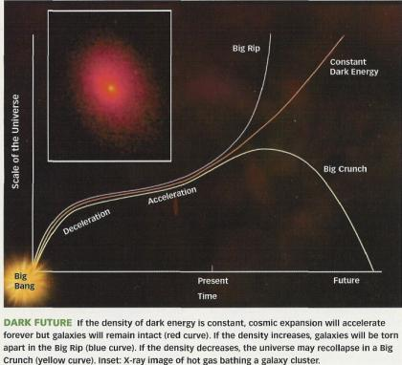

Slide 30
A Look Ahead Using SN Ia’s and Cosmic Microwave Background

Slide 31
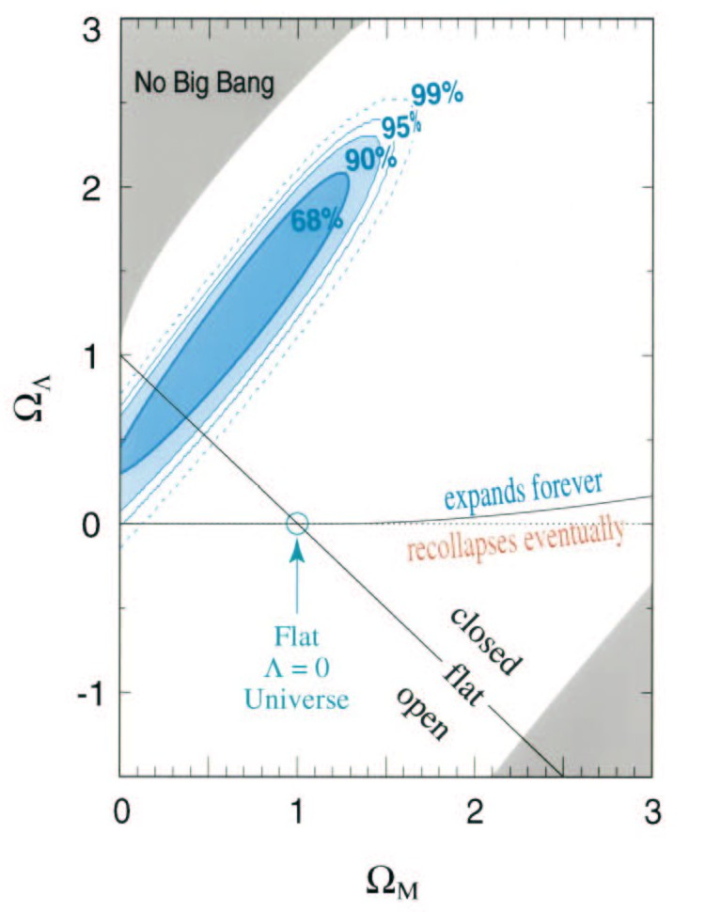
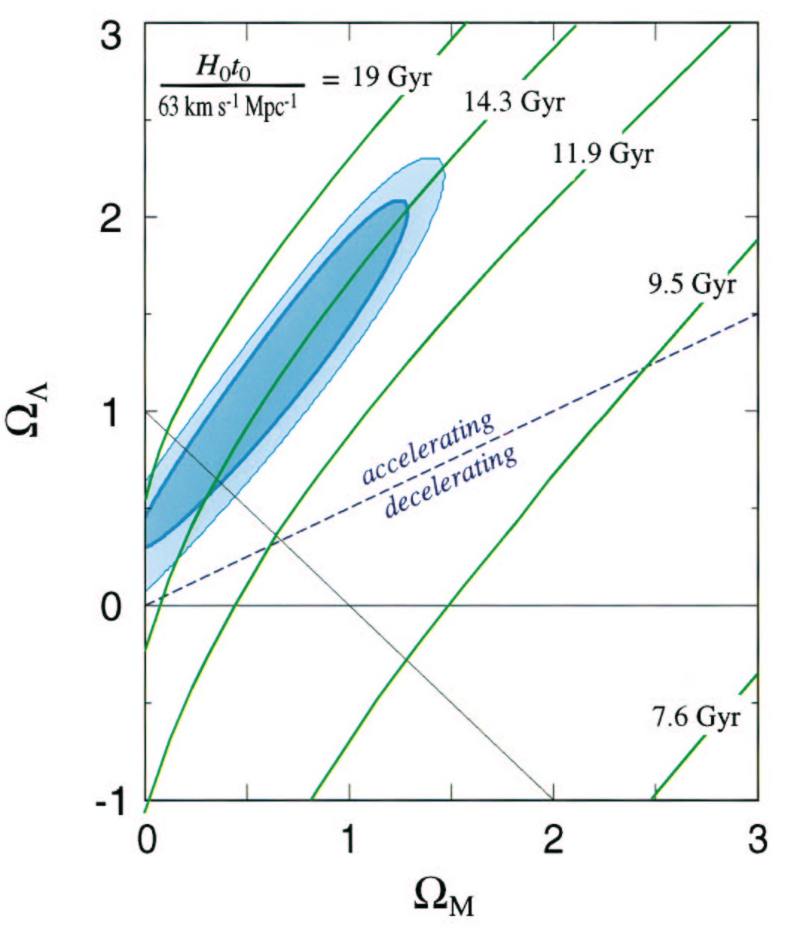
Other SN Ia data ⇒ H₀=74±4 implying t₀=12 Gyr for the best-fit region.

